Slide 1


Basic Lecture II:
Definition of Tally
May 2021 revised
Title
Notes:
PHITS講習会 基礎実習

Slide 2
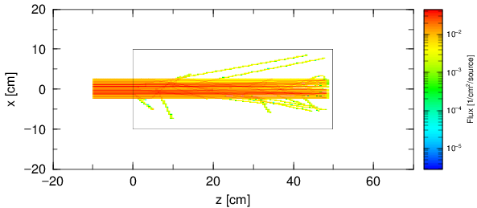
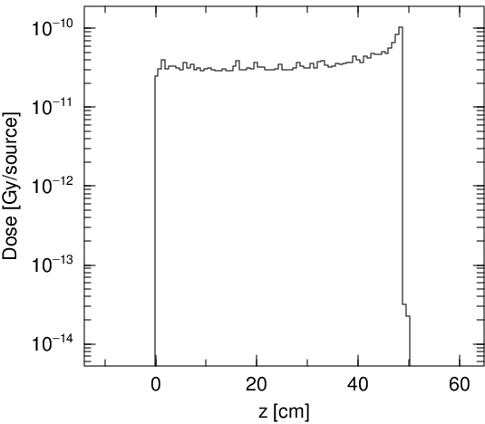
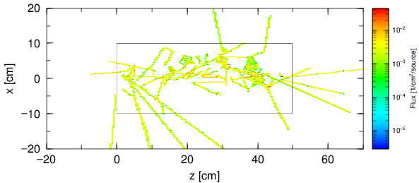
Purpose of This Lecture
Learn how to deduce various physics quantities from PHITS simulations
You can obtain this kind of results at the end of this lecture.
Particle fluence (left) and depth-dose distribution (right) for the simulation condition for homework.
Purpose

Slide 3
Contents of Lecture II
  What is Tally?
Introduction and usage of “Tally”
  How to use Tally for checking geometry
  How to use Tally for calculating physical quantities
Kinds of Tally
Summary
Contents

Slide 4
What is Tally?
Tally: a record of the number or amount of something, especially one that you can keep adding to;
[Oxford Advanced Learner’s Dictionary (7th edition), OXFORD.]
In PHITS, the word of “Tally” used for functions to
Deduce physical quantities such as flux and deposition energy,
or
Depict the 2D or 3D geometry in certain area.
What is tally?

Slide 5
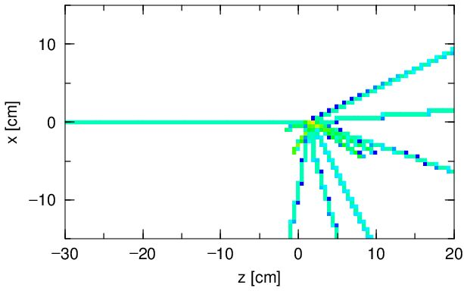
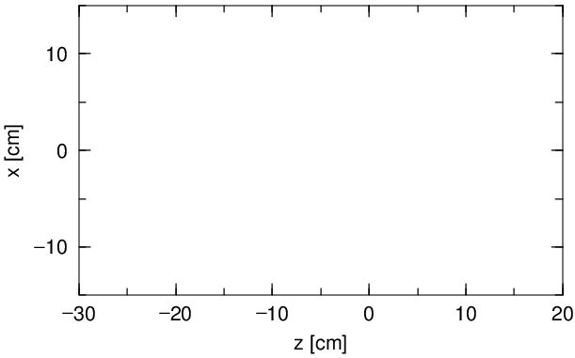

Concept of Tally
PHITS simulates the motion of each particle using the Monte Carlo method. You can estimate their average behavior by calculating various physical quantities, such as flux and deposition energy in a certain region, by using “Tally”.
How many particles were passed through this region?
→ Use “track-length” tally.
Result of [T-Track] (Track-length tally)
What is tally?

Slide 6
Tally Types
Various tally functions are implemented in PHITS.
Many physical quantities can be deduced from the PHITS simulation by selecting an appropriate tally.
For example…
Calculating physical quantity
  Particle fluence → [T-Track], [T-Cross]
  Deposition energy (heat) → [T-Deposit], [T-Deposit2]
  Secondary particles → [T-Yield], [T-Product]
  LET or microdosimetric distribution → [T-LET], [T-SED]
Checking geometry
  2-dimensional visualization → gshow option, [T-Gshow], [T-Rshow]
  3-dimensional visualization → [T-3Dshow]
Kinds of Tally in PHITS

Slide 7
Contents of Lecture II
  What is Tally?
Introduction and usage of “Tally”
  How to use Tally for checking geometry
  How to use Tally for calculating physical quantities
Kinds of Tally
Summary
Contents

Slide 8
Geometry Check
Every time you construct a new geometry, it is better to check the geometry using [T-Track] with the gshow option (2D), [T-3Dshow] (3D) or PHIG-3D (3D).
Otherwise you would obtain wrong results without noticing miss-definition of the geometry, especially when you make an overlapped region!
Tally for checking geometry

Slide 9
Exercise 1
Confirm the geometry of lec02.inp in a 2-dimensional view using gshow option in [T-Track] tally.
Set icntl = 8 in [Parameters] section and execute PHITS.
(You have to set icntl = 8, when you use gshow option in tallies.)
lec02.inp
[ M a t e r i a l ]
mat[1] H 2 O 1
・ ・ ・ ・ ・ ・
[ S u r f a c e ]
10 so 500.
11 cz 10.
12 pz 0.
13 pz 50.
[ C e l l ]
100 -1 10
101 1 -1. -11 12 -13
110 0 -10 #101
A water cylinder with a radius of 10 cm and a height of 50 cm.
10 cm
50 cm
Tally for checking geometry

Slide 10
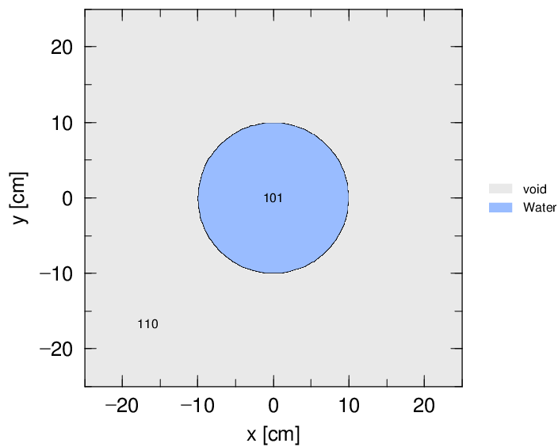
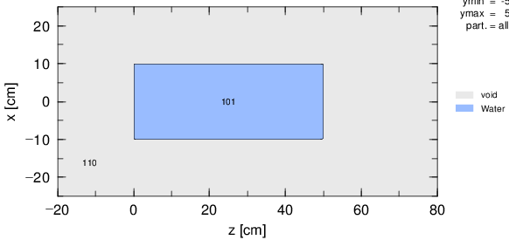
Answer 1
Confirm the geometry of lec02.inp in a 2-dimensional view using gshow option in [T-Track] tally.
lec02.inp
[ P a r a m e t e r s ]
icntl = 8
・ ・ ・ ・ ・ ・
[ T - T r a c k ]
・ ・ ・ ・ ・ ・
axis = xy
file = track_xy.out
part = all
gshow = 3
epsout = 1
[ T - T r a c k ]
・ ・ ・ ・ ・ ・
axis = xz
file = track_xz.out
part = all
gshow = 3
epsout = 1
track_xy.eps
xy-plane
The radius is 10 cm.
track_xz.eps
The height is 50 cm.
xz-plane
Gshow option
Tally for checking geometry

Slide 11
Exercise 2
Confirm the geometry of lec02.inp in a 3-dimensional view using PHIG-3D.
Windows: Right-click “lec02.inp”, and select “Send to” -> “PHIG-3D”.
macOS: Drag and drop “lec02.inp” to the PHIG-3D icon in the Dock.
Linux: move to the “lec02” folder, and type “phits3d.sh lec02.inp”.
track_xy.eps
track_xz.eps
How is this geometry shown in 3 dimensions?
Tally for checking geometry

Slide 12
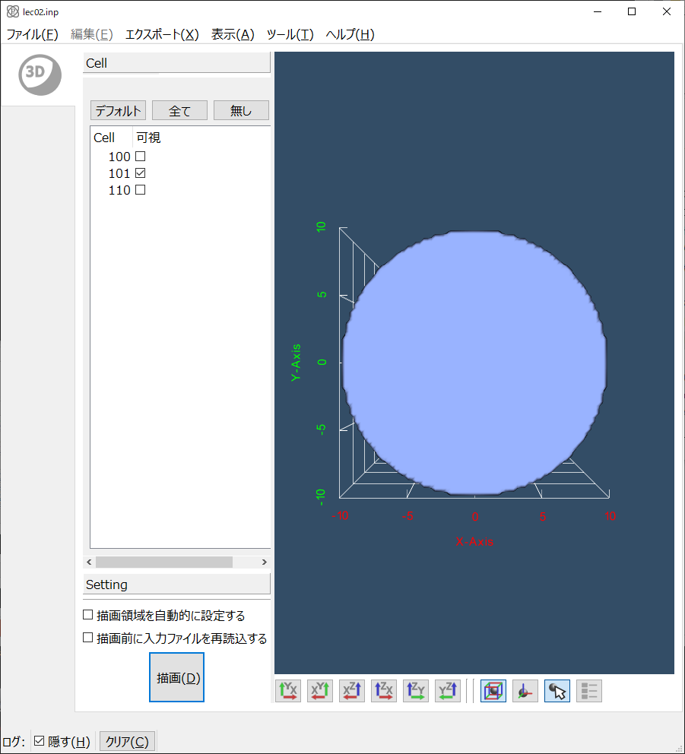
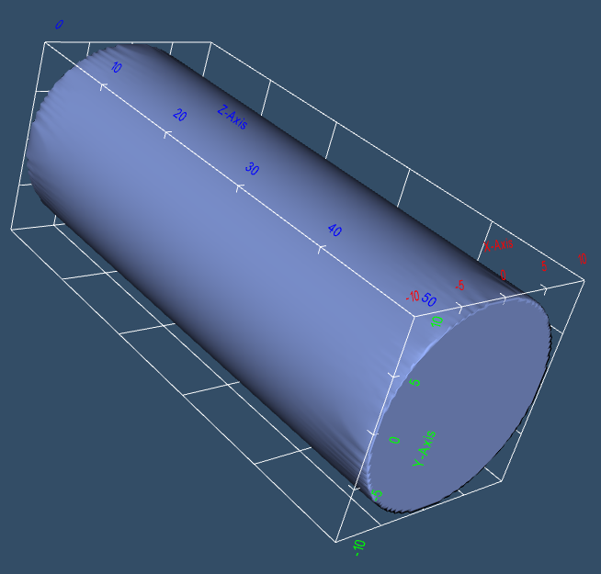
Answer 2
Confirm the geometry of lec02.inp in a 3-dimensional view using PHIG-3D.
Geometry can be rotated by mouse.
Tally for checking geometry

Slide 13
Contents of Lecture II
  What is Tally?
Introduction and usage of “Tally”
  How to use Tally for checking geometry
  How to use Tally for calculating physical quantities
Kinds of Tally
Summary
Contents

Slide 14
How to define Tally
You have to determine …
what physical quantities
Select types of tally: [T-Track], [T-Deposit] etc.
in where
Select geometrical mesh: mesh = reg, xyz, r-z
of what particle
Select particle type: part = neutron, proton etc.
in which unit e.g. (cm/source), (1/cm²/source) etc.
Select unit: unit = 1, 2, 3 …
in what output form
Select output axis: axis = eng, reg, xy, etc.
Tally for calculating physical quantities

Slide 15
Example of [T-Track] tally in lec02.inp
[ T - T r a c k ]
title = Track Detection in xyz mesh
mesh = xyz
x-type = 2
nx = 25
xmin = -25.
xmax = 25.
y-type = 2
ny = 25
ymin = -25.
ymax = 25.
z-type = 1
nz = 1
-5.0 5.0
e-type = 1
ne = 1
0.0 5000.0
unit = 1
axis = xy
file = track_xy.out
part = all
gshow = 3
epsout = 1
[T-Track]: Tally for calculating track-lengths or fluences of particles in certain regions.
Geometrical mesh
[T-Track] can be useful for visualizing particle trajectories by setting a fine mesh in the tally region.
Unit of output
Output form
Particle type
Tally for calculating physical quantities

Slide 16
Visualize Particle Trajectory
z-axis
x-axis
Tally for calculating physical quantities

Slide 17
Visualize Particle Trajectory
z-axis
x-axis
Tally for calculating physical quantities

Slide 18
Visualize Particle Trajectory
z-axis
x-axis
Tally for calculating physical quantities

Slide 19
Visualize Particle Trajectory
z-axis
x-axis
Tally for calculating physical quantities

Slide 20
Visualize Particle Trajectory
z-axis
x-axis
Tally for calculating physical quantities

Slide 21
Exercise 3
Confirm particle fluence by using [T-Track].
Set “icntl = 0” in [Parameters] section and execute PHITS.
lec02.inp
[ P a r a m e t e r s ]
icntl = 8
・ ・ ・ ・ ・ ・
[ S o u r c e ]
s-type = 1
r0 = 2.5
z0 = -10.
z1 = -10.
dir = 1.0
e0 = 250.
proj = 12C
A carbon beam at 250 MeV/u with a radius of 2.5 cm
What is the behavior of the particles?
Open the track-xy.eps and track-xz.eps.
Tally for calculating physical quantities

Slide 22
Answer 3
Confirm particle fluence by using [T-Track].
lec02.inp
[ P a r a m e t e r s ]
icntl = 0
・ ・ ・ ・ ・ ・
[ T - T r a c k ]
・ ・ ・ ・ ・ ・
axis = xy
file = track_xy.out
part = all
gshow = 3
epsout = 1
[ T - T r a c k ]
・ ・ ・ ・ ・ ・
axis = xz
file = track_xz.out
part = all
gshow = 3
epsout = 1
file = :
Define output file name.
epsout = 1:
Generate eps file. The eps file name will be picked up from output file name.
（e.g. track_xz.out → track_xz.eps）
For 2D-plots, error files (***_err.out, ***_err.eps) are automatically generated.
Tally for calculating physical quantities

Slide 23
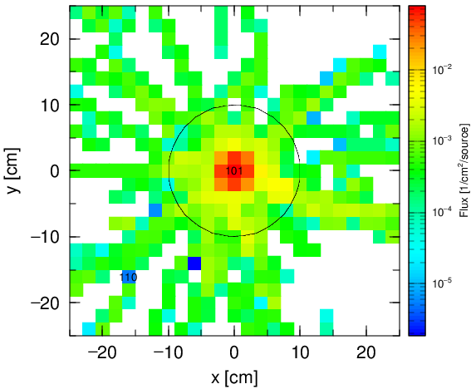
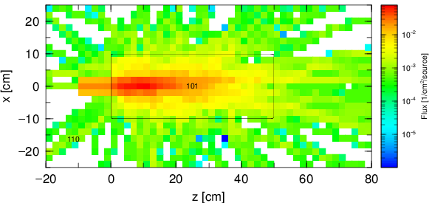
Answer 3
Confirm particle fluence by using [T-Track].
lec02.inp
[ P a r a m e t e r s ]
icntl = 0
・ ・ ・ ・ ・ ・
[ T - T r a c k ]
・ ・ ・ ・ ・ ・
axis = xy
file = track_xy.out
part = all
gshow = 3
epsout = 1
[ T - T r a c k ]
・ ・ ・ ・ ・ ・
axis = xz
file = track_xz.out
part = all
gshow = 3
epsout = 1
track_xy.eps
track_xz.eps
Tally for calculating physical quantities

Slide 24
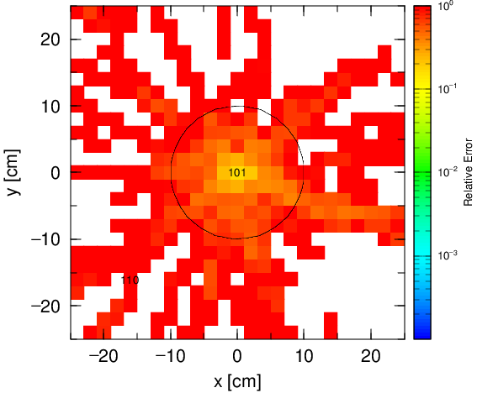
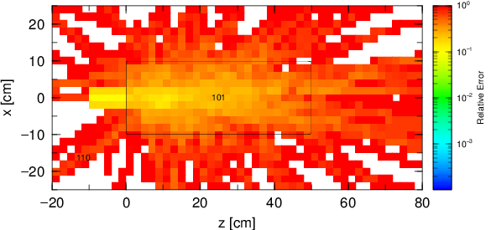
Error file (*_err.eps)
In 2D-plots such as tallies with “axis = xy, xz”, statistical errors are output in another file named ***_err.eps.
Warmer colors indicate larger relative standard errors (closer to 1), while colder colors mean smaller errors.
track_xy_err.eps
track_xz_err.eps
Tally for calculating physical quantities

Slide 25
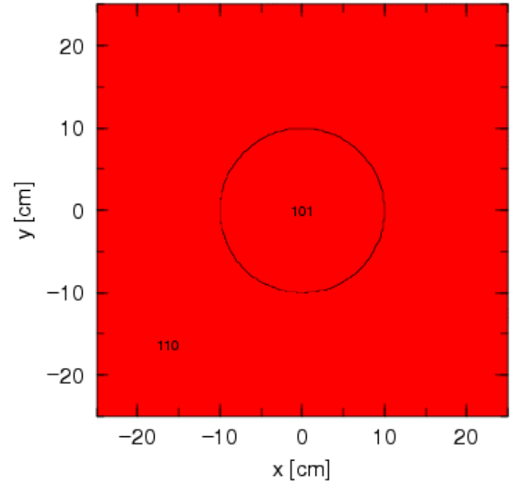
Red Screen
If no particle is scored in a tally, all regions are painted in red
→ usually something is wrong with the input file!!
track_xy.eps for dir = -1.0
Tally for calculating physical quantities

Slide 26
How to define Tally
You have to determine …
what physical quantities
Select types of tally: [T-Track], [T-Deposit] etc.
in where
Select geometrical mesh: mesh = reg, xyz, r-z
of what particle
Select particle type: part = neutron, proton etc.
in which unit e.g. (cm/source), (1/cm²/source) etc.
Select unit: unit = 1, 2, 3 …
in what output form
Select output axis: axis = eng, reg, xy, etc.
Tally for calculating physical quantities

Slide 27
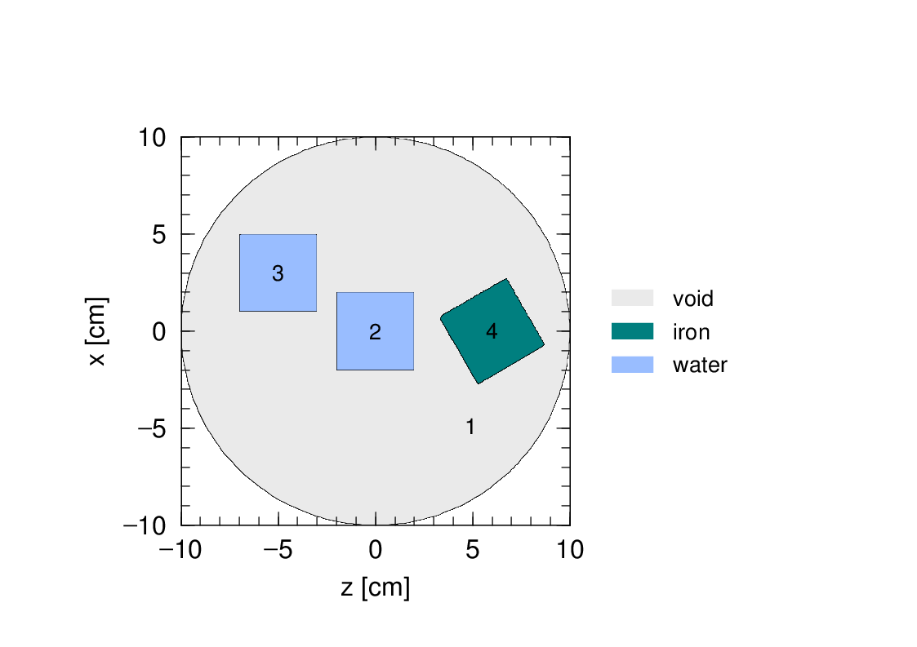
Geometrical Mesh Types
There are 3 types of geometrical mesh in PHITS.
xyz mesh:
Divide the regions in
the XYZ coordinates.
r-z mesh:
Divide the regions in
the Cylindrical coordinates.
reg mesh:
Divide the regions in
cells defined in the
PHITS virtual space.
Z
R
Z
Y
X
Tally for calculating physical quantities

Slide 28
Geometrical Mesh
lec02.inp
[ T - T r a c k ]
・ ・ ・ ・ ・ ・
mesh = xyz
x-type = 2
nx = 25
xmin = -25.
xmax = 25.
y-type = 2
ny = 25
ymin = -25.
ymax = 25.
z-type = 1
nz = 1
-5.0 5.0
e-type = 1
ne = 1
0.0 5000.0
t-type = 1
nt = 1
0.0 1.0e+6
・ ・ ・ ・ ・ ・
mesh = xyz :
Define tally region according to the xyz coordinate system.
⇒ x-type, y-type, z-type subsections
are required to define each mesh.
X-axis (x-type = 2)
xmin : minimum value
xmax : maximum value
nx : number of bins
Z-axis (z-type = 1)
nz : (number of bins)
-5.0 5.0 : (Boundaries of bins）
Tally for calculating physical quantities

Slide 29
How to Define a Mesh
Mesh is a common concept used in many tallies.
x-type, y-type, z-type, r-type, e-type, t-type, a-type etc.
x-axis y-axis z-axis radius energy time angle
There are 5 types to define a mesh as follows. (types 4 & 5 are rarely used)
1: Define # of bins
and their boundaries.
2,3: Define # of bins, and the range (min & max values).
Mesh is divided equally by linear scale (= 2) or log scale (= 3).
x-type = 1
nx = 10
0 1 2 3 5 10
15 20 30 50 100
x-type = 2
nx = 100
xmin = 0
xmax = 1000
x-type = 3
nx = 100
xmin = 0.1
xmax = 5000
4,5: Define the range of the mesh (min & max values) and xdel for the mesh width.
(= 5: xdel is given by log value of mesh interval)
Replace “x” to “y”, “z”, “r”, “e” , “t” , or “a” if you want to define other meshes.
(e.g. y-type, ny, ymin)
Tally for calculating physical quantities

Slide 30
Exercise 4
To see a finer structure in a 2D plot, increase # of bins in the [T-Track].
lec02.inp
[ T - T r a c k ]
・ ・ ・ ・ ・ ・
mesh = xyz
x-type = 2
nx = 25
・ ・ ・ ・ ・ ・
y-type = 2
ny = 25
・ ・ ・ ・ ・ ・
[ T - T r a c k ]
・ ・ ・ ・ ・ ・
mesh = xyz
x-type = 2
nx = 25
・ ・ ・ ・ ・ ・
z-type = 2
nz = 50
・ ・ ・ ・ ・ ・
Multiply nx and ny in the [T-Track] section with “axis = xy” by 4.
Multiply nx and nz in the [T-Track] section with “axis = xz” by 4.
track_xy.eps
track_xz.eps
Tally for calculating physical quantities

Slide 31
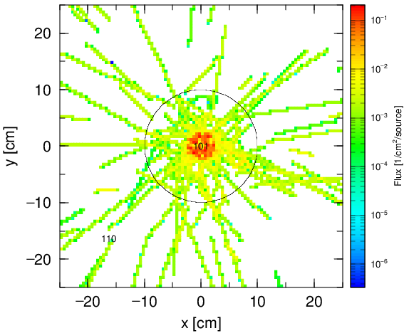
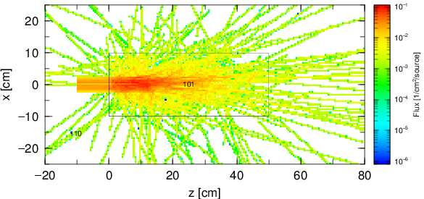
Answer 4
To see a finer structure in a 2D plot, increase # of bins in the [T-Track].
lec02.inp
[ T - T r a c k ]
・ ・ ・ ・ ・ ・
mesh = xyz
x-type = 2
nx = 100
・ ・ ・ ・ ・ ・
y-type = 2
ny = 100
・ ・ ・ ・ ・ ・
[ T - T r a c k ]
・ ・ ・ ・ ・ ・
mesh = xyz
x-type = 2
nx = 100
・ ・ ・ ・ ・ ・
z-type = 2
nz = 200
・ ・ ・ ・ ・ ・
track_xy.eps
track_xz.eps
We can see the tracks with a better resolution by increasing nx and ny.
Tally for calculating physical quantities

Slide 32
Exercise 5
To see a change of fluence with a time, subdivide the time mesh in the [T-Track].
lec02.inp
[ T - T r a c k ]
・ ・ ・ ・ ・ ・
e-type = 1
ne = 1
0.0 5000.0
t-type = 1
nt = 1
0.0 1.0e+9
・ ・ ・ ・ ・ ・
Edit t-type sub-section in the [T-Track] section with “axis=xz”.
Set “t-type = 2” and set nt, tmin, tmax to be 5, 0.0, 5.0, respectively.
(See “How to Define a Mesh” in p. 29.)
Delete or comment out the unnecessary line.
Tally for calculating physical quantities

Slide 33
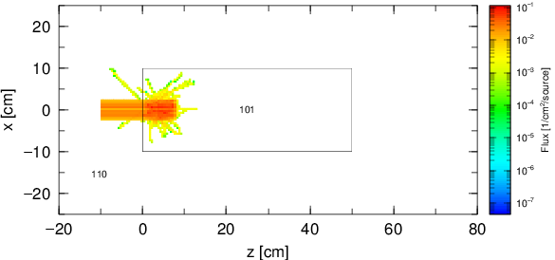
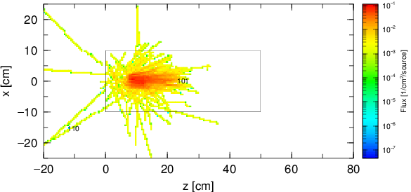
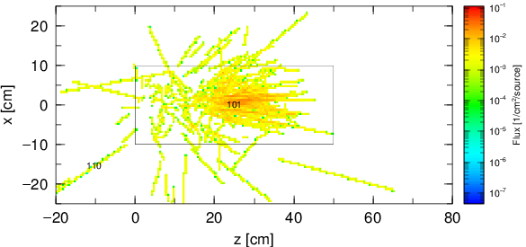
Answer 5
To see a change of fluence with a time, subdivide the time mesh in the [T-Track].
lec02.inp
[ T - T r a c k ]
・ ・ ・ ・ ・ ・
e-type = 1
ne = 1
0.0 5000.0
t-type = 2
nt = 5
$ 0.0 1.0e+9
tmin = 0.0
tmax = 5.0
・ ・ ・ ・ ・ ・
track_xz.eps
1st page
（t = 0 ~ 1 nsec）
2nd page
（t = 1 ~ 2 nsec）
In GSview, the pages of *.eps can be switched by space and backspace keys.
3rd page
（t = 2 ~ 3 nsec）
The GIF animation can be made. (See phits/utility/animation)
Tally for calculating physical quantities

Slide 34
How to define Tally
You have to determine …
what physical quantities
Select types of tally: [T-Track], [T-Deposit] etc.
in where
Select geometrical mesh: mesh = reg, xyz, r-z
of what particle
Select particle type: part = neutron, proton etc.
in which unit e.g. (cm/source), (1/cm²/source) etc.
Select unit: unit = 1, 2, 3 …
in what output form
Select output axis: axis = eng, reg, xy, etc.
Tally for calculating physical quantities

Slide 35
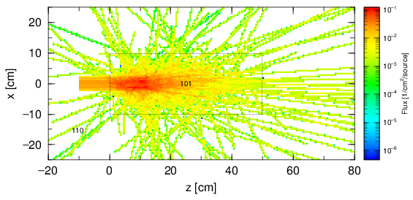
Exercise 6
Show the fluences of individual particle species.
Replace “part = all” in the [T-Track] tally with “axis = xz” by “part = 12C proton neutron”.
Restore t-type subsection to the original settings.
(i.e. “t-type = 1”)
lec02.inp
[ T - T r a c k ]
・ ・ ・ ・ ・ ・
t-type = 2
nt = 5
$ 0.0 1.0e+9
tmin = 0.0
tmax = 5.0
・ ・ ・ ・ ・ ・
axis = xz
file = track_xz.out
part = all
・ ・ ・ ・ ・ ・
track_xz.eps
What are the individual behaviors of ¹²C, protons, and neutrons?
Tally for calculating physical quantities

Slide 36
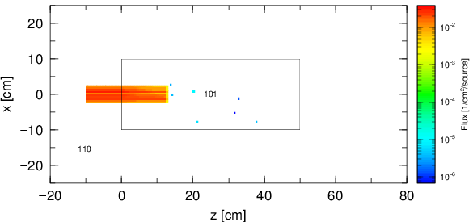
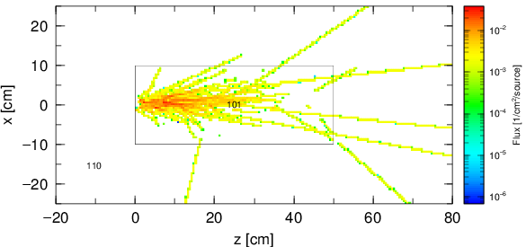
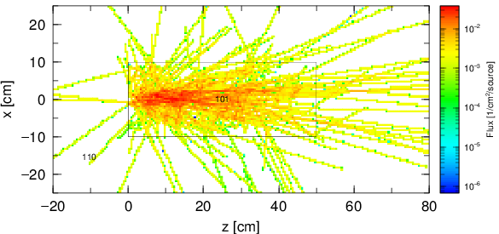
Answer 6
Show the fluences of individual particle species.
lec02.inp
[ T - T r a c k ]
・ ・ ・ ・ ・ ・
t-type = 1
nt = 1
0.0 1.0e+9
$ tmin = 0.0
$ tmax = 5.0
・ ・ ・ ・ ・ ・
axis = xz
file = track_xz.out
part = 12C proton neutron
・ ・ ・ ・ ・ ・
track_xz.eps
1st page
(part = ¹²C)
2nd page
(part = proton)
3rd page
(part = neutron)
Tally for calculating physical quantities

Slide 37
How to define Tally
You have to determine …
what physical quantities
Select types of tally: [T-Track], [T-Deposit] etc.
in where
Select geometrical mesh: mesh = reg, xyz, r-z
of what particle
Select particle type: part = neutron, proton etc.
in which unit e.g. (cm/source), (1/cm²/source) etc.
Select unit: unit = 1, 2, 3 …
in what output form
Select output axis: axis = eng, reg, xy, etc.
Tally for calculating physical quantities

Slide 38
Exercise 7
Show the particle fluence with its energy distribution.
lec02.inp
[ T - T r a c k ]
・ ・ ・ ・ ・ ・
x-type = 2
nx = 100
・ ・ ・ ・ ・ ・
z-type = 2
nz = 200
・ ・ ・ ・ ・ ・
e-type = 1
ne = 1
0.0 5000.0
unit = 1
axis = xz
file = track_xz.out
・ ・ ・ ・ ・ ・
Replace “axis = xz” by “axis = eng”.
Set “e-type = 2” and set ne, emin, and emax to be 100, 0.0, and 5000.0, respectively.
(See “How to Define a Mesh” in p. 29.)
Set “nx = 1” and “nz = 1” to reduce the number of pages in the output.
Change the output file name to “track_eng.out”.
Tally for calculating physical quantities

Slide 39
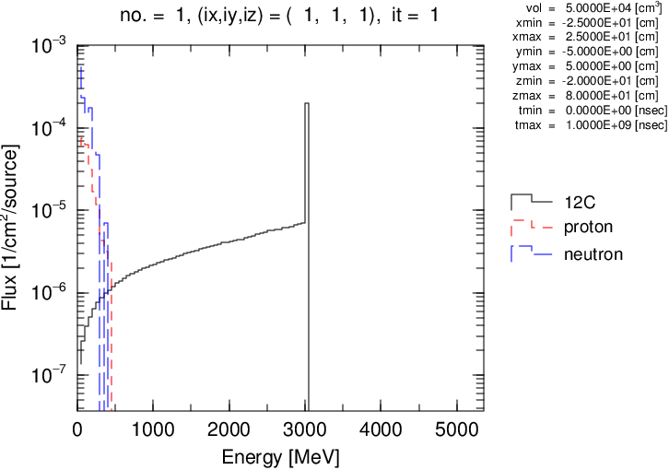
Answer 7
Show the particle fluence with its energy distribution.
lec02.inp
[ T - T r a c k ]
・ ・ ・ ・ ・ ・
x-type = 2
nx = 1
・ ・ ・ ・ ・ ・
z-type = 2
nz = 1
・ ・ ・ ・ ・ ・
e-type = 2
ne = 100
$ 0.0 5000.0
emin = 0.0
emax = 5000.0
unit = 1
axis = eng
file = track_eng.out
・ ・ ・ ・ ・ ・
track_eng.eps
The beam energy is 250×12=3000MeV
In the default setting, emin and emax are defined in the unit of “MeV”. If you want to defined them in the unit of “MeV/u”, specify “iMeVperU = 1” in [Parameter] section.
Tally for calculating physical quantities

Slide 40
Exercise 8
Change the horizontal axis to a logarithmic scale.
lec02.inp
[ T - T r a c k ]
・ ・ ・ ・ ・ ・
x-type = 2
nx = 1
・ ・ ・ ・ ・ ・
z-type = 2
nz = 1
・ ・ ・ ・ ・ ・
e-type = 2
ne = 100
$ 0.0 5000.0
emin = 0.0
emax = 5000.0
unit = 1
axis = eng
file = track_eng.out
・ ・ ・ ・ ・ ・
Set “e-type=3” and “emin=1.0”.
track_eng.eps
This figure is shown in linear scale.
Tally for calculating physical quantities

Slide 41
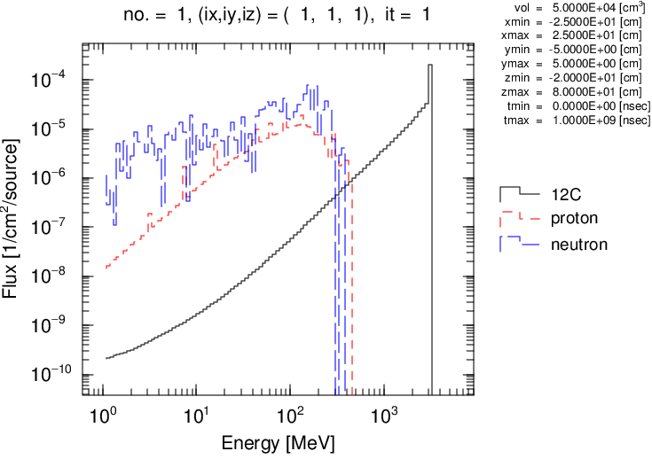
Answer 8
Change the horizontal axis to a logarithmic scale.
lec02.inp
[ T - T r a c k ]
・ ・ ・ ・ ・ ・
x-type = 2
nx = 1
・ ・ ・ ・ ・ ・
z-type = 2
nz = 1
・ ・ ・ ・ ・ ・
e-type = 3
ne = 100
$ 0.0 5000.0
emin = 1.0
emax = 5000.0
unit = 1
axis = eng
file = track_eng.out
・ ・ ・ ・ ・ ・
track_eng.eps
We can check the low energy region in detail.
Tally for calculating physical quantities

Slide 42
Exercise 9
Show the energy distributions inside and outside of the cylinder.
lec02.inp
[ T - T r a c k ]
mesh = xyz
x-type = 2
nx = 1
xmin = -25.
xmax = 25.
y-type = 1
ny = 1
-5.0 5.0
z-type = 2
nz = 1
zmin = -20.
zmax = 80.
・ ・ ・ ・ ・ ・
Change the geometrical mesh from the xyz mesh to the reg mesh.
Add “reg” parameter and define cell numbers of inside and outside of the cylinder.
The cell numbers of inside and outside of the cylinder are 101 and 110, respectively.
Delete or comment out parameters for “mesh = xyz” sub-section.
Add “reg” parameter
Delete
or
Comment out
Tally for calculating physical quantities

Slide 43
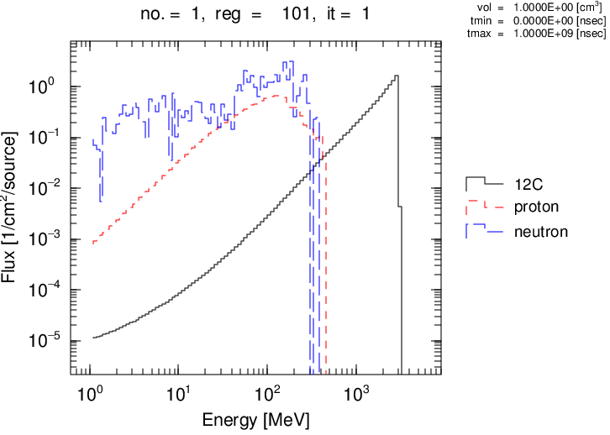
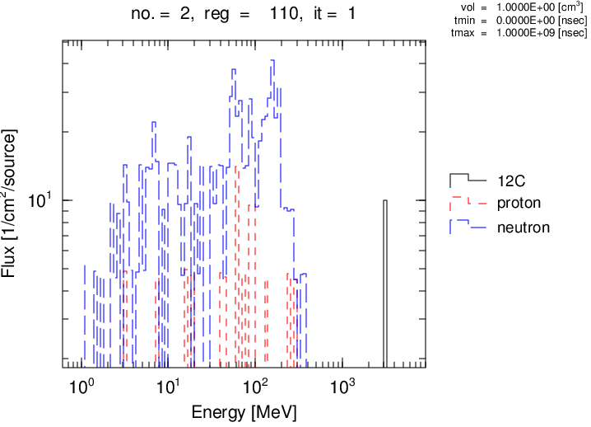
Answer 9
Show the energy distributions inside and outside of the cylinder.
lec02.inp
[ T - T r a c k ]
mesh = reg
reg = 101 110
$ x-type = 2
$ nx = 1
$ xmin = -25.
$ xmax = 25.
$ y-type = 1
$ ny = 1
$ -5.0 5.0
$ z-type = 2
$ nz = 1
$ zmin = -20.
$ zmax = 80.
・ ・ ・ ・ ・ ・
track_eng.eps
1st page
(reg = 101: water)
2nd page
(reg = 110: void)
Tally for calculating physical quantities

Slide 44
Exercise 10
Confirm spatial distribution of deposited energies (i.e. dose) in water cylinder using [T-Deposit].
Copy [T-Deposit] section from t-deposit.inp and paste it in lec02.inp.
Execute PHITS with the input file of lec02.inp.
t-deposit.inp
[ T - D e p o s i t ]
title = Energy deposition in xyz mesh
mesh = xyz
・ ・ ・ ・ ・ ・
unit = 1
material = all
output = dose
axis = xz
file = deposit.out
part = all
gshow = 1
epsout = 1
[T-Deposit]: Tally for calculating deposited energy in materials
Tally for calculating physical quantities

Slide 45
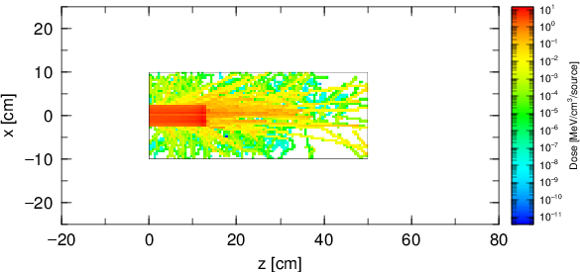
Answer 10
Confirm spatial distribution of deposited energies (i.e. dose) in water cylinder using [T-Deposit].
Energy deposition by the carbon beam.
deposit.eps
Energy deposition by the secondary particles.
Tally for calculating physical quantities

Slide 46
How to define Tally
You have to determine …
what physical quantities
Select types of tally: [T-Track], [T-Deposit] etc.
in where
Select geometrical mesh: mesh = reg, xyz, r-z
of what particle
Select particle type: part = neutron, proton etc.
in which unit e.g. (cm/source), (1/cm²/source) etc.
Select unit: unit = 1, 2, 3 …
in what output form
Select output axis: axis = eng, reg, xy, etc.
Tally for calculating physical quantities

Slide 47
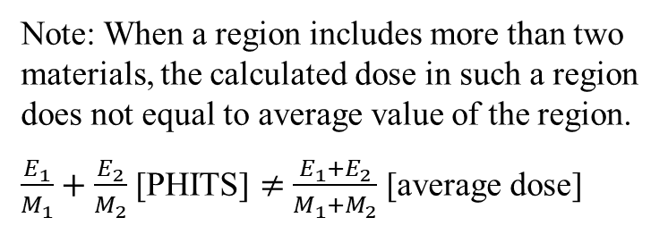
Exercise 11
Change the unit of the output in the [t-deposit] tally from [MeV/cm³/source] to [Gy/source].
The concept of the (/source) will be learned in the basic lecture III.
lec02.inp
[ T - D e p o s i t ]
・ ・ ・ ・ ・ ・
unit = 1
material = all
output = dose
axis = xz
file = deposit.out
part = all
gshow = 1
epsout = 1
Replace “unit = 1” by “unit = 0”.
Calculating the deposit energy in units of Gy = J/kg.
Note: When a region includes more than two materials, the calculated dose in such a region does not equal to average value of the region.
$\frac{E_{1}}{M_{1}}+\frac{E_{2}}{M_{2}}$ [PHITS] $≠$ $\frac{E_{1}+E_{2}}{M_{1}+M_{2}}$ [average dose]
Tally for calculating physical quantities

Slide 48
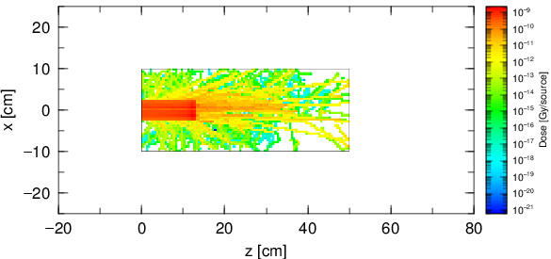
Answer 11
Change the unit of the output in the [t-deposit] tally from [MeV/cm³/source] to [Gy/source].
lec02.inp
[ T - D e p o s i t ]
・ ・ ・ ・ ・ ・
unit = 0
material = all
output = dose
axis = xz
file = deposit.out
part = all
gshow = 1
epsout = 1
deposit.eps
The unit and its scale have changed.
Tally for calculating physical quantities

Slide 49
Exercise 12
Show the energy deposition along the z-axis in the water cylinder by using an r-z mesh.
lec02.inp
[ T - Deposit ]
・ ・ ・ ・ ・ ・
mesh = xyz
x-type = 2
nx = 100
xmin = -25.
xmax = 25.
y-type = 1
ny = 1
-5.0 5.0
z-type = 2
nz = 200
zmin = -20.
zmax = 80.
・ ・ ・ ・ ・ ・
axis = xz
file = deposit.out
・ ・ ・ ・ ・ ・
Change the geometrical mesh from the xyz mesh to the r-z mesh.
Delete of comment out the parameters for x-type sub-section.
Change y-type sub-section to r-type sub-section and set radial range from 0 to 10 cm within 1 bin.
Replace “axis=xz” by “axis=z”.
Delete
or
Comment out
Change to r-type
R
Z
Plot the depth distribution of the energy deposition with an r-z mesh.
Tally for calculating physical quantities

Slide 50
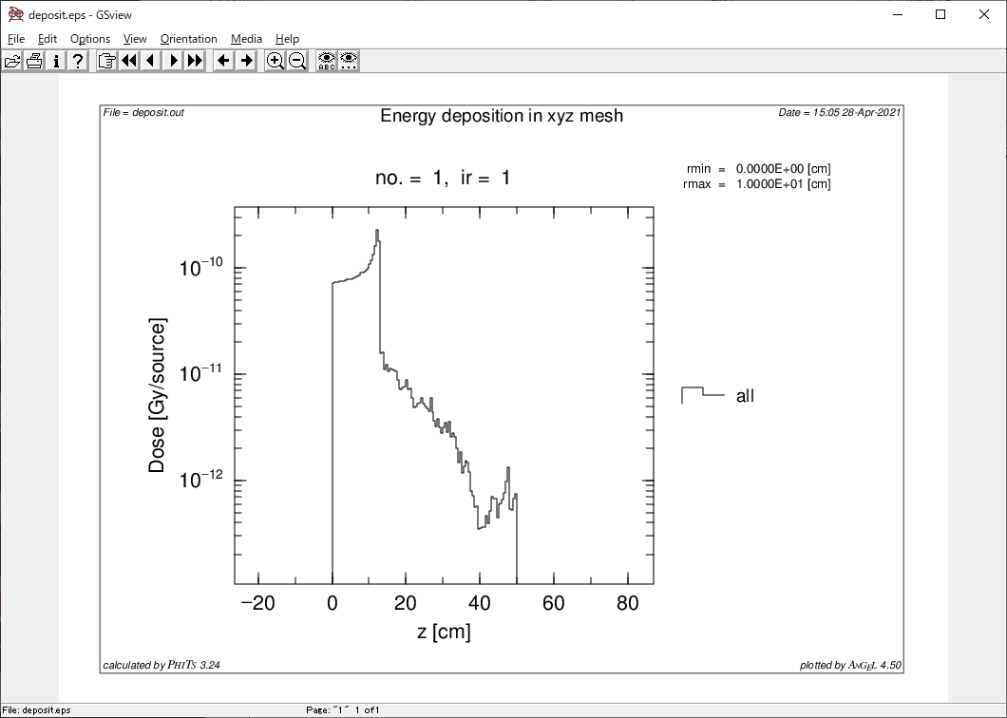
Answer 12
Show the energy deposition along the z-axis in the water cylinder by using an r-z mesh.
lec02.inp
[ T - Deposit ]
・ ・ ・ ・ ・ ・
mesh = r-z
$ x-type = 2
$ nx = 100
$ xmin = -25.
$ xmax = 25.
r-type = 1
nr = 1
0.0 10.0
z-type = 2
nz = 200
zmin = -20.
zmax = 80.
・ ・ ・ ・ ・ ・
axis = z
file = deposit.out
・ ・ ・ ・ ・ ・
deposit.eps
A Bragg peak of the carbon beam is shown at z=12 cm.
Tally for calculating physical quantities

Slide 51
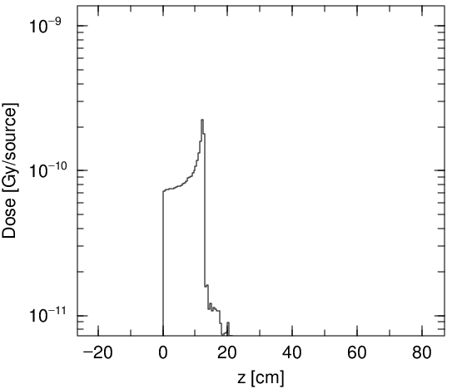
Graphic utility ANGEL
What is ANGEL?
A software to convert text data files (*.out) to image files (*.eps).
You can adjust regions of vertical axes by setting angel parameter in the tally sections. (See the ANGEL manual for details of angel parameters)
You can write angel parameters to the *.out files directly.
You can execute ANGEL only by ”right-click→send to→ANGEL” (Windows) or “drag&drop to the ANGEL ion” (Mac).
(You don’t have to execute PHITS again only to re-draw the image files.)
For example, add
p: ymin(1e-11) ymax(1e-9)
to deposit.out, and then execute ANGEL.
The range of the vertical axis changes.
Tally for calculating physical quantities

Slide 52
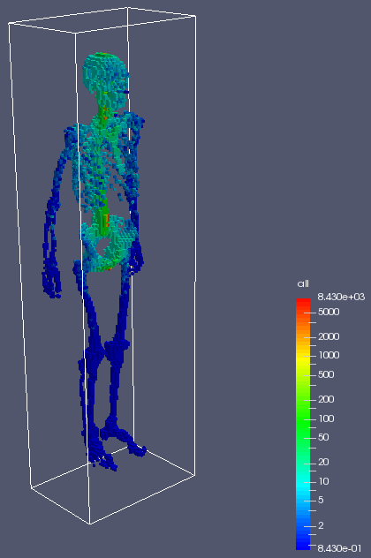
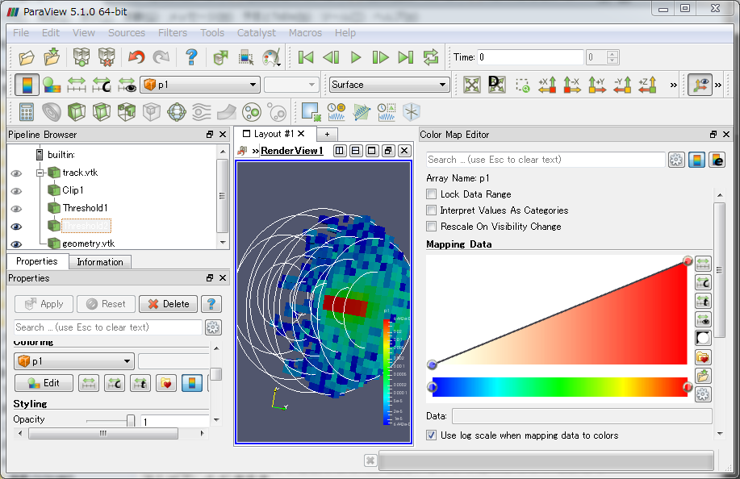
3D visualization software ParaView
A free software for 3D visualization.
Draw 3D view of tally results for mesh = xyz.
You can output tally results in ParaView format (*.vtk) by specifying “vtkout = 1” in each tally section.
ParaView + PHITS sample (lecture\advanced\ParaView)
http://www.paraview.org
Purpose
Notes:
「実習」 前の基本的な話から

Slide 53
Contents of Lecture II
  What is Tally?
Introduction and usage of “Tally”
  How to use Tally for checking geometry
  How to use Tally for calculating physical quantities
Kinds of Tally
Summary
Contents

Slide 54
List of Tallies (Visualize geometry)
[T-Gshow] | 2D geometry visualization
[T-Rshow] | 2D geometry visualization with physical quantities
[T-3Dshow] | 3D geometry visualization

Slide 55
[T-Gshow]
Tally for visualizing the geometry in 2 dimensions cut by certain slices.
Show region boundary, cell number, material ID etc.
Other tallies can be used for this purpose by setting icntl=8 in the [Parameters] section (see Lecture I).
Kinds of tally in PHITS

Slide 56
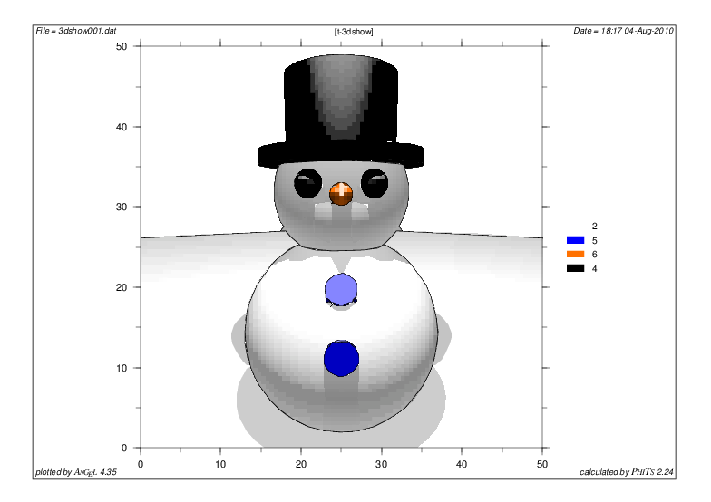
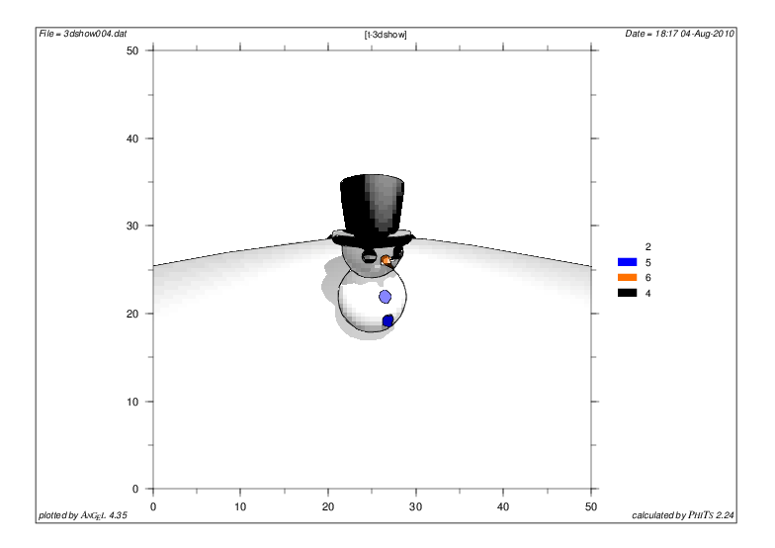
[T-3Dshow]
Tally for visualizing the geometry in 3 dimensions from a viewpoint of a certain location in PHITS virtual space.
Activated only when icntl = 11 in the [Parameters] section.
Kinds of tally in PHITS

Slide 57
Parameters used in [T-3Dshow]
Spherical coordinates
Eye Point
Picture Flame
(e-the,e-phi,e-dst)
Spherical Coordinates
Light source
(l-the,l-phi,l-dst)
e-dst
w-dst
w-hgt
(w-mnh)
w-wdt
(w-mnw)
w-mnw × w-mnh ＝ #Pixel
100 × 100 (default)
Origin (x0,y0,z0)
XYZ-coordinates
Tally for checking geometry

Slide 58
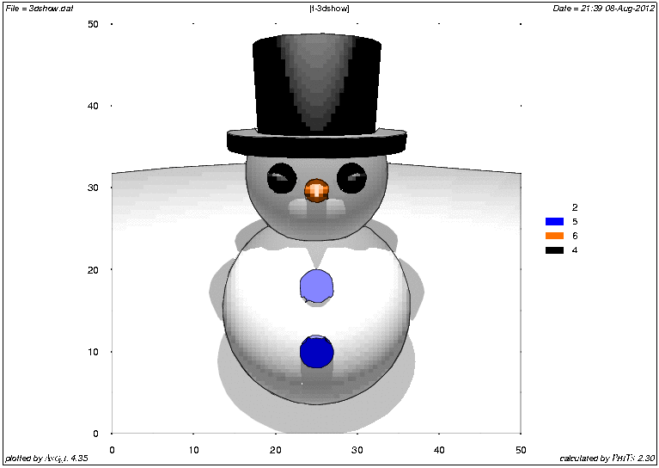
[T-3Dshow] (for your FUN!)
You can rotate [T-3Dshow] picture using Python software.
See “/phits/utility/animation/rotate3dshow” in more detail.
Tally for checking geometry

Slide 59
List of Tallies (Deduce physical quantity)
[T-Track] | Particle fluence in a certain region
[T-Cross] | Particle fluence/current across a certain surface
[T-Point] | Particle fluence at a certain point
[T-Deposit] | Deposit energy in a certain region
[T-Deposit2] | Deposit energies in two certain regions
[T-Yield] | Residual nuclei yield in a certain region
[T-Product] | Produced particle in a certain region
[T-DPA] | Displacement Per Atom (DPA) in a certain region
[T-LET] | LET distribution in a certain region
[T-SED] | Microdosimetric quantity distribution in a certain region
[T-Interact] | Number of interactions in a certain region
[T-DCHAIN] | Residual nuclide yields (in combination with DCHAIN)
[T-Time] | Time information of particle in a certain region
[T-Adjoint] | Particle fluence in a certain region with adjoint mode calculation
[T-Volume] | Volumes of a certain cell
[T-WWG] | Parameters used for the [Weight Window] section
[T-WWBG] | Parameters used for the [WW Bias] section
[T-Userdefined] | Any user-defined quantities
Described in the following pages.
Kinds of tally in PHITS

Slide 60
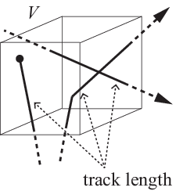
[T-Track]
Tally for calculating track-length (cm) of particles in certain regions.
Average fluence (/cm²) in the region can be also deduced from this tally, dividing the track length (cm) by the volume of the region (cm³).
You can visualize the trajectory of particle using [T-Track] by setting small mesh for tallying regions.
Kinds of tally in PHITS

Slide 61
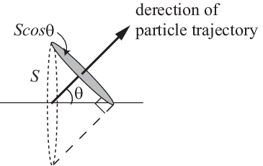
[T-Cross]
Tally for calculating fluence or current (/cm²) of particles across certain surfaces.
Current is simply added by 1 when a particle cross the surface, while flux is added by 1/cos(θ).
direction of particle trajectory
Kinds of tally in PHITS

Slide 62
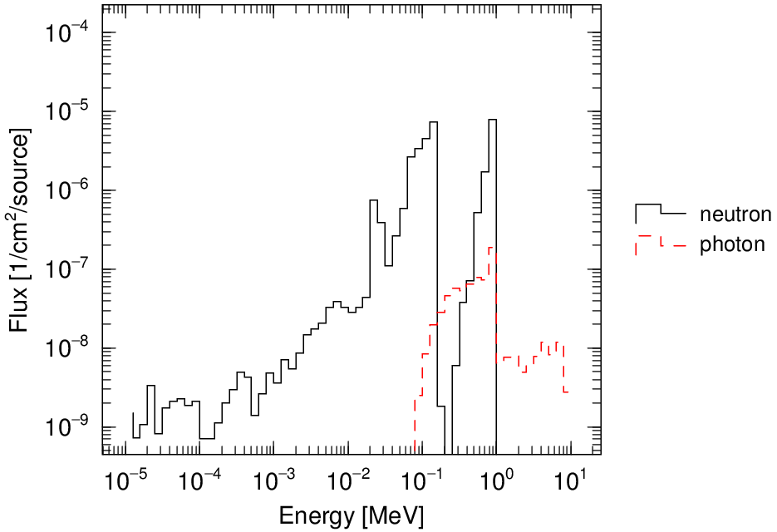
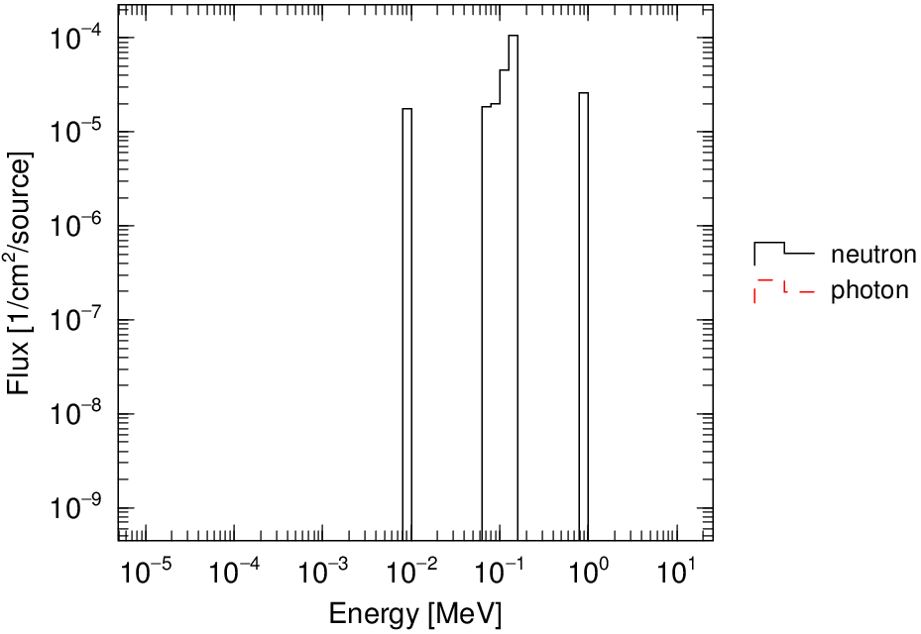
[T-Point]
Tally for calculating fluence (/cm²) of neutron and/or photon at a certain point or ring.
There are some using limitations. (See phits/utility/tpoint)
[T-Point]
[T-Track]
Neutron and photon fluences calculated by [T-Point] and [T-Track] for similar conditions.
Kinds of tally in PHITS

Slide 63
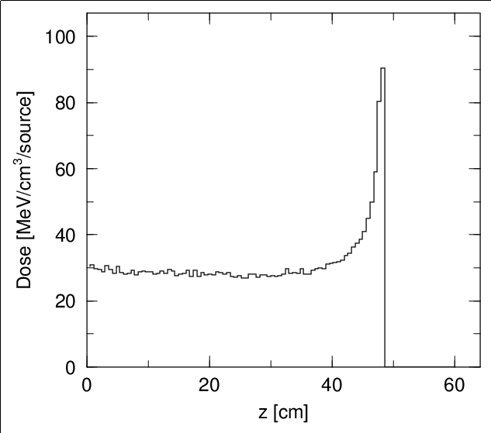
[T-Deposit]
Tally for calculating deposition energy (MeV) in certain regions.
Ionization energy losses by charged particles are scored. → Event-by-event data can be also deduced!
Neutron and photon doses can be also calculated by the kerma approximation.
Bragg peak calculated by [T-Deposit] tally
Kinds of tally in PHITS

Slide 64
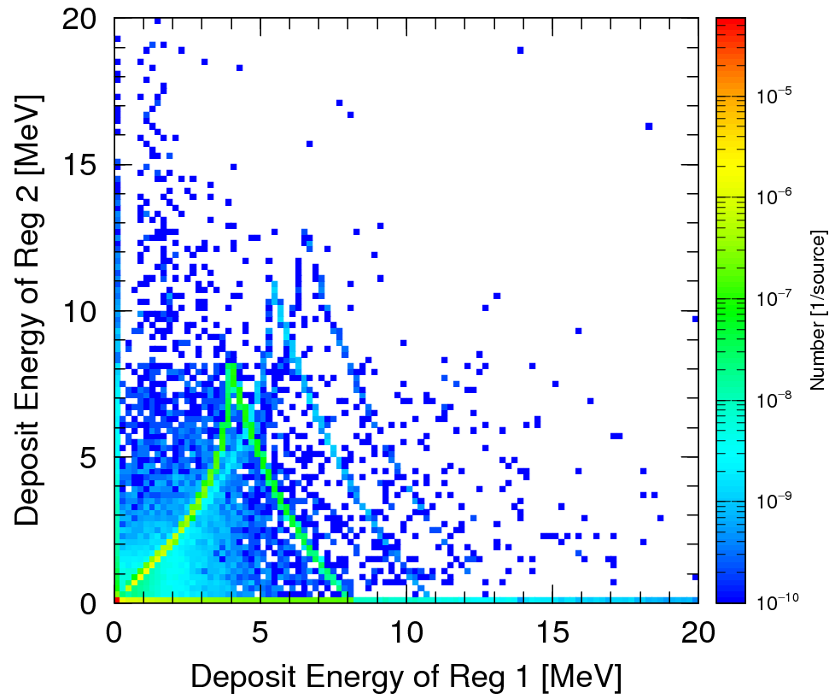
[T-Deposit2]
Tally for calculating event-by-event deposition energies in two regions.
Output a 2D plot to show their correlation.
Useful for simulating experimental data obtained by using two detectors.
Example of [T-Deposit2] tally
Kinds of tally in PHITS

Slide 65
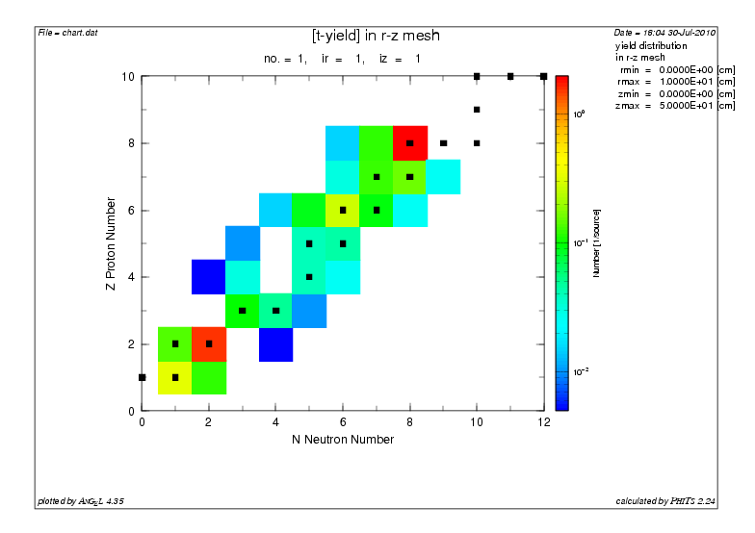
[T-Yield], [T-Product]
Tally for calculating the number of secondary particles generated by nuclear reactions in certain regions.
Energy or time distribution of secondary particles can be obtained from [T-Product].
Yields of each nuclide can be depicted on nuclear chart with [T-Yield].
Example of [T-Yield]
Kinds of tally in PHITS

Slide 66
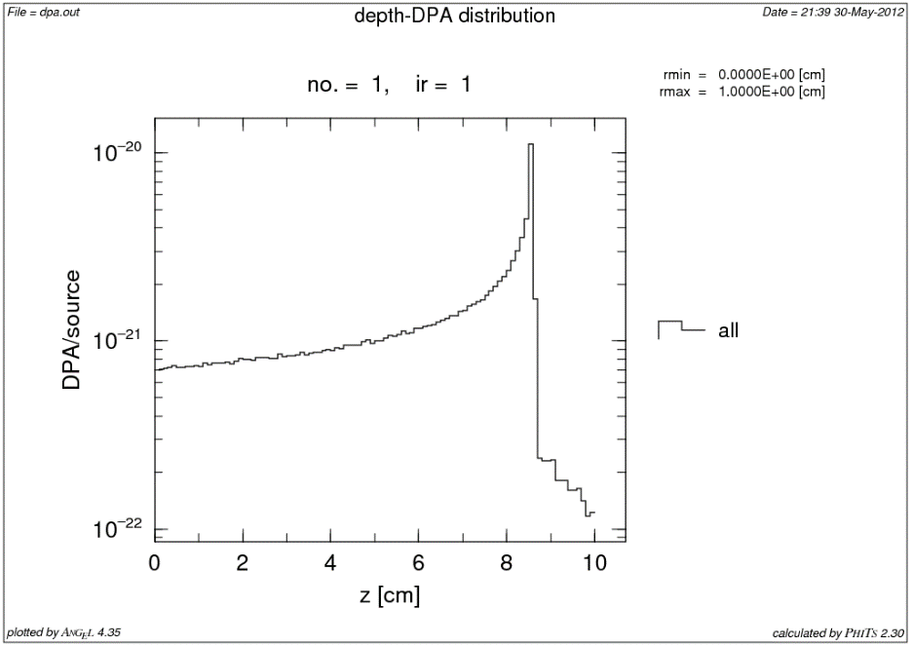
[T-DPA]
Tally for calculating the radiation damage index DPA in certain regions.
DPA is the average number of displaced atoms per atom of a material, and is calculated by multiplying the fluence with the damage cross section.
Depth-DPA distribution calculated using [T-DPA]
Kinds of tally in PHITS

Slide 67
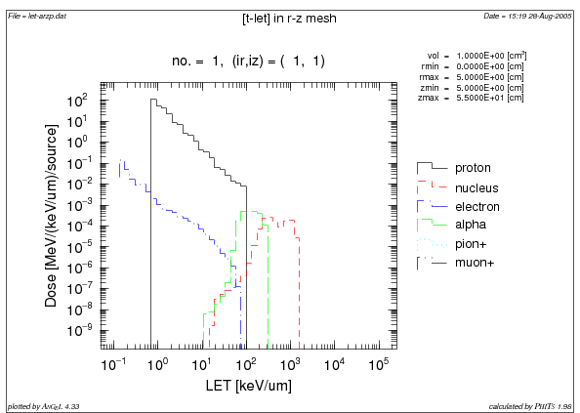
[T-LET], [T-SED]
Tally for calculating the probability densities of deposition energy or fluence in terms of LET, lineal energy (y), or specific energy (z) in microscopic sites distributed in certain regions.
Useful for radiobiological calculations.
*SED represents
Specific Energy Distribution
Example of [T-LET] tally
Kinds of tally in PHITS

Slide 68
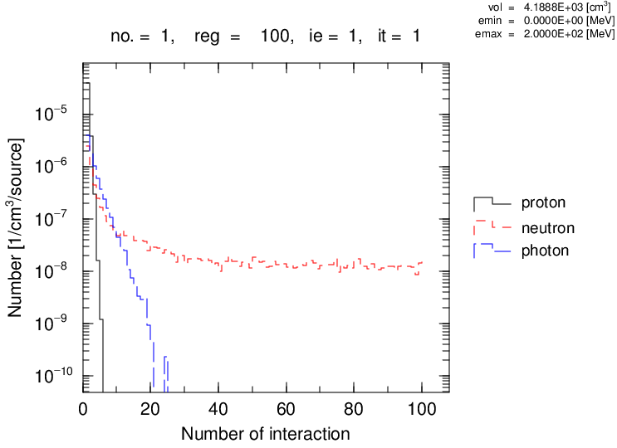
[T-Interact]
Tally for calculating the number of interactions occurred in certain regions.
The mean number or probability density of interactions can be obtained.
Example of [T-Interact] tally
Kinds of tally in PHITS

Slide 69
[T-DCHAIN]
Tally for generating input files for DCHAIN, which can calculate the time evolution of the radioactive nuclides during and after irradiation.
DCHAIN is also included in the PHITS package.
Time-dependent radioactivities of a water phantom irradiated by 150-MeV protons for 6 min.
Please see recommendation/dchain in detail

Slide 70
Contents of Lecture II
  What is Tally?
Introduction and usage of “Tally”
  How to use Tally for checking geometry
  How to use Tally for calculating physical quantities
Kinds of Tally
Summary
Contents

Slide 71
Summary
A variety of information can be deduced from the PHITS simulation using functions called “Tally”.
2 types of tallies are implemented in PHITS, one is for visualizing PHITS geometry, and the other is for calculating physical quantities.
For defining tally, you have to determine …
You can find examples of each tally in the “phits/sample/tally” folder.
what physical quantities
in where
of what particle
in which unit
in what output form
Summary

Slide 72
Homework #2
Depict the neutron and proton fluences, respectively, in your homework.
Adjust [t-deposit] to see the Bragg peak of proton.
Investigate the difference of the depth-dose distributions between the inside and outside of the beam center (within the radius of 2.5 cm or not) by setting an r-z mesh.
Change the minimum & maximum values of y axis in the graph for the depth-dose distribution. (set “angel = ymin(XXX) ymax(YYY)” in [t-deposit] tally) (XXX & YYY are the min & max values of the Y axis)
Homework

Slide 73
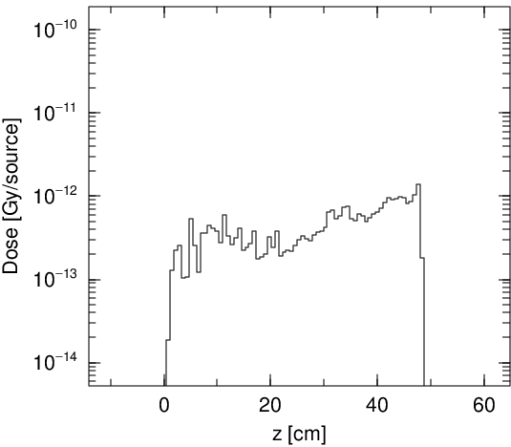
Example Answer
Proton (up) and neutron (down) fluences.
Depth-dose distribution inside (up)
and outside (down) the beam radius.
Homework

