Slide 1
PHITS
Multi-Purpose Particle and Heavy Ion Transport code System
Useful Functions
Feb. 2019 revised
Title
1
Notes:
PHITS講習会 入門実習

Slide 2
Table of Contents
[transform]
[magnetic field]
[multiplier]
[counter]
Table of Contents
2
Notes:
PHITS講習会 入門実習

Slide 3
[transform] section
You can translate and/or rotate the spatial coordinates of [source], [surface], [cell], [magnetic field] as well as r-z and xyz meshes defined in any tallies.
Z
Y
Rotation
X
XYZ coordinate system
Translation
[transform]
3

Slide 4
How to use
1, Define [transform] section
2, Use this [transform] by setting trcl=n in [cell], [source], etc.
To define a transformation, ID and 13 parameters should be specified.
six numbers should be set
[ Transform ]
*Trn $X_{0} { Y}_{0}$ $Z_{0} { θ}_{z}$ $θ_{y}$ $θ_{x}$ 0 0 0 0 0 0 M
Angle unit option
*: degree
non: radian
X-, Y-, and Z-components for translation
Rotation angles around Z-,Y-,X-axes
Parameter of transformation equation
M=2：translation after rotation
M=-2：rotation after translation
Transformation ID
Example 1: *tr1 0 0 10 0 45 0 0 0 0 0 0 0 2
Rotating around Y-axis by 30 degrees, and then translating along +Z-axis by 10cm.
Example 2： tr1 0 0 -10 0 pi/4 0 0 0 0 0 0 0 -2
Translating along +Z-axis by 10cm, and then rotating around Y-axis by 45 degrees.
(Note that when M=-2, direction of translation is opposite to that in M=2.)
[transform]
4

Slide 5
(Supplement) General description
Definition with M=1,-1 can specify any rotation.
[ Transform ]
Trn O₁ O₂ O₃ B₁ B₂ B₃ B₄ B₅ B₆ B₇ B₈ B₉ M
In the case of M=1,
$$B_{1}=\cos\left(x^{′},x\right)$$
$$B_{2}=\cos\left(x^{′},y\right)$$
$$B_{3}=\cos\left(x^{′},z\right)$$
$$B_{4}=\cos\left(y^{′},x\right)$$
$$B_{5}=\cos\left(y^{′},y\right)$$
$$B_{6}=\cos\left(y^{′},z\right)$$
$$B_{7}=\cos\left(z^{′},x\right)$$
$$B_{8}=\cos\left(z^{′},y\right)$$
$$B_{9}=\cos\left(z^{′},z\right)$$
$\left(\begin{matrix}x′ \\ y′ \\ z′\end{matrix}\right)=\left(\begin{matrix}B_{1} & B_{2} & B_{3} \\ B_{4} & B_{5} & B_{6} \\ B_{7} & B_{8} & B_{9}\end{matrix}\right)\left(\begin{matrix}x \\ y \\ z\end{matrix}\right)$ + $\left(\begin{matrix}O_{1} \\ O_{2} \\ O_{3}\end{matrix}\right)$
n: ID of transformation
O₁,O₂,O₃: Displacement vector
B₁～B₉: Elements of rotation matrix
M: Parameter to change the equation of the transformation（For the case of M=-1, see manual.)
[transform]
5

Slide 6
Confirmation of initial setting
Execute PHITS by setting icntl=8.
transform.inp
[ M a t e r i a l ]
mat[1] H 2 O 1
[ S u r f a c e ]
10 so 500.
11 cz 5.
12 pz 0.
13 pz 10.
[ C e l l ]
100 -1 10
101 1 -1. -11 12 -13
110 0 -10 #101
track_xy.eps
Cylinder with radius of 5cm and height of 10cm
track_xz.eps
[transform]
6

Slide 7
Exercise 1
Let’s rotate the cylinder around Y-axis by 30 degrees.
Define a transformation in [transform].
Use the defined transformation in [cell].
transform.inp
around Y-axis by 30 degrees
[ C e l l ]
100 -1 10
101 1 -1. -11 12 -13 trcl=
110 0 -10 #101
[ Transform ]
*tr1 0 0 0 0 0 0 0 0 0 0 0 0 2
X-, Y-, and Z-components for translation
Rotation angles around Z-,Y-,X-axes
track_xz.eps
[transform]
7

Slide 8
Answer 1
Let’s rotate the cylinder around Y-axis by 30 degrees.
transform.inp
around Y-axis by 30 degrees
[ C e l l ]
100 -1 10
101 1 -1. -11 12 -13 trcl=1
110 0 -10 #101
[ Transform ]
*tr1 0 0 0 0 30 0 0 0 0 0 0 0 2
Rotation angle around Y-axis
track_xz.eps
[transform]
8

Slide 9
Exercise 2
Move this cylinder along the positive direction of the Z-axis by 50 cm!
Specify the Z-component for translation.
transform.inp
along the positive direction of the Z-axis by 50 cm!
[ C e l l ]
100 -1 10
101 1 -1. -11 12 -13 trcl=1
110 0 -10 #101
[ Transform ]
*tr1 0 0 0 0 30 0 0 0 0 0 0 0 2
track_xz.eps
[transform]
9

Slide 10
Answer 2
Move this cylinder along the positive direction of the Z-axis by 50 cm!
transform.inp
along the positive direction of the Z-axis by 50 cm!
[ C e l l ]
100 -1 10
101 1 -1. -11 12 -13 trcl=1
110 0 -10 #101
[ Transform ]
*tr1 0 0 50 0 30 0 0 0 0 0 0 0 2
track_xz.eps
In the cases of M=1,2, the translation is performed after the rotation.
[transform]
10

Slide 11
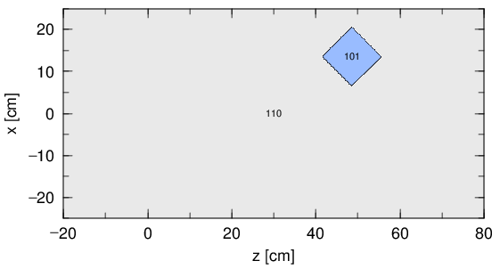
Exercise 3
Let’s rotate the cylinder around Y-axis by 45 degrees, then transform it along with X-axis by 10 cm and Z-axis by 45 cm!
Change parameters of tr1.
transform.inp
Reproduce this geometry
[ C e l l ]
100 -1 10
101 1 -1. -11 12 -13 trcl=1
110 0 -10 #101
[ Transform ]
*tr1 0 0 50 0 30 0 0 0 0 0 0 0 2
step 2
step 3
step 1
track_xz.eps
[transform]
11

Slide 12
Answer 3
Let’s rotate the cylinder around Y-axis by 45 degrees, then transform it along with X-axis by 10 cm and Z-axis by 45 cm!
transform.inp
Reproduce this geometry
[ C e l l ]
100 -1 10
101 1 -1. -11 12 -13 trcl=1
110 0 -10 #101
[ Transform ]
*tr1 10 0 45 0 45 0 0 0 0 0 0 0 2
step 2
step 3
step 1
track_xz.eps
[transform]
12

Slide 13
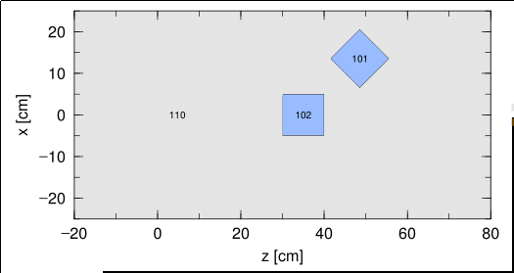
Exercise 4
Construct the geometry shown below by adding a cell.
Do not change [surface] section.
Change [cell] & [transform] section.
(Define the transform tr2 in [transform], and then apply it to a cell 102 in [cell].)
transform.inp
Reproduce this geometry
[ C e l l ]
100 -1 10
101 1 -1. -11 12 -13 trcl=1
102 1 -1. -11 12 -13 trcl=
110 0 -10 #101 #102
[ Transform ]
*tr1 0 0 50 0 30 0 0 0 0 0 0 0 2
*tr2 0 0 0 0 0 0 0 0 0 0 0 2
track_xz.eps
[transform]
13

Slide 14
Answer 4
Construct the geometry shown below by adding a cell.
transform.inp
Reproduce this geometry
[ C e l l ]
100 -1 10
101 1 -1. -11 12 -13 trcl=1
102 1 -1. -11 12 -13 trcl=2
110 0 -10 #101 #102
[ Transform ]
*tr1 0 0 50 0 30 0 0 0 0 0 0 0 2
*tr2 0 0 30 0 0 0 0 0 0 0 0 0 2
Translation along the positive direction of the Z-axis by 30 cm!
track_xz.eps
[transform]
14

Slide 15
Table of Contents
[transform]
[magnetic field]
[multiplier]
[counter]
Table of Contents
15
Notes:
PHITS講習会 入門実習

Slide 16
[magnetic field] section
You can set magnetic fields (dipole and quadrupole) in certain regions in PHITS geometry to change the charged particle trajectories.
Example of dipole magnet：
Homogeneous magnetic field
F=ev×B
[magnetic field]
16

Slide 17
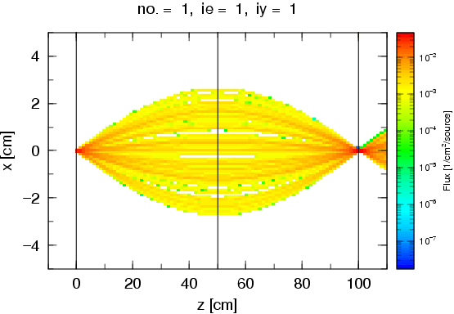
[magnetic field] section
You can set magnetic fields (dipole and quadrupole) in certain regions in PHITS geometry to change the charged particle trajectories.
Example of quadrupole magnet：
Converge charged particle trajectory
Y-axis
N
S
X-axis
S
N
Schematic image of quadrupole magnet
[magnetic field]
17

Slide 18
How to use
After defining [magnetic field] section, you can activate this function by setting imagnf=1 in [parameters].
[ Magnetic Field ]
reg typ gap mgf trcl
1 4 10.0 -5.0 3
2 4 10.0 5.0 1
3 2 10.0 -10.0 0
*For electrons and positrons, this function is available only when you use EGS5 (after PHITS version 2.90).
reg: cell ID to set the magnetic field
typ: dipole (=2) or quadrupole (=4)
gap: half distance between magnet in cm
(not used for dipole but dummy input needed)
mgf: strength of magnetic field in kG
trcl: transform ID
Direction of Magnetic Field
Y-axis (positive direction) for dipole
→positive charged particles go to the negative direction of X-axis when they go to the positive direction of Z-axis
For quadrupole
→positive charged particles converge in X-axis and diverge in Y-axis when it goes to the positive direction of Z-axis
[magnetic field]
18

Slide 19
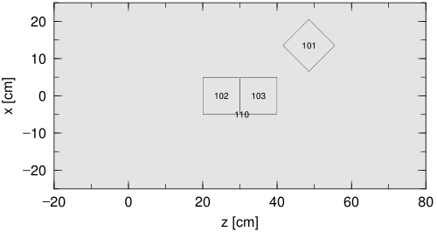
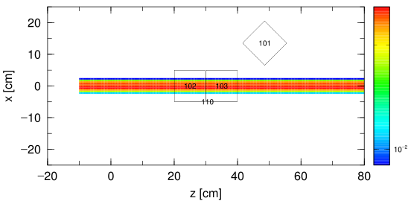
Confirmation of initial setting
magfield.inp
Execute PHITS by setting icntl=8 and 0.
[ S o u r c e ]
s-type = 1
proj = proton
dir = 1
r0 = 2.5
z0 = -10.
z1 = -10.
e0 = 200
[ S u r f a c e ]
10 so 500.
11 cz 5.
12 pz 0.
13 pz 10.
[ C e l l ]
100 -1 10
101 0 -11 12 -13 trcl=1
102 0 -11 12 -13 trcl=2
103 0 -11 12 -13 trcl=3
110 0 -10 #101 #102 #103
icntl=8
icntl=0
track_xz.eps
[magnetic field]
19

Slide 20
Exercise 1
Set dipole magnet in cell 103.
Remove a comment mark $, to set imagnf=1 in [parameters].
Confirm the setting of [Magnetic Field].
magfield.inp
Set dipole magnet
[ P a r a m e t e r s ]
icntl = 0
maxcas = 1000
maxbch = 1
$ imagnf = 1
file(6) = phits.out
・ ・ ・ ・ ・ ・
[Magnetic Field]
reg typ gap mgf
103 2 10 100
track_xz.eps
[magnetic field]
20

Slide 21
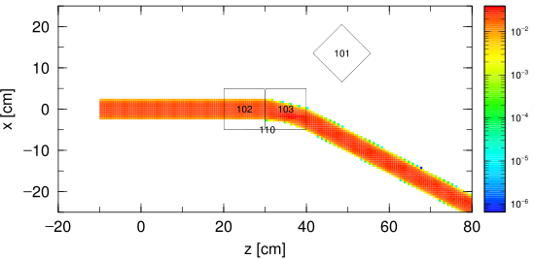
Answer 1
Set dipole magnet in cell 103.
magfield.inp
The beam goes to the negative direction of X-axis.
[ P a r a m e t e r s ]
icntl = 0
maxcas = 1000
maxbch = 1
imagnf = 1
file(6) = phits.out
・ ・ ・ ・ ・ ・
[Magnetic Field]
reg typ gap mgf
103 2 10 100
track_xz.eps
[magnetic field]
21

Slide 22
Exercise 2
Set quadrupole magnet in cell 103.
Set typ to 4 in [Magnetic Field].
magfield.inp
Set quadrupole magnet
[ P a r a m e t e r s ]
icntl = 0
maxcas = 1000
maxbch = 1
imagnf = 1
file(6) = phits.out
・ ・ ・ ・ ・ ・
[Magnetic Field]
reg typ gap mgf
103 2 10 100
track_xz.eps
[magnetic field]
22

Slide 23
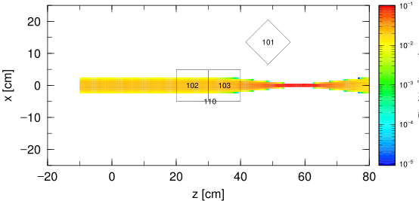
Answer 2
Set quadrupole magnet in cell 103.
magfield.inp
The beam converges in X-axis.
[ P a r a m e t e r s ]
icntl = 0
maxcas = 1000
maxbch = 1
imagnf = 1
file(6) = phits.out
・ ・ ・ ・ ・ ・
[Magnetic Field]
reg typ gap mgf
103 4 10 100
track_xz.eps
[magnetic field]
23

Slide 24
Exercise 3
Check divergence of particle trajectories along to the Y-axis!
Change z-type in the [T-Track] section with axis=xy.
Set nz=3 and set z coordinates to confirm the xy-plane at z=35,45,55cm.
magfield.inp
[ T - T R A C K ]
mesh = xyz
x-type = 2
nx = 100
xmin = -25.
xmax = 25.
y-type = 2
ny = 100
ymin = -25.
ymax = 25.
z-type = 1
nz = 3
-5.0 5.0
part = proton
・ ・ ・ ・ ・ ・ ・ ・ ・ ・ ・ ・ ・ ・ ・ ・ ・ ・
file = track_xy.out
Z=35, 45, 55cm
track_xz.eps
[magnetic field]
24

Slide 25
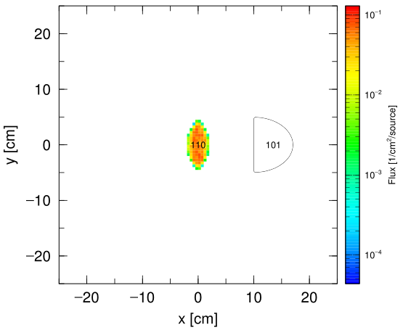
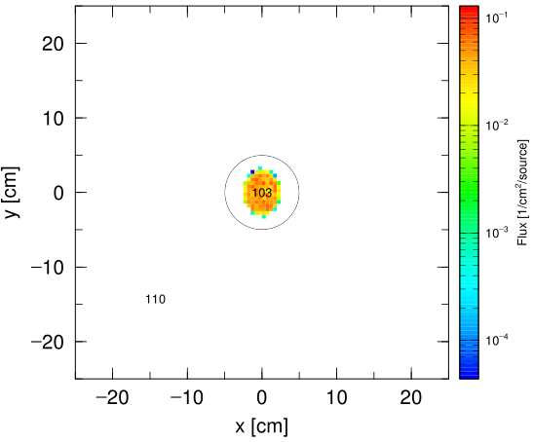
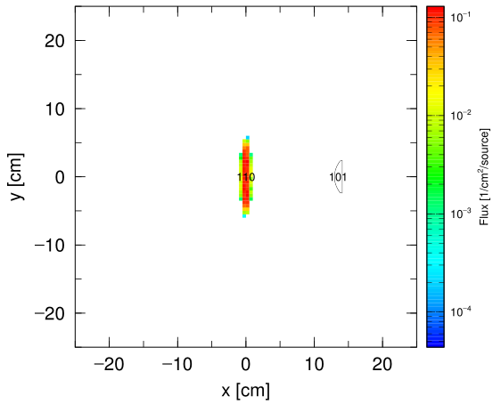
Answer 3
Check divergence of particle trajectories along to the Y-axis!
magfield.inp
[ T - T R A C K ]
mesh = xyz
x-type = 2
nx = 100
xmin = -25.
xmax = 25.
y-type = 2
ny = 100
ymin = -25.
ymax = 25.
z-type = 1
nz = 3
30.0 40.0 50.0 60.0
part = proton
・ ・ ・ ・ ・ ・ ・ ・ ・ ・ ・ ・ ・ ・ ・ ・ ・ ・
file = track_xy.out
track_xy.eps
[magnetic field]
25

Slide 26
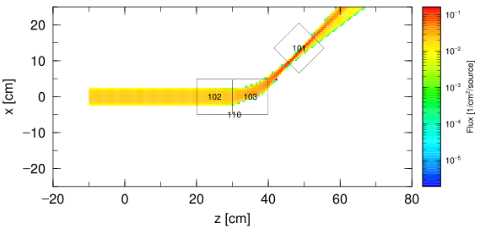
Exercise 4
Bend and converge the beam to hit the cell 101 like the picture below.
(No need to consider the divergence of beam along to Y-axis).
Set two different magnetic fields.
Control the beam by changing the direction and strength of the magnetic fields.
magfield.inp
[ P a r a m e t e r s ]
icntl = 0
maxcas = 1000
maxbch = 1
imagnf = 1
file(6) = phits.out
・ ・ ・ ・ ・ ・
[Magnetic Field]
reg typ gap mgf
102 10
103 10
track_xz.eps
[magnetic field]
26

Slide 27
Answer 4
Bend and converge the beam to hit the cell 101 like the picture below.
(No need to consider the divergence of beam along to Y-axis).
magfield.inp
[ P a r a m e t e r s ]
icntl = 0
maxcas = 1000
maxbch = 1
imagnf = 1
file(6) = phits.out
・ ・ ・ ・ ・ ・
[Magnetic Field]
reg typ gap mgf
102 4 10 50
103 2 10 -150
track_xz.eps
[magnetic field]
27

Slide 28
Table of Contents
[transform]
[magnetic field]
[multiplier]
[counter]
Table of Contents
28
Notes:
PHITS講習会 入門実習

Slide 29
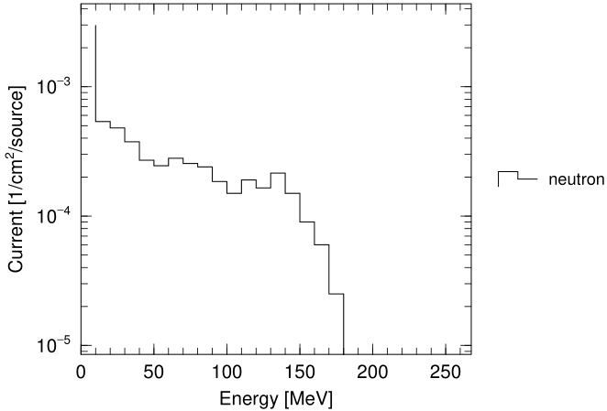
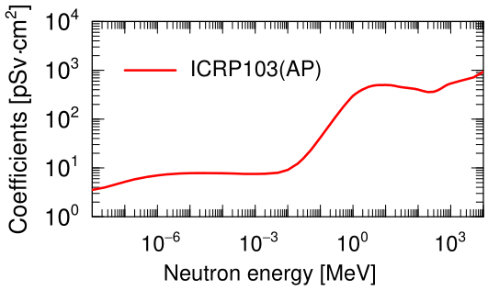
[multiplier] section
You can obtain tally results multiplied by coefficients depending on energies for [t-track], [t-cross], and [t-point].
To estimate effective dose at specified regions
→ by multiplying particle fluences by conversion coefficients of effective dose
Energy distribution of neutron fluences
Conversion coefficients based on ICRP103 (AP irradiation)
[multiplier]
29

Slide 30
How to use
Add a multiplier subsection to the tally section.
[ t-track ]
・ ・ ・ ・ ・ ・
multiplier = all
mat mset1 mset2 mset3 mset4
all ( 1.0 -200 ) ( 1.0 -201 ) ( 1.0 -204 ) ( 1.0 -202 )
multiplier subsection
mseti: multiplier set
(maximum of six sets can be defined)
Usually, “all” should be set.
Normalization factor
ID number.
Implemented data sets and user-defined sets can be used.
[multiplier]
30

Slide 31
Implemented data sets
Kind of data set | ID number
H*(10) | -200
Effective dose based on ICRP60 (AP irradiation) | -201
Effective dose based on ICRP103 (AP irradiation) | -202
Effective dose based on ICRP103 (ISO irradiation) | -203
New operational quantity H* | -204
Sex-averaged effective dose equivalent (ISO irradiation) | -210
Effective dose equivalent for male ・ female (ISO irradiation) | -211・-212
Dose equivalent for male ・ female red-bone marrow (ISO irradiation) | -213・-214
Dose equivalent for male ・ female skin (ISO irradiation) | -215・-216
Soft error rate on semiconductor device (ISO irradiation) | -299
Besides, values of 1/weight (ID=-1), 1/velocity (ID=-2), and material density (ID=-120) are set as the multiplication factors.
[multiplier]
31

Slide 32
Definition of multiplication factors
You can define original coefficients to multiply tally results in [multiplier] section.
ID number: negative integers between -200 and -299 are available.
(The same number as that of the implemented data set can be specified.)
[ multiplier ]
number = -202
interpolation = log
part = neutron
ne = 68
1.0000E-09 3.0900E+00
1.0000E-08 3.5500E+00
2.5000E-08 4.0000E+00
1.0000E-07 5.2000E+00
・ ・ ・ ・ ・ ・
Interpolation method: log (logarithmic) or lin (linear)
Particle type
Number of data
Numerical data:
ne sets of energies [MeV] and strengths are given.
[multiplier]
32

Slide 33
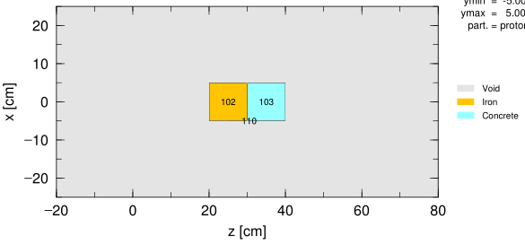
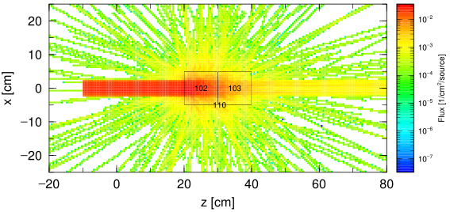
Confirmation of initial setting
multiplier.inp
Execute PHITS by setting icntl=8 and 0.
icntl=8
[ S o u r c e ]
s-type = 1
proj = neutron
e0 = 20
・ ・ ・ ・ ・ ・
[ M a t e r i a l ]
MAT[ 1 ]
Fe 1.0
MAT[ 2 ]
H -0.023
C -0.0023
O -1.22
・ ・ ・ ・ ・ ・
[ C e l l ]
100 -1 10
102 1 -7.86 -11 12 -13 trcl=2
103 2 -2.302 -11 12 -13 trcl=3
110 0 -10 #102 #103
icntl=0, neutron
track_xz.eps(1st page)
[multiplier]
33

Slide 34
Exercise 1
Convert the depth distribution of the particle fluence to that of the effective dose in the concrete.
Add a multiplier subsection to the [t-track] section with axis=z.
Set ID number -202 to obtain the effective dose based on ICRP103 (AP irradiation).
multiplier.inp
[ T - T r a c k ]
・ ・ ・ ・ ・ ・
z-type = 2
zmin = 30.0
zmax = 40.0
nz = 50
・ ・ ・ ・ ・ ・
axis = z
file = track_z.out
part = all
gshow = 3
epsout = 2
y-txt = Effective dose [pSv/source]
multiplier = all
mat mset1
all ( 1.0 -202 )
Tally in the concrete region (30cm<z<40cm)
Rewrite the text of the y-axis
multiplier
subsection
[multiplier]
34

Slide 35
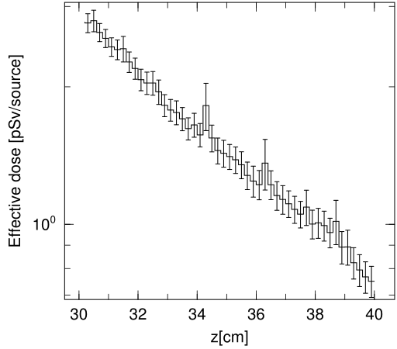
Answer 1
Convert the depth distribution of the particle fluence to that of the effective dose in the concrete.
multiplier.inp
[ T - T r a c k ]
・ ・ ・ ・ ・ ・
z-type = 2
zmin = 30.0
zmax = 40.0
nz = 50
・ ・ ・ ・ ・ ・
axis = z
file = track_z.out
part = all
gshow = 3
epsout = 2
y-txt = Effective dose [pSv/source]
multiplier = all
mat mset1
all ( 1.0 -202 )
The depth distribution of the effective dose was obtained.
track_z.eps
[multiplier]
35

Slide 36
Exercise 2
Convert the unit of dose from pSv to μSv.
Change the normalization factor in the multiplier subsection.
Rewrite y-txt. pSv→$\mu$Sv (surround by $$ marks to use Greek alphabet)
multiplier.inp
From p(pico:10⁻¹²) to μ(micro:10⁻⁶)
[ T - T r a c k ]
・ ・ ・ ・ ・ ・
z-type = 2
zmin = 30.0
zmax = 40.0
nz = 50
・ ・ ・ ・ ・ ・
axis = z
file = track_z.out
part = all
gshow = 3
epsout = 2
y-txt = Effective dose [pSv/source]
multiplier = all
mat mset1
all ( 1.0 -202 )
track_z.eps
[multiplier]
36

Slide 37
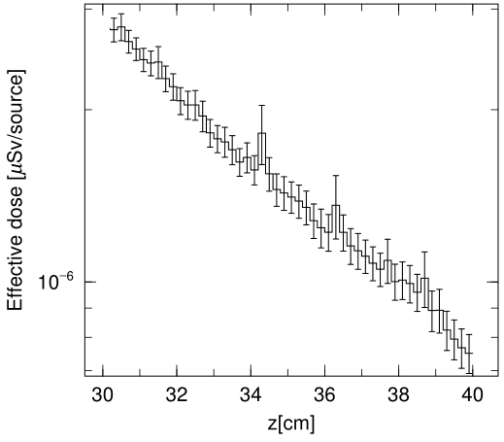
Answer 2
Convert the unit of dose from pSv to μSv.
multiplier.inp
[ T - T r a c k ]
・ ・ ・ ・ ・ ・
z-type = 2
zmin = 30.0
zmax = 40.0
nz = 50
・ ・ ・ ・ ・ ・
axis = z
file = track_z.out
part = all
gshow = 3
epsout = 2
y-txt = Effective dose [$\mu$Sv/source]
multiplier = all
mat mset1
all ( 1e-6 -202 )
track_z.eps
Values on the y-axis became small.
[multiplier]
37

Slide 38
Table of Contents
[transform]
[magnetic field]
[multiplier]
[counter]
Table of Contents
38
Notes:
PHITS講習会 入門実習

Slide 39
What is “Counter” in PHITS?
Each particle has its own “Counter” number to identify what it has been experienced, such as entering, exiting from, reacting in, and reflected by a certain region.
To investigate the origin of the tallied particles
→ What is the difference between particles
produced in different regions?
Tally
When a particle reacts in a region, count = counter +1.
[counter]
39

Slide 40
How to use
1, Define [counter] section
2, Use this function by setting ctmin(i), ctmax(i) in each tally section (i is counter ID).
[ Counter ]
counter = 1
part = neutron proton
reg in out coll ref
1 1 10000 0 0
2 1 10000 0 0
Counter: counter ID (up to 3)
part: Particle species to which this counter is applied.
Event Types
in: Enter the cell
out: Exit from the cell
coll: React in the cell*
ref: Reflected by the cell
Cells to activate this counter
Action
0: Nothing happens
10000: Set counter = 0 (Reset)
Other: Counter = Counter + specified Number
*You can distinguish further detailed channels for coll. (See the next slide.)
[counter]
40

Slide 41
Detailed classification of coll
coll is classified as nucl, atom, and dcay. Furthermore, nucl and atom have 3 and 8 channels, respectively.
coll: reactions
nucl: nuclear interactions
elst: elastic scatterings
iels: inelastic scatterings
fiss: fissions
atom: atomic interactions
delt: delta-ray production
knoe: knock-on electrons production by electrons and positrons
fluo: fluorescence x-ray production
auge: Auger electron production
brem: Bremsstrahlung
phel: photoelectric effect
cmpt: Compton scatterings
pprd: electron-positron pair production
anih: electron-positron pairs annihilation
[counter]
41
dcay: particle decays

Slide 42
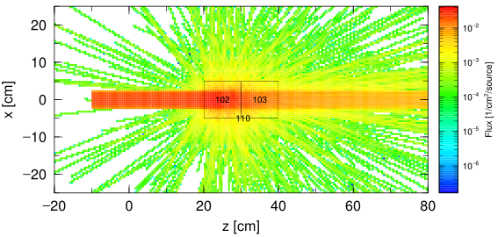
Confirmation of initial setting
counter.inp
Execute PHITS by setting icntl=8 and 0.
icntl=8
[ S o u r c e ]
s-type = 1
proj = neutron
e0 = 150
・ ・ ・ ・ ・ ・
[ M a t e r i a l ]
MAT[ 1 ]
Fe 1.0
MAT[ 2 ]
H -0.023
C -0.0023
O -1.22
・ ・ ・ ・ ・ ・
[ C e l l ]
100 -1 10
102 1 -7.86 -11 12 -13 trcl=2
103 2 -2.302 -11 12 -13 trcl=3
110 0 -10 #102 #103
icntl=0, neutron
track_xz.eps(1st page)
[counter]
42

Slide 43
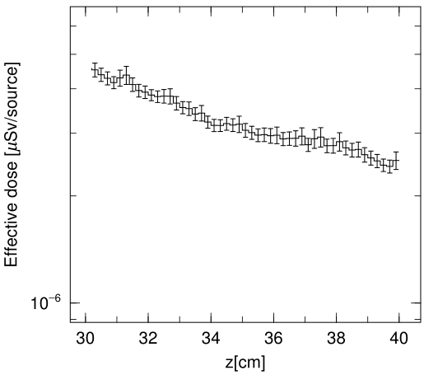
Confirmation of [t-track]
counter.inp
[ T - T r a c k ]
・ ・ ・ ・ ・ ・
z-type = 2
zmin = 30.0
zmax = 40.0
nz = 50
e-type = 1
ne = 1
0.0 5000.0
unit = 1
axis = z
file = track_z.out
part = all
gshow = 3
epsout = 2
angel = ymin(1.E-6) ymax(6.E-6)
y-txt = Effective dose [$\mu$Sv/source]
multiplier = all
mat mset1
all ( 1e-6 -202 )
track_z.eps
Depth distribution of effective dose based on ICRP103(AP irradiation) in the concrete.
[counter]
43

Slide 44
Exercise 1
Estimate contribution of neutrons do NOT scatters in the iron material to the dose.
Copy & paste the [t-track] section with axis=z.
In one of the sections, add ctmin(1)=0 and ctmax(1)=0, and change the output file name.
counter.inp
[ C o u n t e r ]
counter = 1
part = neutron
reg coll
102 1
[ T - T r a c k ]
・ ・ ・ ・ ・ ・
file = track_z-c0.out
・ ・ ・ ・ ・ ・
multiplier = all
mat mset1
all ( 1e-6 -202 )
ctmin(1) = 0
ctmax(1) = 0
When a neutron occurs a collision in cell 102, its counter increases by 1.
Min & Max values of the counter ID1 for tallied particle
How much is the contribution of high-energy neutrons passing through the iron?
[counter]
44

Slide 45
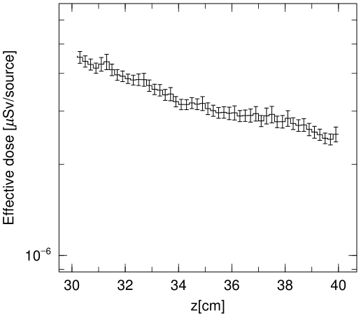
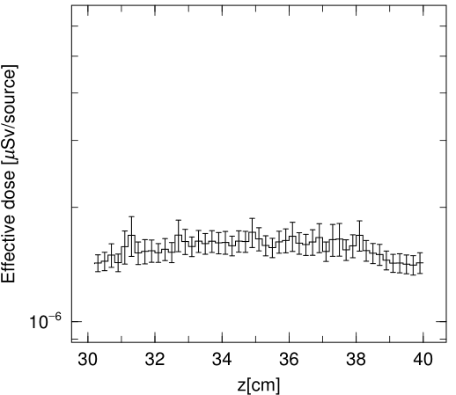
Answer 1
Estimate contribution of neutrons which do NOT scatter in the iron material to the dose.
counter.inp
Total
Unscattered particles in iron
[ C o u n t e r ]
counter = 1
part = neutron
reg coll
102 1
[ T - T r a c k ]
・ ・ ・ ・ ・ ・
file = track_z-c0.out
・ ・ ・ ・ ・ ・
multiplier = all
mat mset1
all ( 1e-6 -202 )
ctmin(1) = 0
ctmax(1) = 0
track_z.eps
track_z-c0.eps
High-energy neutrons which don’t scatter in the iron have dominant contribution to the dose in the deep region of the concrete.
[counter]
45

Slide 46
Exercise 2
Estimate contribution of neutrons scatter in the iron material to the dose.
Copy & paste the [t-track] section with axis=z again.
In the third [t-track] section, set only ctmin(1)=1.
Change the output file name.
counter.inp
[ C o u n t e r ]
counter = 1
part = neutron
reg coll
102 1
[ T - T r a c k ]
・ ・ ・ ・ ・ ・
file = track_z-c1.out
・ ・ ・ ・ ・ ・
multiplier = all
mat mset1
all ( 1e-6 -202 )
ctmin(1) = 1
Minimum value of the counter ID1 for tallied particle
[counter]
46

Slide 47
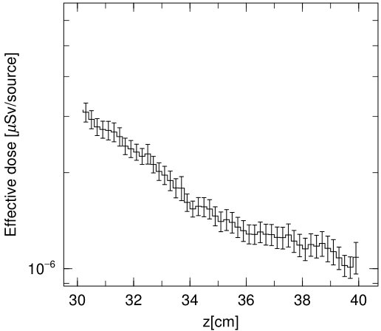
Answer 2
Estimate contribution of neutrons scatter in the iron material to the dose.
Total
counter.inp
[ C o u n t e r ]
counter = 1
part = neutron
reg coll
102 1
[ T - T r a c k ]
・ ・ ・ ・ ・ ・
file = track_z-c1.out
・ ・ ・ ・ ・ ・
multiplier = all
mat mset1
all ( 1e-6 -202 )
ctmin(1) = 1
track_z.eps
Scattered particles in iron
Unscattered particles in iron
track_z-c0.eps
track_z-c1.eps
Scattered particles have main contribution in the surface region of the concrete.
[counter]
47

Slide 48
Summary
Use [transform] section to translated/rotated geometrical components, source and tallies.
Use [magnetic field] section to apply magnetic field to charged particles.
Use multiplier subsection and [multiplier] section to estimate effective dose or operational quantity easily.
Use [counter] section to filter particles scored by tallies based on their detailed origin.
Summary
48
Notes:
《休憩はさむ》
まとめ

