Slide 1
PHITS
Multi-Purpose Particle and Heavy Ion Transport code System
PHITS Tutorial
PHITS simulation using DICOM
Feb. 2018 revised
Title
1

Slide 2
Contents
How to use DICOM2PHITS
Application using DICOM2PHITS
How to use PHITS2DICOM
Table of Contents
2
Notes:
PHITS講習会 入門実習

Slide 3
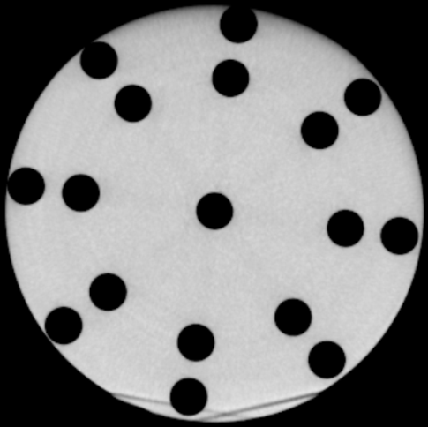
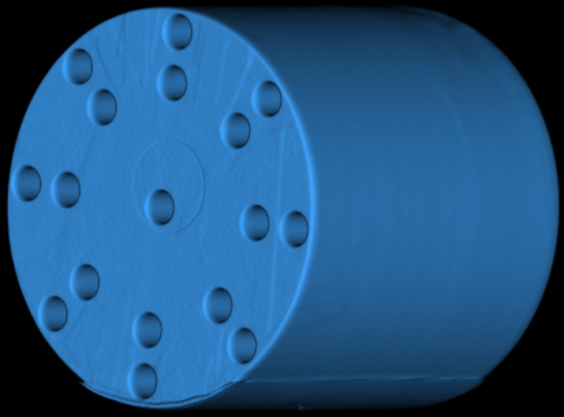
DICOM format (Binary)
Data for 1 slice （sample001.dcm）
① Header (Information on time, voxel size etc.)
② CT values（1,1→2,1→3,1→…→n_{x}-1, n_{y} → n_{x}, n_{y}）
Several files are contained in one folder to represent an object
cross sectional view
3D view
It is necessary to convert from DICOM to PHITS-input format
(CT value, binary) (Universe number, text)
What is DICOM
3

Slide 4
DICOM2PHITS
Convert from Dicom data to PHITS input format (voxel phantom)
Relation between CT value and material density is defined in data/HumanVoxelTable.data
1. Make an input file for DICOM2PHITS （dicom2phits.inp） Details given in README
DICOM2PHITS input Signature for a DICOM2PHITS input
"data/HumanVoxelTable.data" Conversion table
"DICOM/" DICOM files are automatically identified in this directory
"PHITSinputs/" Directory for PHITS inputs to be created
1 20 Slices to be used (1<=z<=20)
1 512 1 512 Clipping (1<=x<=512, 1<=y<=512)
8 8 1 Coarse graining (Average on 4 times 4 voxels in x and y direction)
0 Origin: 0:Voxel center 1:DICOM center
2 PHITS parameter: 1:Photon therapy 2:Particle therapy
2. Execute
Windows: Drag dicom2phits.inp and drop into dicom2phits.bat
Mac: Double click dicom2phits.command and type dicom2phits.inp + enter
DICOM2PHITS HowTo
4

Slide 5
Outputs of DICOM2PHITS
A sample input (phits.inp) for PHITS is created
in the specified directory (work/PHITSinput/)
In addition, the following include files are created
・material.inp : A file containing material info
・universe.inp : A file specifies universe for each material
・voxel.inp : A file containing voxel data converted to PHITS format
・libpath.inp : A file specifying paths for nuclear and photon data library
“libpath.inp” is created only when it dose not exist. Modification is required to fit the path of file(1) following your environment but once the file is created and modified in the specified folder no need of the modification at the second and later time.
file(1) = c:/phits
Modification is not necessary for default Windows installation
libpath.inp
DICOM2PHITS outputs
5

Slide 6
Generated Input File
phits.inp
file=phits.inp
[ Parameters ]
...
[ S u r f a c e ]
set: c81[ 64] $ number of x pixel
set: c82[ 64] $ number of y pixel
set: c83[ 20] $ number of z pixel
set: c84[ 0.37600] $ unit voxel x
set: c85[ 0.37600] $ unit voxel y
set: c86[ 0.50000] $ unit voxel z
…
[Surface]
$ Unit voxel
5000 rpp -c87 -c87+c84 -c88
-c88+c85 -c89 -c89+c86
$ Outer region
99 so 500
$ Main Space
97 rpp -c87+c90 c87-c90 -c88+c90
c88-c90 -c89+c90 c89-c90
98 500 rpp -c87+c90 c87-c90
-c88+c90 c88-c90 -c89+c90 c89-c90
Always 1st line. Necessary for
using “infl” command
[ C e l l ]
$ Material universe
infl:{universe.inp}
$ Voxel universe
5000 0 -5000 lat=1 u=5000
fill= 0: 63 0: 63 0: 19
infl: { voxel.inp }
$ Main space
97 0 -97 trcl=500 fill=5000
98 0 -99 #97 $ Void
99 -1 99 $ Outer region
Size and number of voxels are automatically adjusted
Center of voxel phantom is set at the origin of the XYZ coordinate
Transform is feasible
Include file command
Voxel data file generated as is specified in DICOM2PHITS
Refer to “PHTS Tutorial for making Voxel Phantom” (phits/lecture/advanced/voxel/phits-lec-voxel-jp.ppt) for details
Dicom to PHITS
6

Slide 7
Conversion table
e.g. data/HumanVoxelTable.data [Ref. W. Schneider, Phys. Med. Biol. 45(2000)459}
2nd line：Number of materials
1st line：Comment appearing at execution
Table for human voxel based on W. Schneider, Phys. …
24 ! Number of universe di …
-1000.0d0 -1.21e-3 3 ! Lowest CT value, Dens
-950.0d0 -0.26 10 ! Universe 2
-120.0d0 -0.927 8 ! Universe 3
-82.0d0 -0.958 8 ! Universe 4 NOTE: Den …
-52.0d0 -0.985 9 ! Universe 5 [10^…
-22.0d0 -1.012 8 ! Universe 6 [g/…
…
1500.0d0 -1.935 11 ! Universe 24
1600.0d0 ! Highest CT value for…
#1 Air :: Air density is used ! Composition
14N -75.5 ! Element, Ele…
16O -23.2 !
40Ar -1.3 !
#2 Lung :: Lung density is used ! Composition o…
1H -10.3
12C -10.5
14N -3.1
…
3rd line：Definition of material 1
Smallest CT value
-1000 ≤ material 1 < -950
Density
Number of elements
Largest CT value for the last material
Element
Partition line：starting with #
Composition of material 1
Partition line：starting with #
Ratio: > 0 particle density ratio, <0 weight ratio
< Smallest CT value of material 1 => Show warning msg. and substitute material l
> Largest CT value of the last material => Show warning msg. and substitute the last material
Conversion table
21

Slide 8
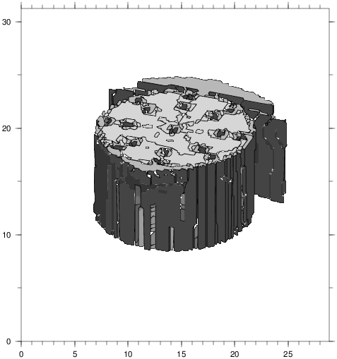
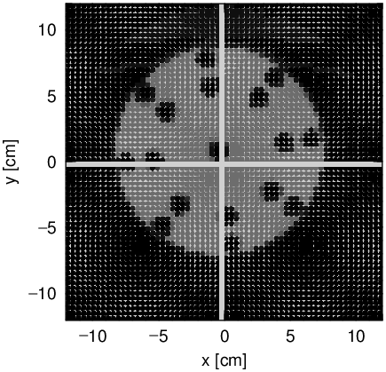
Geometry check
icntl = 11
icntl = 8
CT3D.eps
deposit-xy.eps
Geometry check
8

Slide 9
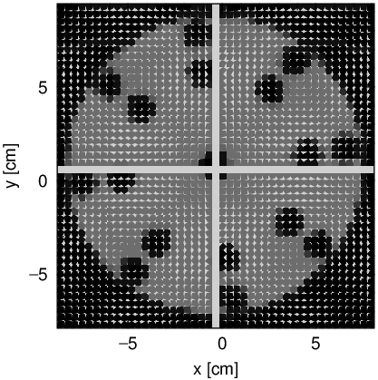
Change voxelized region
dicom2phits.inp
DICOM2PHITS input
"data/HumanVoxelTable.data" ! File for conversion of human voxel data
"work/DICOM/" ! DICOM file directory
"work/PHITSinput/" ! Filename for voxel include file
2 19 ! Minimum slice number, Maximum slice number
70 430 90 460 ! Clipping: Nxmin, Nxmax, Nymin, Nymax
8 8 1 ! Coarse graining: Nxc, Nyc, Nzc
1 ! Origin 0:Voxel center 1:DICOM center
2 ! PHITS parameter: 1:PhotonTherapy 2:Particle Therapy
[ Transform ]
$ Transform system according to DICOM header
tr500 -12.00770 -12.00775 -117.80000
1.00000 0.00000 0.00000
0.00000 1.00000 0.00000
0.00000 0.00000 1.00000
1
Object position is extracted from DICOM header and the object is transformed in this position for origin option = 1
deposit-xy.eps
Region specification
9

Slide 10
Rotation & translation
After making [transform] section, you can use this function by setting trcl=n in [cell], [source], and so on.
[ T r a n s f o r m ]
Trn O₁ O₂ O₃ B₁ B₂ B₃ B₄ B₅ B₆ B₇ B₈ B₉ M
In the case of M=1,
$$B_{1}=\cos\left(x^{′},x\right)$$
$$B_{2}=\cos\left(x^{′},y\right)$$
$$B_{3}=\cos\left(x^{′},z\right)$$
$$B_{4}=\cos\left(y^{′},x\right)$$
$$B_{5}=\cos\left(y^{′},y\right)$$
$$B_{6}=\cos\left(y^{′},z\right)$$
$$B_{7}=\cos\left(z^{′},x\right)$$
$$B_{8}=\cos\left(z^{′},y\right)$$
$$B_{9}=\cos\left(z^{′},z\right)$$
$\left(\begin{matrix}x′ \\ y′ \\ z′\end{matrix}\right)=\left(\begin{matrix}B_{1} & B_{2} & B_{3} \\ B_{4} & B_{5} & B_{6} \\ B_{7} & B_{8} & B_{9}\end{matrix}\right)\left(\begin{matrix}x \\ y \\ z\end{matrix}\right)$ + $\left(\begin{matrix}O_{1} \\ O_{2} \\ O_{3}\end{matrix}\right)$
n: ID of transformation
O₁,O₂,O₃: Displacement vector
B₁～B₉: Elements of rotation matrix
M: Parameter to change the equation of the transformation（The case of M=1 is shown here.)
[transform]
10

Slide 11
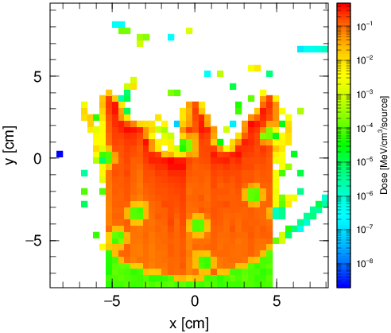
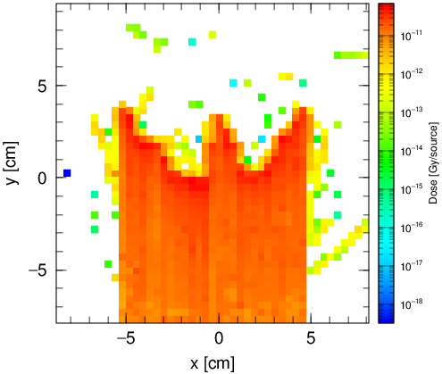
Example of dose calculation
icntl = 0
[But without using EGS (negs=0) because it takes too long due to many materials]
Proton 100 MeV
unit = 2
⇒ MeV/cm³/source
unit = 0
⇒ Gy/source
deposit-xy.eps
Dose calculation
11

Slide 12
Contents
How to use DICOM2PHITS
Application using DICOM2PHITS
How to use PHITS2DICOM
Table of Contents
12
Notes:
PHITS講習会 入門実習

Slide 13
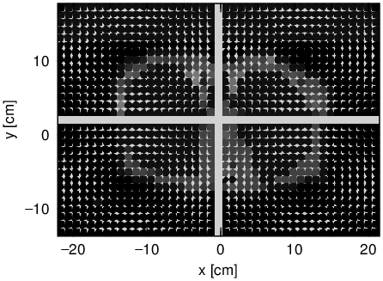
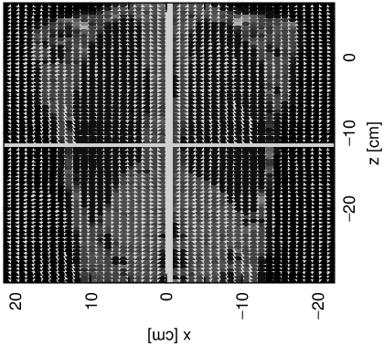
Advanced application
1. Execute DICOM2PHITS using modified dicom2phits.inp as follows
DICOM2PHITS input
"data/HumanVoxelTable.data" ! File for conversion of human voxel data
"work_Kumamoto/DICOM/" ! DICOM file directory
"work_Kumamoto/PHITSinput/" ! Filename for PHITS input
1 148 ! Minimum slice number, Maximum slice number
83 430 150 400 ! Clipping: Nxmin, Nxmax, Nymin, Nymax
8 8 2 ! Coarse graining: Nxc, Nyc, Nzc
1 ! Origin 0:Voxel center 1:DICOM center
2 ! PHITS parameter: 1:PhotonTherapy 2:ParticleTherapy
2. Execute PHITS with icntl=8 using phits.inp at the folder work_Kumamoto/PHITSinput
[But without using EGS (negs=0) because it takes too long due to many materials]
deposit-xy.eps
deposit-xz.eps
Further application
13

Slide 14
Reduce computational time
Purpose
Every time PHITS runs…
It converts its input file to binary, and re-reads the binary file
It is better to…
Make binary file of voxel phantom prior to the PHITS execution
Procedure
① Insert the following 2 lines in the [Parameters] section
ivoxel = 2 # Convert the “fill” part of lattice to binary and output to file(18)
file(18) = voxel.bin # Output file name for binary voxel phantom
② Execute PHITS → Binary file was successfully generated!!
③ Change “ivoxel = 1”, and comment out “infl” command
ivoxel = 1 # Read the “fill” part of lattice from file(18)
Speed up!
$ infl:{voxel.inp}
Dicom to PHITS
14

Slide 15
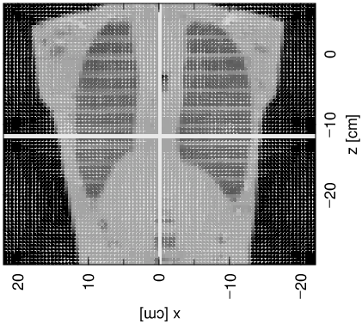
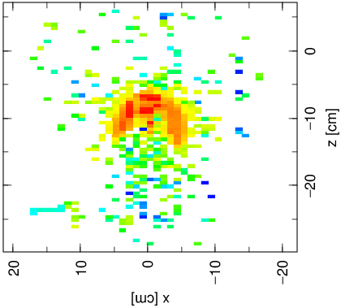
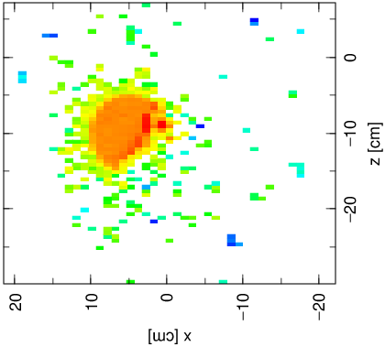
Application: Beam modification
Beam position change
[ Transform ]
$ Transform source directing beam along x-axis
tr400 -0.31739 -14.15528 -11.37500
$ Center of radiation field
1.00000 0.00000 0.00000
0.00000 0.00000 -1.00000
0.00000 1.00000 0.00000
1
…
[ Source ]
s-type = 1
$ Create radiation field centered on 0
$ Adjust center of radiation field in trcl=400
x0 = 0.0
y0 = 0.0
z0 = 0.0
z1 = 0.0
r0 = 5.0
dir = 1.0
trcl = 400
…
5.0
-10.0
-10.0
-11.375
x, z: Center of RF -> Voxel center
y: Beam start -> Voxel edge
-0.31739
5.0
icntl = 0
Beam is transformed into y-direction by Trcl=400
How does this change?
deposit-xz.eps
Application: Modification of beam profile
15

Slide 16
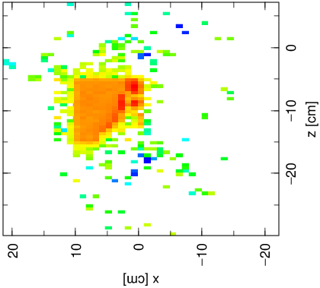
Application: Beam modification
Field shape change
[ Transform ]
$ Transform source directing beam along x-axis
tr400 5.0 -14.15528 -10.0
$ Center of radiation field
1.00000 0.00000 0.00000
0.00000 0.00000 -1.00000
0.00000 1.00000 0.00000
1
…
[ Source ]
s-type = 1
$ Create radiation field centered on 0
$ Adjust center of radiation field in trcl=400
x0 = 0.0
y0 = 0.0
z0 = 0.0
z1 = 0.0
r0 = 5.0
dir = 1.0
trcl = 400
…
5cm
10cm
-10.0
10cm
2
5.0
x0 = -5.0
x1 = 5.0
y0 = -5.0
y1 = 5.0
z0 = 0.0
z1 = 0.0
$ r0 = 5.0
dir = 1.0
trcl = 400
Set radiation field in xy plane centering 0
icntl = 0
Square surface source of 10cm x 10cm
Circular surface source of radius 5cm
How does this change?
deposit-xz.eps
Application: Modification of beam profile
16

Slide 17
Application: Beam modification
[ Transform ]
$ Transform source directing beam along x-axis
tr400 -0.31739 -14.15528 -11.37500 $ Center of radiation field
…
[ Source ]
s-type = 1
$ Create radiation field centered on 0
$ Adjust center of radiation field in trcl=400
x0 = 0.0
y0 = 0.0
z0 = 0.0
z1 = 0.0
r0 = 5.0
dir = 1.0
trcl = 400
…
[ Transform ]
$ Transform source directing beam along x-axis
tr400 5.0 -14.15528 -10.0
$ Center of radiation field
…
[ Source ]
s-type = 1
$ Create radiation field centered on 0
$ Adjust center of radiation field in trcl=400
x0 = 0.0
y0 = 0.0
z0 = 0.0
z1 = 0.0
r0 = 5.0
dir = 1.0
trcl = 400
x, z: Center of RF -> Voxel center
y: Beam start -> Voxel edge
Set radiation field center for (x, z)
Beam is transformed into y-direction by Trcl=400
icntl = 0
Beam position change
icntl = 0
(x,z)=
(-0.31739,-11.37500)
(x,z)=(5.0,-10.0)
deposit-xz.eps
deposit-xz.eps
Modification of beam profile
17

Slide 18
Application: Beam modification
[ Transform ]
$ Transform source directing beam along x-axis
tr400 5.0 -14.15528 -10.0
$ Center of radiation field
…
[ Source ]
s-type = 1
$ Create radiation field centered on 0
$ Adjust center of radiation field in trcl=400
x0 = 0.0
y0 = 0.0
z0 = 0.0
z1 = 0.0
r0 = 5.0
dir = 1.0
trcl = 400
…
[ Transform ]
$ Transform source directing beam along x-axis
tr400 5.0 -14.15528 -10.0
$ Center of radiation field
…
[ Source ]
s-type = 2
$ Create radiation field centered on 0
$ Adjust center of radiation field in trcl=400
x0 = -5.0
x1 = 5.0
y0 = -5.0
y1 = 5.0
z0 = 0.0
z1 = 0.0
dir = 1.0
trcl = 400
Cylindrical source
Rectangular source
Set radiation field in xy plane centering 0
Square surface source of 10cm x 10cm
Circular surface source of radius 5cm
icntl = 0
Field size change
icntl = 0
5cm
10cm
10cm
deposit-xz.eps
deposit-xz.eps
Modification of beam profile
18

Slide 19
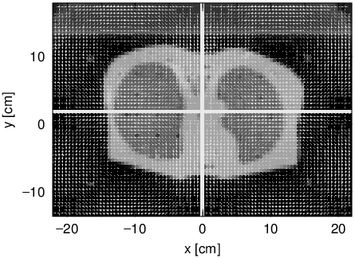
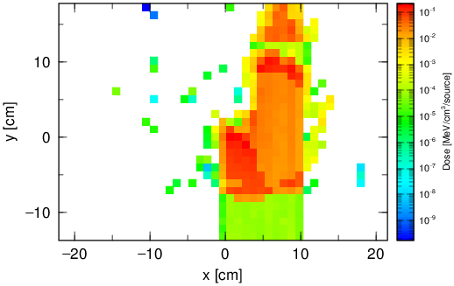
Dose with modified beam
icntl = 0
Beam range is elongated due to low density in lung
deposit-xy.eps
Application: Dose calculation with modified beam
19

Slide 20
How to Deal with High-Resolution Phantom?
High resolution voxel phantom requires numerous memory
Default setting of PHITS is allowed to use memory only less than 640 MByte
e.g.) Whole body voxel phantom (180cm×30cm×50cm) with 1mm³
resolution consists of 270,000,000 voxels, and costs 5.4 GByte
memory, since PHITS uses memory approximately 20 Byte / voxel
How to deal with the situation?
Change “param.inc” included in “src” folder
increase mdas: Maximum memory allowed to be used by PHITS (Byte) / 8
increase latmax: Maximum number of lattice in a cell
declare integer*8 for several parameters (see next page in detail)
Delete all object files (*.o) and re-compile PHITS*
Memory is insufficient?
Divide voxel phantom into several regions to reduce the area to be voxelized
Combine several CT pixels into one voxel to decrease the resolution of phantom
*For Windows PC, gfortran is recommended to be used for this purpose, because PHITS executable file compiled by Intel Fortran may cause “stack overflow” for large voxel phantom
20

Slide 21
Notice for many materials with EGS
Preparation of cross-section data for EGS takes very long time if simulation geometry contains many materials (the data for all the materials will be prepared at the beginning of PHITS execution).
For repeated PHITS simulation, it is useful to keep the created cross-section data for EGS not to reconstruct the data at each time
How to
1. Set ipegs=-1at the parameter section and execute PHITS
=> The cross-section data for EGS will be created without transport calculation
2. Set ipegs=2 at the parameter section and execute PHITS
=> Transport calculation will be conducted using the created data
For details, please refer to the parameter section for EGS in PHITS manual
Many materials with EGS
21

Slide 22
Contents
How to use DICOM2PHITS
Application using DICOM2PHITS
How to use PHITS2DICOM
Table of Contents
22
Notes:
PHITS講習会 入門実習

Slide 23
PHITS2DICOM
Convert PHITS output (3D dose distribution) into DICOM RT-dose format
1. Compute 3D dose distribution by PHTIS
=> Run PHITS with phits.inp in work/PHITSinput by eliminating “OFF” at the last t-deposit
=> 3D dose distribution deposit-3D.out will be created
2.. Create input file of PHITS2DICOM (phits2dicom.inp)
PHITS2DICOM input Signature of input file for PHITS2DICOM
data/sample.dcm Name of RTdose sample file with PATH
work/DICOM/sample010.dcm Name of Rtimage file with PATH used in DICOM2PHITS
work/PHITSinput/deposit-3D.out Name of PHITS 3D dose file with PATH
work/PHITSinput/phits.out Name of phits.out file with PATH
work/PHITSinput/RTD.deposit-3D.dcm Name of output file with PATH
0 Dose normalization 0:One for max 1:Given below
3. Execute PHITS2DICOM
Windows: Drag phits2dicom.inp and drop into dicom2phits.bat
Mac: Double click dicom2phits.command and type phits2dicom.inp + enter
=> RT-dose format file will be created (work/PHITSinput/RTD.deposit-3D.dcm)
PHITS2DICOM HowTo
23

Slide 24
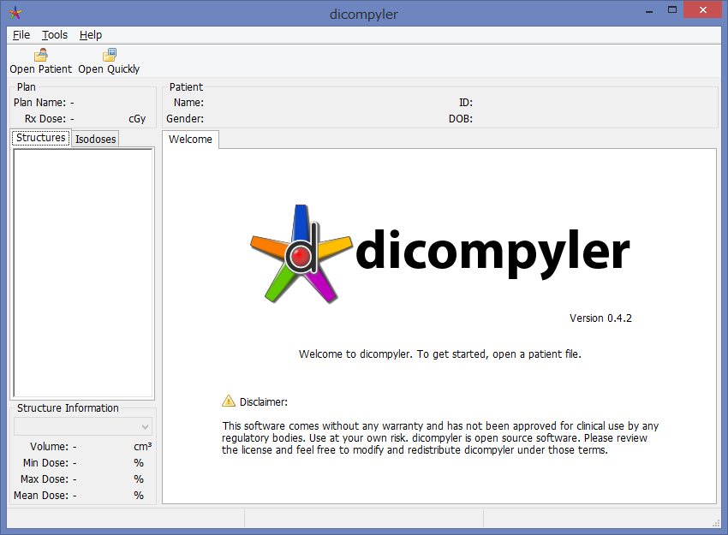
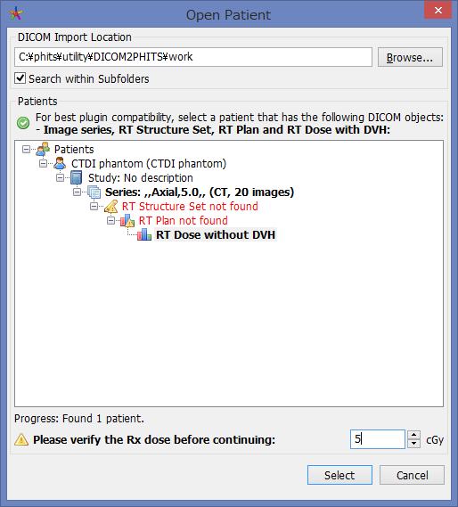
Check with DICOM viewer (dicompyler)
dicompyler: http://www.dicompyler.com/ (Free software)
Able to show RT-dose together with RT-image
1. Click
Click
2. Select “work” folder
3. Set about 30cGy
4. Click
dicompyler
24

Slide 25
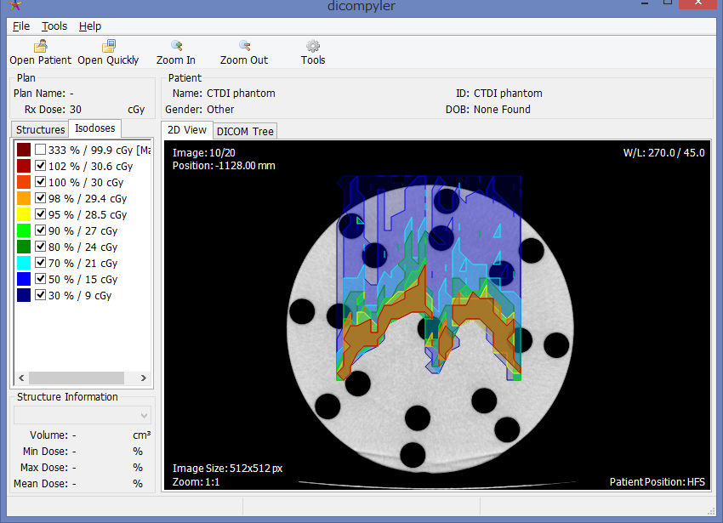
Check with DICOM viewer (dicompyler)
dicompyler: http://www.dicompyler.com/ (Free software)
Able to show RT-dose together with RT-image
Color map appears by clicking in the squares
dicompyler
25

Slide 26
Application: Normalization of dose
1. Run PHITS2DICOM by modifying phits2dicom.inp as below
PHITS2DICOM input Signature of input file for PHITS2DICOM
data/sample.dcm Name of RTdose sample file with PATH
work/DICOM/sample010.dcm Name of Rtimage file with PATH used in DICOM2PHITS
work/PHITSinput/deposit-3D.out Name of PHITS 3D dose file with PATH
work/PHITSinput/phits.out Name of phits.out file with PATH
work/PHITSinput/RTD.deposit-3D.dcm Name of output file with PATH
1 Dose normalization 0:One for max 1:Given below
-0.23 -0.23 -1128.0 Normalization point (x,y,z) [mm]
2.0 Normalized value
2. Check with DICOM viewer (dicompyler) with Rx dose = 200cGy
2 Gy at the position
(-0.23, -0.23, -1128.0)
can be confirmed !
PHITS2DICOM HowTo
26

Slide 27
Summary
DICOM image data can be converted into PHITS format by using DICOM2PHITS
Adjustment of source profile is required to fit the situation
PHITS 3D dose distribution output can be converted to RT-dose format by using PHITS2DICOM
Dose analysis of RT-dose by simultaneous display with RT-image using DICOM viewer (f.g. dicompyler) is feasible
Summary
27

