Slide 1
How to stop α, β, γ-rays and neutrons?
Sep. 2020 revised
title
Notes:
PHITS講習会 入門実習

Slide 2
Purpose of this Exercise
It is generally said that …
α particles can be stopped by a piece of paper
β rays can be stopped by an aluminum plate
γ rays can be stopped by a lead block
neutrons can penetrate all of these materials
Let’s check whether they are correct or not, using PHITS!
Contents
Notes:
「実習」 前の基本的な話から

Slide 3
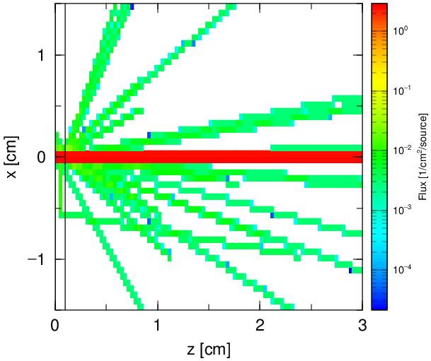
Check Range.inp
Calculation Condition
Incident particles：
Geometry：
Tally：
Photons with an energy distribution (r = 0.01cm)
Cylindrical Al shielding (t = 0.1cm, r = 5cm) & Void
[t-track] for visualizing particle trajectories
[t-cross] for calculating particle fluences behind the shielding
(Error bars are plotted by setting epsout = 2)
Photon
Al
Void
Geometry
track.eps
cross.eps*
*Error bar is depicted when epsout = 2

Slide 4
Source with Energy Distribution
Energy distribution is defined by e-type subsection.
e-type = 21: number of energy bins (ne)
lower boundary of each bin (MeV)
Relative fluence in each energy bin (/MeV)
[ S o u r c e ]
s-type = 1
proj = photon
r0 = 0.0100
x0 = 0.0000
y0 = 0.0000
z0 = -20.000
z1 = -20.000
dir = 1.0000
e-type = 21
ne = 3
$ E_low Flux(/MeV)
0.0 1.0
1.0 3.0
2.0 1.0
3.0
1 : 3 : 1
Relative fluence in each bin (/MeV)
Lower boundary of each energy bin (ne+1)
See manual or lecture\advanced\sourceA for more detail

Slide 5
Procedure for this exercise
Change the source to β-rays
Change the thickness of the Al shielding
Change the tallied region
Change the source to α-rays
Change the target to a piece of paper
Change the source to γ-rays, and the target to a lead block
Find an appropriate thickness of the lead block
Reduce the statistical uncertainty
Change the source to neutrons
Find an appropriate shielding material for neutrons
The input file for each procedure are prepared as “range*.inp”
Procedure

Slide 6
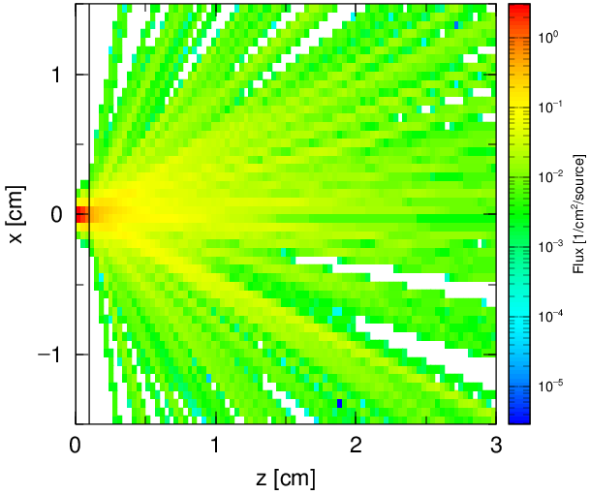
Step 1：Change Source
1. Change energy distribution according to Table 1 → Check cross.eps
2. Change particle to electron (proj) → Check track.eps
Table 1 Relative fluence of β-rays
[ S o u r c e ]
s-type = 1
proj = photon
r0 = 0.0100
x0 = 0.0000
y0 = 0.0000
z0 = -20.000
z1 = -20.000
dir = 1.0000
e-type = 21
ne = 3
$ E_low Flux(/MeV)
0.0 1.0
1.0 3.0
2.0 1.0
3.0
Energy range | Relative Fluence (/MeV)
0 ～ 0.5 MeV | 2.0
0.5 ～ 1.0 MeV | 1.0
1.0 ～ 1.5 MeV | 0.5
Change parameters in red
cross.eps after step1
track.eps after step2
(2nd page)
Step 1

Slide 7
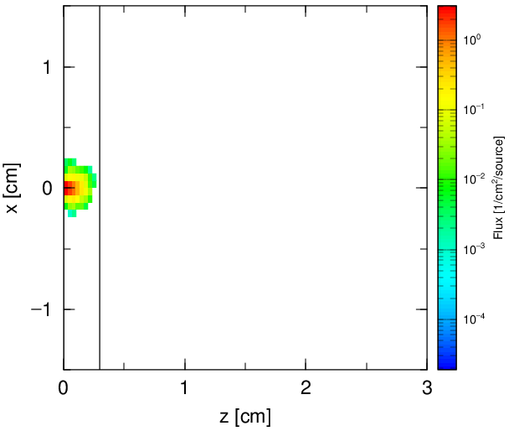
Step 2: Change the Thickness
Find an appropriate thickness of the Al plate, which can fully stop electrons (check by a 1-mm step)
[ S u r f a c e ]
set: c1[0.1] $ Thickness of Target (cm)
1 pz 0.0
2 pz c1
3 pz 50.0
11 cz 5.0
999 so 100.0
Thickness of target is defined as the variable c1
Electron fluence (track.eps, 2nd page)
3 mm is thick enough!
Step 2

Slide 8
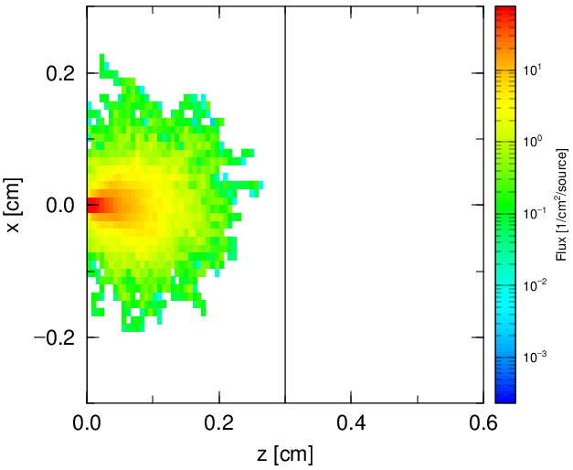
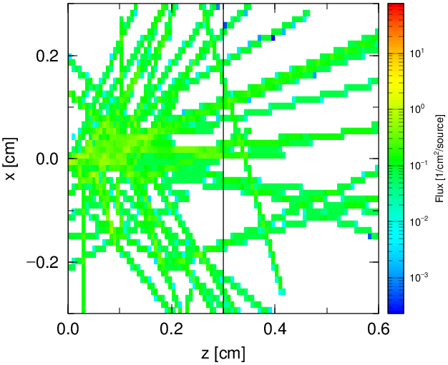
Step 3：Change Tally Region
Let’s see the fluence distribution inside the target in more detail!
Target thickness (c1) should be 0.3 cm
Tally from -c1 to +c1 cm for X&Y directions
Tally from 0 to c1*2 cm for Z direction
[ T - T r a c k ]
title = Track in
mesh = xyz
x-type = 2
xmin = -1.5
xmax = 1.5
nx = 50
y-type = 2
ymin = -1.5
ymax = 1.5
ny = 1
z-type = 2
zmin = 0.0
zmax = 3.0
nz = 90
-c1
c1
-c1
c1
c1*2
Electron fluence
Stopped close to the distal edge
Photon fluence
Penetrated
Step 3

Slide 9
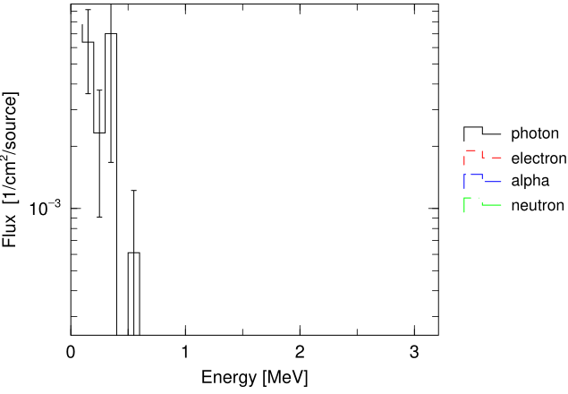
Check Energy Spectrum
Integrated value?
You can find the integrated fluence per source at ”# sum over” at the 70 line of cross.out
photon... electron
…
# sum over 2.4091E-02 0.0000E+00
0.024 photons/incident electron escape from the aluminum plate
Particle fluence behind the target（cross.eps）
An aluminum plate, which is thick enough to stop β-ray, is not thick enough to stop secondary photons!
Photons with energies from 10 keV to 500 keV escape
Step 3

Slide 10
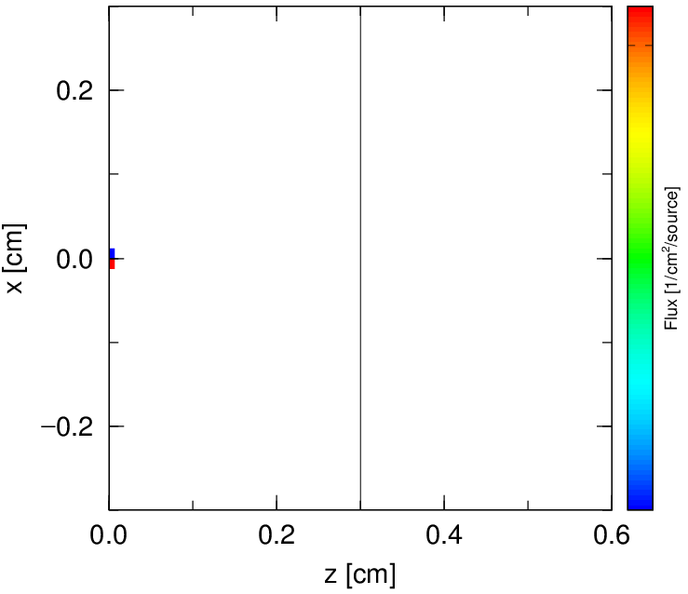
Step 4: How about α particles?
Change the source to α particles emitted from ²¹⁰Po decay
Particle type is defined by “proj” (α particle is “alpha”)
Use RI source function (e-type = 28)*
Replace # of energy bins (ne) by # of Isotopes (ni)
Define RI & its activity in Bq (e.g. Po-210 1.0)
[ S o u r c e ]
s-type = 1
proj = electron
r0 = 0.0100
x0 = 0.0000
y0 = 0.0000
z0 = -20.000
z1 = -20.000
dir = 1.0000
e-type = 21
ne = 3
$ E_low Flux(/MeV)
0.0 2.0
0.5 1.0
1.0 0.5
1.5
alpha
e-type = 28
ni = 1
Po-210 1.0
Fluence of α particles
(3rd page of track.eps)
*See lecture\advanced\SourceA for more detail
10

Slide 11
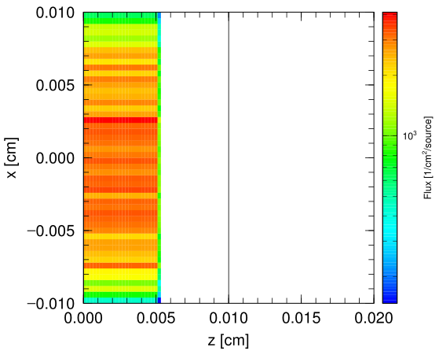
Step 5: Change Geometry
Change the target to a piece of paper (C₆H₁₀O₅)_{n}
Assume density = 0.82 g/cm³ & thickness = 0.01 cm
[ M a t e r i a l ]
MAT[ 1 ] # Aluminum
27Al 1.0
[ C e l l ]
1 1 -2.7 1 -2 -11 $ Target
2 0 2 -3 -11 $ Void
98 0 #1 #2 -999 $ Void
99 -1 999 $ Outer region
[ S u r f a c e ]
set: c1[ 0.3 ] $ Thickness of Target (cm)
1 pz 0.0
2 pz c1
3 pz 50.0
11 cz 5.0
999 so 100.0
C 6.0 H 10.0 O 5.0
-0.82
0.01
Fluence of α particle
Stop at 0.005 cm in paper
No secondary particles are generated
Step 5

Slide 12
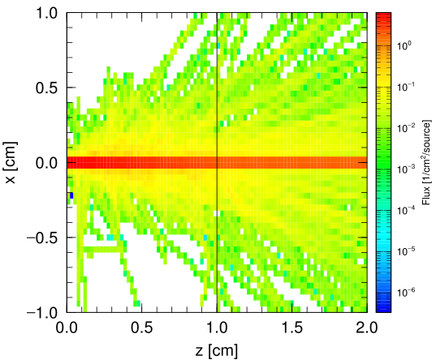
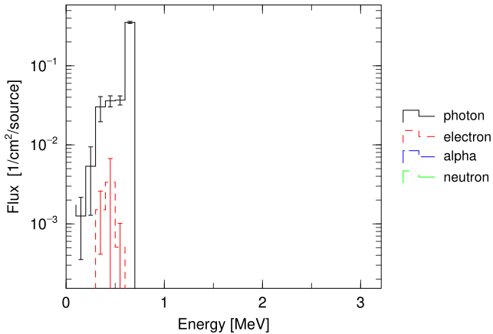
Step 6: How about γ-rays?
Change the source to γ-rays at 0.662 MeV
Change the target to a 1 cm lead (Pb) block (11.34 g/cm³)
Use mono-energetic source (e0) instead of RI source (e-type=28)
Energy spectra behind the target
Most of source photons penetrate the target without reactions
Photon fluence
Target thickness is not enough
Step 6

Slide 13
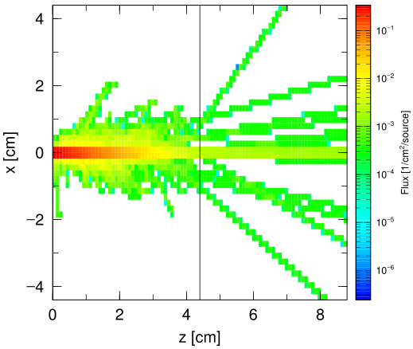
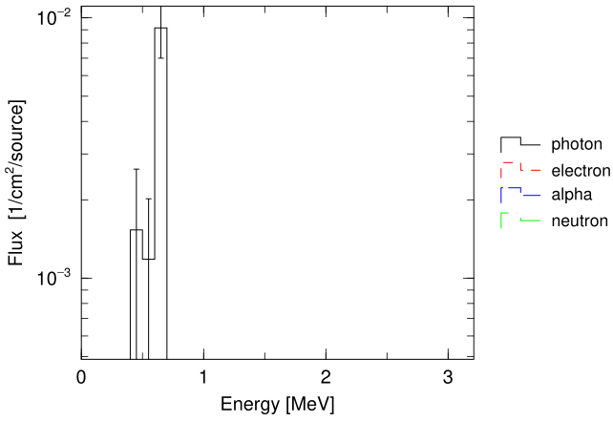
Step 7: Find an appropriate thickness
Change the target thickness to decrease the direct penetration rate of photons down to 0.01
Check the 45th line (0.6 MeV < E < 0.7 MeV) in cross.out
Statistically insignificant!
Photon fluence for
the 4.4-cm lead target case
Energy spectrum
Penetration rate = 0.009
Step 7
13

Slide 14
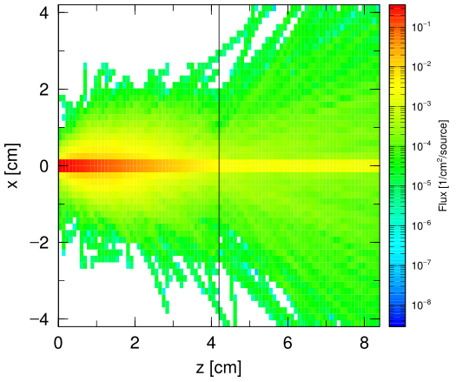
Step 8: Consider Statistical Uncertainty
Estimate a statistically-significant shielding thickness that has a penetration rate < 0.01, by changing maxcas, maxbch, batch.out, istdev etc.
Thickness = 4.4 cm，maxcas = 2000, maxbch = 1
E_{low}(MeV) E_{high}(MeV) Photon r.err
2.0000E-01 3.0000E-01 0.0000E+00 0.0000
3.0000E-01 4.0000E-01 0.0000E+00 0.0000
4.0000E-01 5.0000E-01 1.5326E-03 0.7118
5.0000E-01 6.0000E-01 1.1820E-03 0.7078
6.0000E-01 7.0000E-01 9.1494E-03 0.2348
See the 45th line in cross.out
Statistical uncertainty is too large (~23%)
Thickness = 4.2 cm，maxcas = 2000, maxbch =32
2.0000E-01 3.0000E-01 8.2373E-05 0.5927
3.0000E-01 4.0000E-01 8.0646E-04 0.2499
4.0000E-01 5.0000E-01 1.4322E-03 0.1340
5.0000E-01 6.0000E-01 2.9153E-03 0.0810
6.0000E-01 7.0000E-01 9.5912E-03 0.0406
0.00959 $±$ 4.06% → The penetration rate is below 0.01 with statistical significance
Step 8

Slide 15
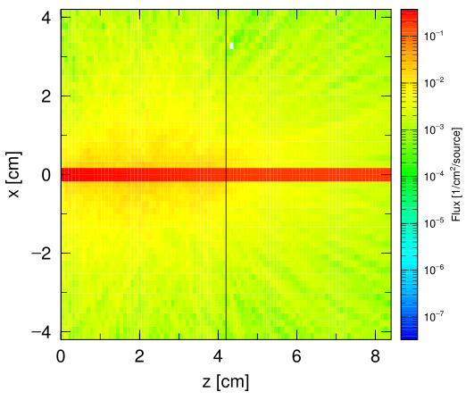
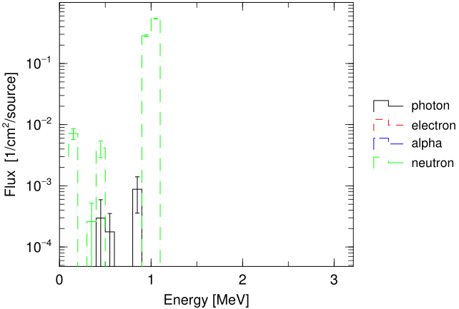
Step 9: How about neutrons?
Change the source to neutron at 1.0 MeV
Set “maxbch = 3”
Neutron fluence
Penetrate!
Energy spectra
80% of neutrons penetrate the
target without reactions
Step 9

Slide 16
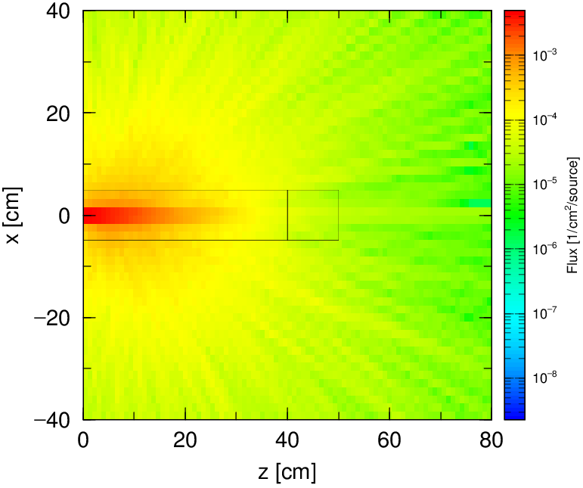
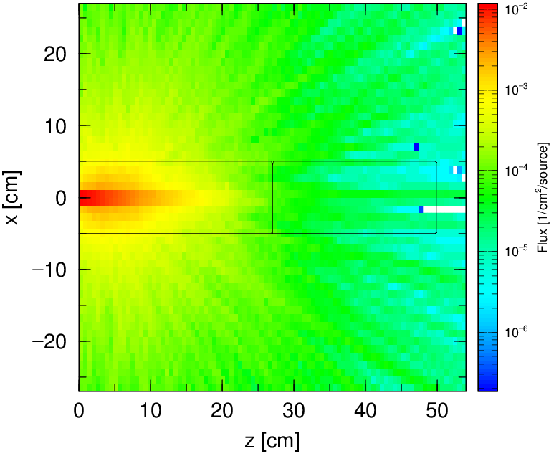
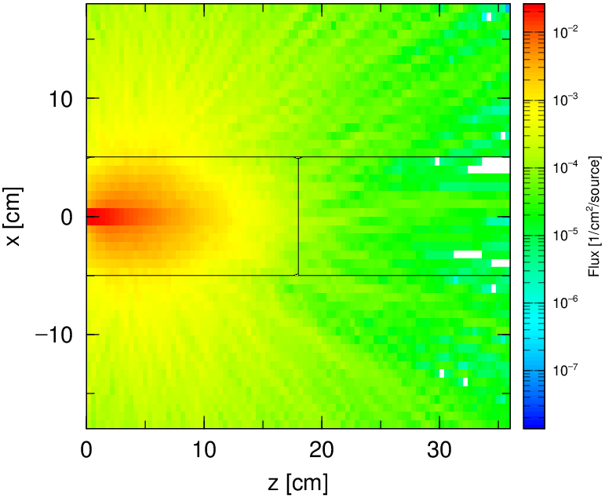
Step 10: Shielding material for neutrons
Change the target material and thickness in order to decrease the penetration rate of neutrons down to 0.01 (see ”# sum over”@ the 70th line)
Try various materials for the target. Find out an appropriate shielding material for neutrons
Al (2.7 g/cm³)
ca. 40 cm
C (1.77 g/cm³)
ca. 27 cm
H₂O (1.0 g/cm³)
ca. 18 cm
Light nuclei (e.g. hydrogen) are suitable for neutron shielding
Step 10

Slide 17
Summary
Common sense on the shielding profiles of α, β, γ rays and neutrons has been confirmed by PHITS simulations.
PHITS is useful for particle transport simulation in a mixed radiation field owing to its applicability to various radiation types.
Summary

Slide 18
Homework (challenge!)
Let’s design a shielding for high-energy neutrons (100 MeV)
Index for the effectiveness of shielding is not the fluence but the effective dose
Find the thinnest shielding that can reduce the doses by 2 order of magnitude
Combine 2 materials for the shielding
Hints
Use [t-track] in “h10multiplier.inp” in the recommendation settings
See the histogram of the dose by changing the axis from “xz” to “z”
Change “nx” parameter to 1 to simplify the files
Low-energy neutrons are effectively shielded by light nuclei, while high-energy neutrons are shielded by intermediate-mass nuclei
Homework

Slide 19
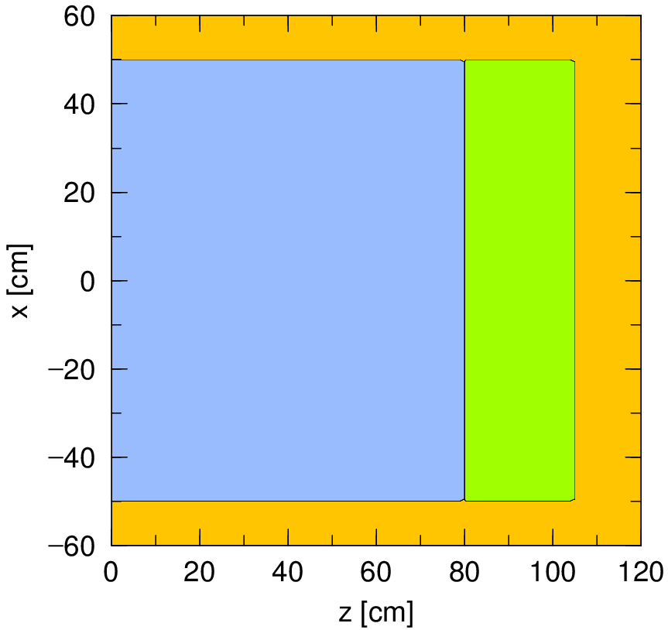
Example of Answer（answer1.inp）
Concrete
Iron
Air
2-layer shielding that consists of 80 cm iron and 25 cm concrete
Let’s Think
How much of the total dose is contributed by photon?
Why 2-layer shielding is more effective than a mono-layer one?
What happens when the order of the 2 layers is inverted?
Homework

