Slide 1
Basic Lecture III:
Parameter Setting
Mar. 2022 revised
title

Slide 2
Purpose of This Lecture
PHITS simulation is controlled by various parameters defined in [Parameters] section.
Every parameter has its default value, and you do not have to change most of them.
But you have to change some parameters to obtain appropriate results depending on the condition of the particle transport.
You will learn how to setup those parameters in this lecture!
Introduction

Slide 3
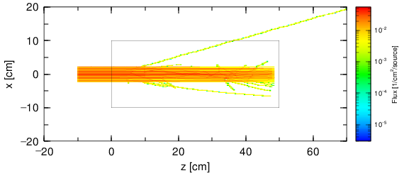
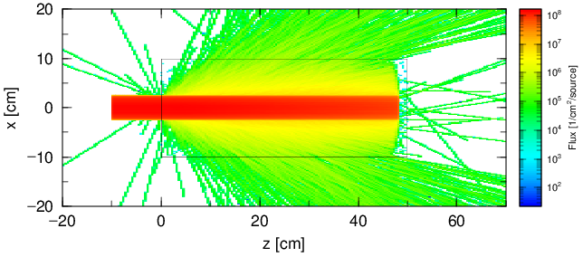
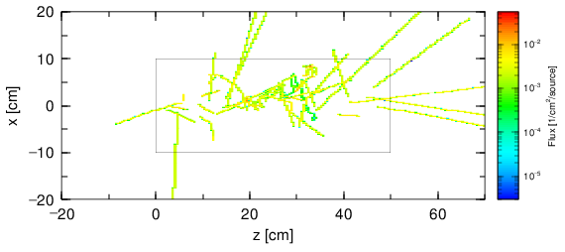
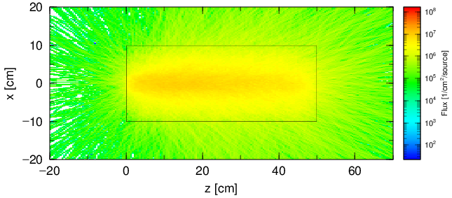
Goal of This Lecture
Proton (up) and neutron (down) fluences calculated by default settings in the homework
Proton (up) and neutron (down) fluences calculated by appropriate settings in the homework
You can obtain such results at the end of this lecture
Purpose

Slide 4
Contents of Lecture III
Selection of Calculation Mode
Convenient functions for input
Setting for statistics
Monte Carlo integration
History Number and statistical error
Scaling of tally results
Setting for physics
Nuclear Data Library
Physics Models
Summary
Contents

Slide 5
Selection of Calculation Mode
The mode can be changed by icntl in [parameters] section.
Value | Explanation (D=0)
0 | Normal particle transport simulation
1 | Nuclear reaction calculation (under development)
5 | Calculation assuming all regions are void (no reaction, no ionization)
6 | Source check by [t-product]
7, 8 | 2D geometry visualization by [t-gshow] tally (=7) or gshow option(=8)
9, 10 | 2D geometry visualization by [t-rshow] tally (=9) or rshow option(=10)
11 | 3D geometry visualization by [t-3dshow]
12 | Re-calculation using dumpall file
13 | Function to sum up tally results (sumtally function)
14 | Automatic calculation of region volume
15 | Execute [t-wwbg] to obtain [ww bias] parameters
Let’s check the geometry using icntl=11 [3D-show] and icntl=8 (gshow option)

Slide 6
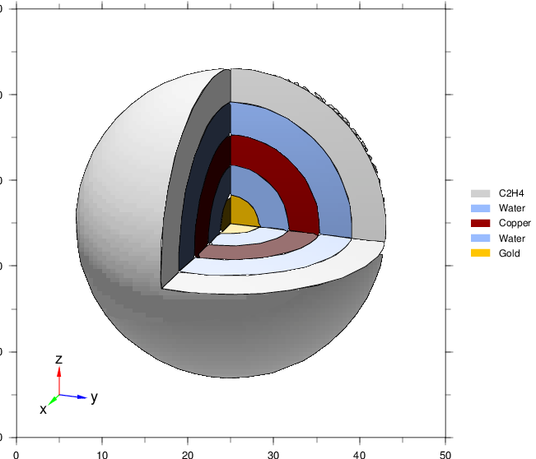
[3D-Show] (icntl=11)
lec03.inp
[ T - 3 D s h o w ]
output = 3
material = -1
6
x0 = 0
y0 = 0
z0 = 0
e-the = 70 $ eye
e-phi = 20
e-dst = 80
l-the = 20 $ light
l-phi = 0
l-dst = 100
w-wdt = 50 $ window
w-hgt = 50
w-dst = 25
heaven = z
line = 1
shadow = 2
file = 3dshow.out
title = Check onion structure using [T-3dshow] tally
epsout = 1
・ ・ ・ ・ ・ ・
[ T i t l e ]
・ ・ ・ ・ ・ ・
[ P a r a m e t e r s ]
icntl = 11
maxcas = 100
maxbch = 10
file(1) = c:/phits
file(6) = phits.out
set: c1[20]
[ S o u r c e ]
・ ・ ・ ・ ・ ・
infl: {onion.inp}[1-33]
Activate
[t-3dshow]
Onion structure
3dshow.eps
Geometry Visualization Mode

Slide 7
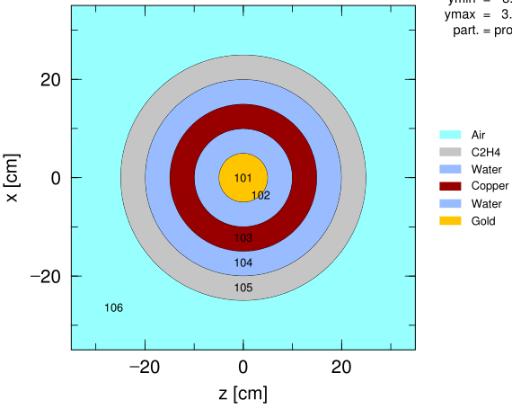
[T-Track] with gshow = 3 (icntl=8)
lec03.inp
[ T - T r a c k ]
mesh = xyz
x-type = 2
nx = 100
xmin = -50.
xmax = 50.
y-type = 1
ny = 1
-5.0 5.0
z-type = 2
nz = 100
zmin = -50.
zmax = 50.
part = proton
e-type = 1
ne = 1
0. 200.
unit = 1
axis = xz
file = track_xz.out
title = Check source
gshow = 3
epsout = 1
Check cell ID and filled materials
[ T i t l e ]
・ ・ ・ ・ ・ ・
[ P a r a m e t e r s ]
icntl = 8
maxcas = 100
maxbch = 10
file(1) = c:/phits
file(6) = phits.out
set: c1[20]
[ S o u r c e ]
・ ・ ・ ・ ・ ・
infl: {onion.inp}[1-33]
[ T i t l e ]
・ ・ ・ ・ ・ ・
[ P a r a m e t e r s ]
icntl = 11
maxcas = 100
maxbch = 10
file(1) = c:/phits
file(6) = phits.out
set: c1[20]
[ S o u r c e ]
・ ・ ・ ・ ・ ・
infl: {onion.inp}[1-33]
Activate gshow option in [t-track]
Track_xz.eps
Geometry Visualization Mode

Slide 8
Check Sources ([t-track])
lec03.inp
Change and Execute
[ T - T r a c k ]
mesh = xyz
x-type = 2
nx = 100
xmin = -50.
xmax = 50.
y-type = 1
ny = 1
-5.0 5.0
z-type = 2
nz = 100
zmin = -50.
zmax = 50.
e-type = 1
ne = 1
0. 200.
unit = 1
axis = xz
file = track_xz.out
title = Check source direction using [T-track] tally
epsout = 1
[ T i t l e ]
・ ・ ・ ・ ・ ・
[ P a r a m e t e r s ]
icntl = 5
maxcas = 100
maxbch = 10
file(1) = c:/phits
file(6) = phits.out

Slide 9
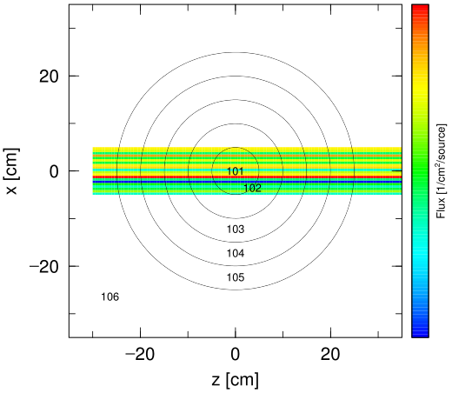
Check Trajectory of Sources
track_xz.eps
No reaction and no ionization because all regions are assumed void.
（You can confirm positions and directions of sources.）

Slide 10
Contents of Lecture III
Selection of Calculation Mode
Convenient functions for input
Setting for statistics
Monte Carlo integration
History Number and statistical error
Scaling of tally results
Setting for physics
Nuclear Data Library
Physics Models
Summary
Contents

Slide 11
Include File
lec03.inp
onion.inp
[ T i t l e ]
・ ・ ・ ・ ・ ・
[ P a r a m e t e r s ]
icntl = 5
maxcas = 100
maxbch = 10
file(1) = c:/phits
file(6) = phits.out
set: c1[5]
[ S o u r c e ]
・ ・ ・ ・ ・ ・
infl: {onion.inp}[1-33]
[ M a t e r i a l ]
・ ・ ・ ・ ・ ・
[ M a t N a m e C o l o r ]
・ ・ ・ ・ ・ ・
[ S u r f a c e ]
10 so 500.
11 so 5.
12 so 10.
13 so 15.
14 so 20.
15 so 25.
[ C e l l ]
100 -1 10
101 1 -19.32 -11
102 2 -1. 11 -12
103 3 -8.93 12 -13
104 4 -1. 13 -14
105 5 -0.9 14 -15
106 6 -1.20e-3 15 -10
You can include other files into PHITS input file using “infl” command
Specify file name by {}, and line numbers by [n1-n2]
infl is disregarded if the section including infl is disactivated by “off”
Write a line file=(input file name) in the first line of input if you run executable directly instead of phits.bat or phits.sh (e.g. MPI cluster)
Replace this line by lines 1 to 33 in “onion.inp”

Slide 12
How to Use Variables
lec03.inp
[ T i t l e ]
・ ・ ・ ・ ・ ・
[ P a r a m e t e r s ]
・ ・ ・ ・ ・ ・
set: c1[5]
[ S o u r c e ]
totfact = 1.0
s-type = 2
proj = proton
e0 = 150.0
x0 = -c1
x1 = c1
y0 = -c1
y1 = c1
z0 = -30.0
z1 = -30.0
dir = 1.0
You can define your own variables in PHITS input file.
Format: set: ci[x]
i: integer (1~99)
x: variable
“set: ci[x]” is valid starting from the command line till the end of the input, but is ignored in “[section] off"
That way the source area is linked with tally area etc.
You can use mathematic equations in PHITS input files
Format: FORTRAN syntax
e.g. exp(-2.0), cos(pi/2), pi*c1**2
(pi is a predefined constant as 3.141592…)
[Intrinsic functions are shown in the next slide.]
You can automatically execute many PHITS simulations by changing certain parameters using infl & set (see phits/utility/script)

Slide 13
Intrinsic functions
function | explanation
sin(x) | sine of x radian
cos(x) | cosine of x radian
tan(x) | tangent of x radian
asin(x) | arc sine of x
acos(x) | arc cosine of x
atan(x) | arc tangent of x
sinh(x) | hyperbolic sine
cosh(x) | hyperbolic cosine
tanh(x) | hyperbolic tangent
function | explanation
int(x) | integer part x
nint(x) | nearest integer to x
abs(x) | absolute value
exp(x) | natural exponential function
log(x) | natural logarithm of x
log10(x) | common logarithm
sqrt(x) | square root of x
max(x,y,…) | maximum of x, y, …
min(x,y,…) | minimum of x, y, …
mod(x,y) | remainder of x divided by y

Slide 14
Exercise 1
Increase the beam width so that the beam covers the whole onion structure.
lec03.inp
Increase the variable c1
set: c1[5]
[ S o u r c e ]
totfact = 1.0
s-type = 2
proj = proton
e0 = 150.0
x0 = -c1
x1 = c1
y0 = -c1
y1 = c1
z0 = -30.0
z1 = -30.0
dir = 1.0
rectangular
(s-type=2)
Source particles travelling along the z-axis are generated from a 10 x 10 cm² square on the xy-plane
track_xz.eps
Increase the beam size so that the beam covers the entire sphere with a radius of 25 cm.

Slide 15
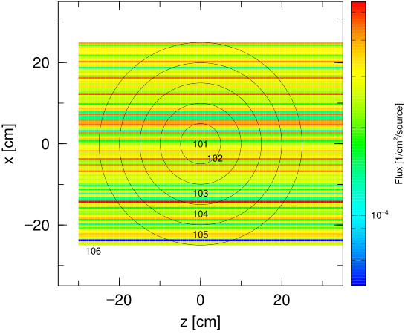
Answer 1
Extend the beam width so that the beam hits the whole of the onion structure.
lec03.inp
set: c1[25]
[ S o u r c e ]
totfact = 1.0
s-type = 2
proj = proton
e0 = 150.0
x0 = -c1
x1 = c1
y0 = -c1
y1 = c1
z0 = -30.0
z1 = -30.0
dir = 1.0
rectangular
(s-type=2)
track_xz.eps
The beam generated from a 50 x 50 cm² square can cover the whole onion structure.

Slide 16
Contents of Lecture III
Selection of Calculation Mode
Convenient functions for input
Setting for statistics
Monte Carlo integration
History Number and statistical error
Scaling of tally results
Setting for physics
Nuclear Data Library
Physics Models
Summary
Contents

Slide 17
Volume and Area Calculation
When you set mesh=reg in tallies, you have to calculate volumes and surface areas of cells in advance*.
How much is the deposit energy per unit volume in the specified cell?
How much is the particle fluence per unit area in the specified cell?
When a cell is a simple object such as spheres and cylinders, you can analytically calculate its volume and surface area.
However, for complex objects?
→ Monte Carlo integration by PHITS!
＊You can set the volumes in [volume] section and the surface areas in ”area” column of [t-cross] section.

Slide 18
Monte Carlo Integration
Monte Carlo Integration is a numerical method to obtain an approximate solution of definite integrals using random numbers. This method estimates the solution approximately by counting the number of points inside a cell after marking random points on a target. Its statistical error depends on the history number.
a cm
Set a target of a 1 x 1 cm² square, and then mark points on it randomly. If the point is inside the colored region, add +1 to the score.
Increasing the trial number, the total score divided by the trial number approaches to the ratio of the colored region to the total area (1/2 for the left case).
By multiplying its result by a area of the target (a²) you can obtain the area of the colored region approximately.
a cm
You can apply this method to any shape.
Furthermore, you can apply the same idea to 3D to estimate the volume of a specified region.

Slide 19
Volume calculation by PHITS
PHITS can estimate an approximate value of the volume of each cell by using [t-volume] tally
Volume of a cell [cm³]
Total track length [cm]
＝
Density of lines [/cm²]
Total track length [cm]
＝
History number / source area [cm²]
Source area
Target
Set a condition that an area of the target is equal to that of the source region.

Slide 20
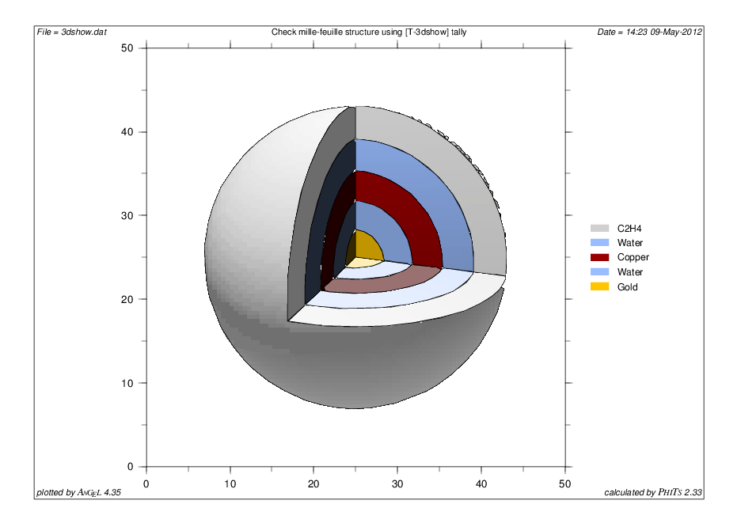
Exercise 2
Let’s calculate the volumes of each cell in the onion structure
Set icntl = 14 (volume calculation mode)
Execute PHITS
Open “volume.out” by a text editor
Check the calculated volumes of each cell
lec03.inp
[ P a r a m e t e r s ]
icntl = 14
maxcas = 100
maxbch = 10
file(1) = c:/phits
file(6) = phits.out
…
[ T - V o l u m e ]
mesh = reg
reg = 101 102 103 104 105
file = volume.out
s-type = 2
x0 = -c1
x1 = c1
y0 = -c1
y1 = c1
z0 = -c1
z1 = c1
→ Rectangular
source area
Monte Carlo
integration range
What are the volumes of these cells?

Slide 21
Results of Calculation
Volumes can be calculated by Monte Carlo integration.
volume.out
[ V o l u m e ]
non reg vol non
1 101 4.1549E+02 0.2106
2 102 3.3346E+03 0.0922
3 103 9.9239E+03 0.0541
4 104 1.8974E+04 0.0361
5 105 3.0770E+04 0.0222
Volume of each cell is…
4π(5)³/3=524 cm³
4π(10)³/3 - 524=3665 cm³
4π(15)³/3 - 4189=9948 cm³
4π(20)³/3 - 14137=19373 cm³
4π(25)³/3 - 33510=31940 cm³
Differences become larger for inner spheres
→ Statistics are not enough!!
→ How to improve the statistics?

Slide 22
Contents of Lecture III
Selection of Calculation Mode
Convenient functions for input
Setting for statistics
Monte Carlo integration
History number and statistical error
Scaling of tally results
Setting for physics
Nuclear Data Library
Physics Models
Summary
Contents

Slide 23
Change History Number
The accuracy of Monte Carlo simulation depends on the number of histories in a simulation
You can obtain results with better statistics by increasing the number of histories
maxcas | (D=10) | Number of histories per 1 batch
maxbch | (D=10) | Number of batch
maxcas×maxbch ＝total number of histories

Slide 24
History and batch
Q. What is number of histories?
Number of source particles generated in the [source] section
Q. What is number of batches?
Total number of histories is divided into a certain number of sets (i.e. batches). Number of histories per batch is “maxcas”; number of batches is “maxbch”
→ Total number of histories = maxcas x maxbch
Q. What does PHITS do at the end of each batch?
PHITS summarizes the tally results, and outputs them in text files
Q. Why is the concept of batch introduced in PHITS?
If PHITS does not output the intermediate results at all, you may waste a long computational time before noticing something wrong in your input file
If PHITS outputs the intermediate results very frequently, you may waste a large part of computational time just for summarizing the tally results
You have to adjust maxcas and maxbch case by case

Slide 25
Exercise 3
Increase the history number to obtain results with better statistics.
lec03.inp
Increase maxcas to 1,000 or 10,000
Confirm that the statistical errors are decreased
[ P a r a m e t e r s ]
icntl = 14
maxcas = 100
maxbch = 10
file(1) = c:/phits
file(6) = phits.out
statistical errors
(relative errors)
volume.out
[ V o l u m e ]
non reg vol non
1 101 4.1549E+02 0.2106
2 102 3.3346E+03 0.0922
3 103 9.9239E+03 0.0541
4 104 1.8974E+04 0.0361
5 105 3.0770E+04 0.0222
How much do the statistical errors decrease when the history number increases by 10 times?

Slide 26
Answer 3
Increase the history number to obtain results with better statistics.
lec03.inp
volume.out
[ V o l u m e ]
non reg vol non
1 101 4.1549E+02 0.2106
2 102 3.3346E+03 0.0922
3 103 9.9239E+03 0.0541
4 104 1.8974E+04 0.0361
5 105 3.0770E+04 0.0222
[ V o l u m e ]
non reg vol non
1 101 5.4065E+02 0.0578
2 102 3.7146E+03 0.0275
3 103 9.8763E+03 0.0170
4 104 1.9252E+04 0.0112
5 105 3.1481E+04 0.0068
[ V o l u m e ]
non reg vol non
1 101 5.1683E+02 0.0187
2 102 3.6593E+03 0.0088
3 103 9.8674E+03 0.0054
4 104 1.9364E+04 0.0035
5 105 3.1935E+04 0.0021
[ P a r a m e t e r s ]
icntl = 14
maxcas = 1000
maxbch = 10
file(1) = c:/phits
file(6) = phits.out
[ P a r a m e t e r s ]
icntl = 14
maxcas = 10000
maxbch = 10
file(1) = c:/phits
file(6) = phits.out
[ P a r a m e t e r s ]
icntl = 14
maxcas = 100
maxbch = 10
file(1) = c:/phits
file(6) = phits.out
exact solutions
（analytic solutions）
4π(5)³/3=524 cm³
4π(10)³/3 - 524=3665 cm³
4π(15)³/3 - 4189=9948 cm³
4π(20)³/3 - 14137=19373 cm³
4π(25)³/3 - 33510=31940 cm³
Relation between history number and statistical error
The result become closer to the exact solution by increasing the history number.
History number increases by 10 times → statistical error decreases by $\sqrt{10}$ times
The statistical error indicates 1σ (68% of tally results are expected to lie within the range)
The true value does not always lie within the statistical error!

Slide 27
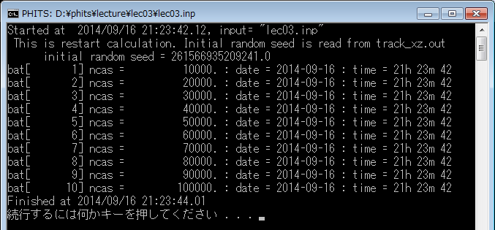
Restart Calculation mode
You can obtain the result with better statistics by restart calculation adding a new result to the previous result.
lec03.inp
[ P a r a m e t e r s ]
icntl = 14
maxcas = 10000
maxbch = 10
file(1) = c:/phits
file(6) = phits.out
istdev = -1
Add istdev=-1, and then execute PHITS in restart calculation mode.
In the restart calculation mode, a message is shown in the console screen.
Information on each batch is also outputted.

Slide 28
Random Number
Random number used in PHITS is a pseudo-random number* with the period of 2⁶⁴-1(~ 10¹⁹)
Default random seed (rseed) is fixed for sustaining the reproducibility of simulation results
rseed | (D=0) rseed = 0 rseed /= 0 | Random number control option Initial random seed =6.647299061401E+12(default) Use rseed as initial random seed
Restart simulation
2⁶⁴-1
Start
Stop
Stop
Stop
*Based on xorshift64 algorithm
28

Slide 29
Terminate PHITS simulation by batch.out
“Batch” is a set of source particles to be simulated in a single program run
When the simulation of one batch is finished
PHITS updates the tally outputs, and the code is still running for the next batch. Plots (*.eps) are also updated if you set “itall=1” in [parameters]
You can terminate the job manually by editing “batch.out” file
batch.out
The value at the first line is the remaining batch number. You can reduce it by changing the value and saving batch.out. For example, changing the value to “0” will terminate the PHITS execution when the simulation of current batch is finished
440 <--- Number of remaining batches
-------------------------------------------------------------------------------
bat[ 560] ncas = 560. : rijk = 151264979546685.
low neutron = 0. : ncall/s = 4.000000000E+00
cpu time = 0.288 s.
date = 2018-05-02
time = 15h 08m 25
History Number

Slide 30
Exercise 4
Terminate the job by “batch.out”
lec03.inp
Comment out the line of istdev by marking $. (Do not use restart calculation mode)
Increase maxbch to 100 to execute a long calculation.
Check the intermediate result.
Terminate the job by “batch.out”.
[ T i t l e ]
・ ・ ・ ・ ・ ・
[ P a r a m e t e r s ]
icntl = 14
maxcas = 10000
maxbch = 1000
file(1) = c:/phits
file(6) = phits.out
$ istdev = -1
This job was terminated by batch.out

Slide 31
Exercise 5
Terminate the job by “stdcut”
lec03.inp
What does “stdcut” means?
[ P a r a m e t e r s ]
icntl = 14
maxcas = 10000
maxbch = 1000
…
[ T - V o l u m e ]
mesh = reg
reg = 101 102 103 104 105
file = volume.out
s-type = 2
x0 = -c1
x1 = c1
y0 = -c1
y1 = c1
z0 = -c1
z1 = c1
stdcut = 0.01
Standard Deviation Cut-off
Terminate the job when the statistical errors of all tally results reach the stdcut
You can specify “stdcut” in each tally
(The job is terminated only when all stdcut conditions are satisfied)
This job is terminated by stdcut

Slide 32
Parallel Mode
Both shared-memory (OpenMP) and distributed-memory (MPI) parallelization are available in PHITS.
Installation of MPI protocol is necessary for using MPI version*, while no additional software installation is required for using the OpenMP version.
You can use the parallelization by adding “$MPI=XX” or “$OMP = XX” (XX: number of CPU core) in your input file before the 1st section.**
MPI is faster than OpenMP when you use the same number of CPU cores.
If you set “$OMP=0”, all CPU cores are used in the PHITS simulation. This option may slow down other applications in your computer.
Important notice
For Windows, OpenMP and MPI versions are available only on 64-bit machines.
For Linux, libiomp5.so library may be required for PHITS with OpenMP. Install & setup the library following the instruction in 2.3.3 in the PHITS manual.
*See manual chap 12.1 for the installation of MPI protocol on Windows
**Only when phits.bat or phits.sh is used for running PHITS. “$MPI” option is not available in Mac
32

Slide 33
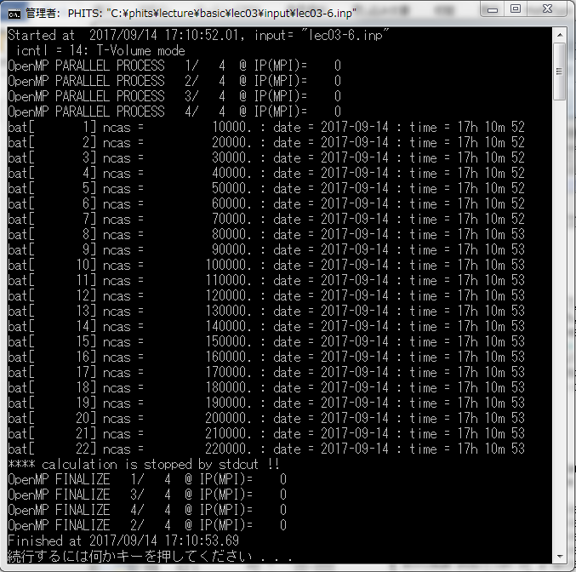
Exercise for 64bit-PC users
Let’s set “$OMP” at the 1st line of input file, and run PHITS
lec03.inp
$OMP = 4
[T i t l e ]
・ ・ ・ ・ ・ ・
Message for the use of OpenMP

Slide 34
Contents of Lecture III
Selection of Calculation Mode
Convenient functions for input
Setting for statistics
Monte Carlo integration
History Number and statistical error
Scaling of tally results
Setting for physics
Nuclear Data Library
Physics Models
Summary
Contents

Slide 35
Normalization of Tally Results
lec03.inp
set: c1[25]
[ S o u r c e ]
totfact = 1.0
s-type = 2
proj = proton
e0 = 150.0
x0 = -c1
x1 = c1
y0 = -c1
y1 = c1
z0 = -30.0
z1 = -30.0
dir = 1.0
Tally outputs are normalized to per “single” source generation*, NOT proportional to the total number of source generation (maxcas x maxbch).
To compare the results with measured values, the calculation results have to be scaled to the source intensity (e.g. Bq and /cm²/s), or multiplied by a conversion factor.
Using the parameter “totfact”, you can obtain the results directly in units you want, such as /cm²/s and mGy/h.
* per “weight” in a more strict sense

Slide 36
Estimate the absolute value of dose in Gy
Assuming that the onion structure is uniformly irradiated by 150-MeV protons. The flux is 10⁶ particle/cm²/sec, and irradiation time is 1 hour. What are the absorbed doses (Gy) deposited in each cell?
150-MeV protons are incident to the onion with the flux of 10⁶ (/cm²/s) for 1 hour

Slide 37
Exercise 6
Let’s calculate the absorbed dose per 1 proton source first!
lec03.inp
[ P a r a m e t e r s ]
icntl = 0
maxcas = 2000
maxbch = 5
…
[ S o u r c e ]
…
infl: {onion.inp}[1-33]
$ infl: {volume.out}
…
[ T - Deposit ]
title = Deposition energy in reg mesh
mesh = reg
reg = 101 102 103 104 105
unit = 0 # unit is [Gy/source]
Set icntl = 0 for normal PHITS simulation
Set maxcas = 2000 and maxbch = 5 to reduce the computational time
Activate infl:{volume.out} command to read the [volume] section generated by [t-volume], otherwise PHITS does not know the volume of each cell
Activate [t-deposit] section
Execute PHITS and check deposit.out

Slide 38
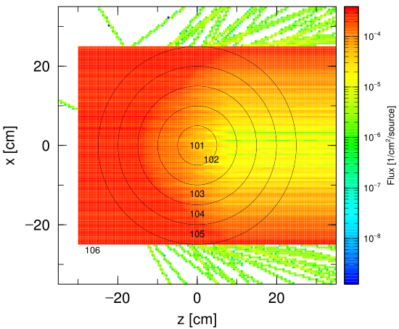
Answer 6
deposit.out
(around line 29)
# num reg volume all r.err
1 101 5.2876E+02 4.7549E-16 0.2879
2 102 3.6874E+03 1.0647E-15 0.2258
3 103 9.9447E+03 2.6794E-14 0.0192
4 104 1.9398E+04 2.8849E-13 0.0118
5 105 3.1908E+04 3.2432E-13 0.0090
Tally results are basically normalized to per source particle (/source)
Only 3.2E-13(Gy) = 0.32 pGy is deposited at the outermost shell per incidence of one 150-MeV proton
Absorbed doses in inner shells are much lower because primary protons cannot reach the cells
track_xz.eps

Slide 39
Exercise 7
How about the case of 1-hour irradiation with flux of 10⁶(/cm²/s)?
lec03.inp
If the flux is 10⁶ protons cm⁻² s⁻¹, how many protons in total should be generated over the whole source area in 1 second?
(source area is (2*c1)²cm² = 2500 cm²)
How about the case of 1-hour irradiation, instead of 1-second irradiation?
Set “totfact” in [source] section for the total number of protons generated in the source area
→ all tally results are multiplied by that number
set: c1[25]
[ S o u r c e ]
totfact = 1.0
s-type = 2
proj = proton
e0 = 150.0
x0 = -c1
x1 = c1
y0 = -c1
y1 = c1
z0 = -30.0
z1 = -30.0
dir = 1.0

Slide 40
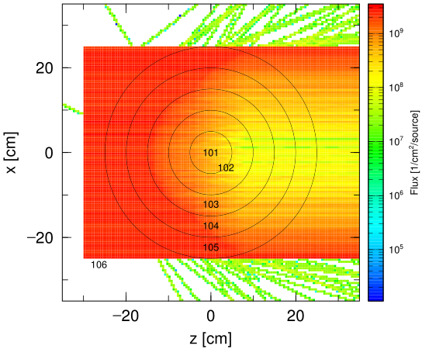
Answer 7
lec03.inp
deposit.out
set: c1[25]
[ S o u r c e ]
totfact = 1.0e6*(2*c1)**2*3600
…
(Around line 29)
# num reg volume all r.err
1 101 5.2876E+02 4.2795E-03 0.2879
2 102 3.6874E+03 9.5821E-03 0.2258
3 103 9.9447E+03 2.4114E-01 0.0192
4 104 1.9398E+04 2.5964E+00 0.0118
5 105 3.1908E+04 2.9189E+00 0.0090
All tally results are multiplied by totfact, i.e. data are scaled to 9x10¹² proton incidence
Absorbed dose in the outmost shell is 2.9 Gy
Absorbed dose in the inner sphere is 4.3 mGy, but this value is not statistically significant due to the large statistical error
Multiplied by totfact
(Label is not changed)
track_xz.eps

Slide 41
Contents of Lecture III
Selection of Calculation Mode
Convenient functions for input
Setting for statistics
Monte Carlo integration
History Number and statistical error
Scaling of tally results
Setting for physics
Nuclear Data Library
Physics Models
Summary
Contents

Slide 42
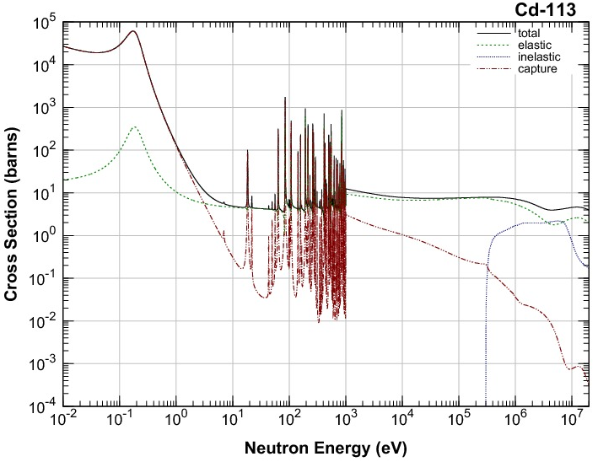
Why cross section data libraries?
Because reaction cross sections of photons, electrons, positrons, and low-energy neutrons (below 20 MeV) have complex structures, reaction models cannot well-describe their behaviors. → Cross section data libraries are required.
Some parameters in [parameters] section should be changed to use data libraries.
Neutron reaction cross sections on ¹¹³Cd target（JENDL-4.0）

Slide 43
Related Parameters
nucdata
Option for the use of neutron nuclear data library
0: Do not use nuclear data library (use nuclear reaction models)
1: Use nuclear data library from 0.1 meV to 20 MeV (default)
negs
Option for electromagnetic transport simulation
-1: Transport only photons based on the PHITS original database (default)
0: Do not transport photons, electrons, and positrons
1: Transport photons, electrons, and positrons based on EGS5 database
Recommended for most calculation!
emin(i), i: particle ID
Cut off energy of each particle ID. Particles below this energy dump the rest of their kinetic energies locally, and are no longer transported in the simulation.
dmax(i), i: particle ID
Maximum energy of each particle ID to use cross section data library

Slide 44
emin(i) & dmax(i)
particles | Cut-off energy | Maximum energy of library use
neutrons | emin(2) = 10⁻¹¹ [MeV] | dmax(2) = 20 [MeV]
electrons | emin(12) = 0.1 [MeV] | dmax(12) = 1000 [MeV]
positrons | emin(13) = 0.1 [MeV] | dmax(13) = 1000 [MeV]
photons | emin(14) = 10⁻³ [MeV] | dmax(14) = 1000 [MeV]
the other particles | emin(i) = 10⁻³ [MeV/n] | dmax(i) = 10⁻³ [MeV/n]
*Note if nucdata = 1 (default) and negs = 1, the numbers in red are automatically set.
(In the case of negs=-1, the values for electrons and positrons are not set.)
You have to change these parameters when you want to…
calculate the deposition energy in a fine mesh (less than 1 mm) → emin(12, 13) = 0.001**
reduce the computating time if the simulation objects are too large → emin(12, 13) = 1.0
transport very high energy photons, electrons, and positrons → dmax(12-14) = 1.0e5
use high-energy nuclear data library → dmax(2) = 150.0 (for JENDL-HE)
**dmax(12,13,14) should be also set to small depending on particle energies

Slide 45
“file” Parameters
file(1) | (D=c:/phits) | PHITS installation directory name. If PHITS installer did not work in your computer, you have to specify this parameter.
file(6) | (D=phits.out) | Summary output file name.
file(7) | (D=file(1)/data/xsdir.jnd) | Address file for cross section data library.
file(15) | (D=dumpall.dat) | Dump file name for dumpall=1 option.
file(18) | (D=voxel.bin) | Binary file name for ivoxel=1,2.
file(20) | (D=file(1)/XS/egs/) | Directory containing the library data for EGS5
file(21) | (D=file(1)/dchain-sp/data/) | Directory containing the library data for DCHAIN-SP
file(22) | (D=batch.out) | Name of file to output information on current batch
file(23) | (D=pegs5) | Output file name for PEGS5
file(24) | (D=file(1)/data) | Directory containing RI source data libraries
file(25) | (D=file(1)/XS/tra) | Directory containing track-structure data libraries

Slide 46
Exercise 8
lec03.inp
Activate electron and positron transport using EGS5
Set maxcas=1000 and maxbch = 1 to reduce the computational time
Set source particles to 10-MeV photons (change “proj” and “e0” in [source] section)
Add electron positron photon in “part” of [t-track]
[ P a r a m e t e r s ]
icntl = 0
maxcas = 2000
maxbch = 5
file(1) = c:/phits
file(6) = phits.out
$ istdev = -1
negs =
[ S o u r c e ]
・ ・ ・ ・ ・ ・
proj = proton
e0 = 150.0
Execute PHITS and check electron, positron, and photon fluxes (see 3rd to 5th pages of track_xz.eps)
[ T - T r a c k ]
mesh = xyz
・ ・ ・ ・ ・ ・
part = proton
・ ・ ・ ・ ・ ・
file = track_xz.out
See negs = 1 in [parameters] section
Execute PHITS again and check the trajectories of electrons and positrons

Slide 47
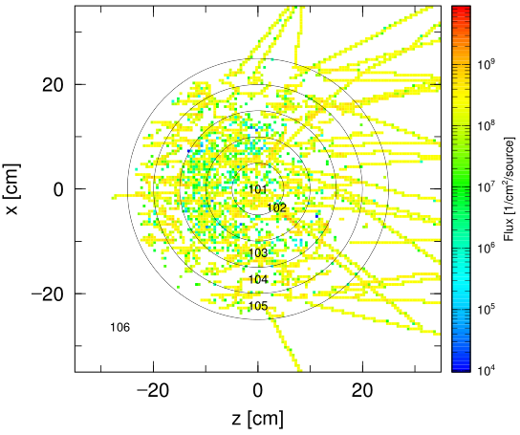
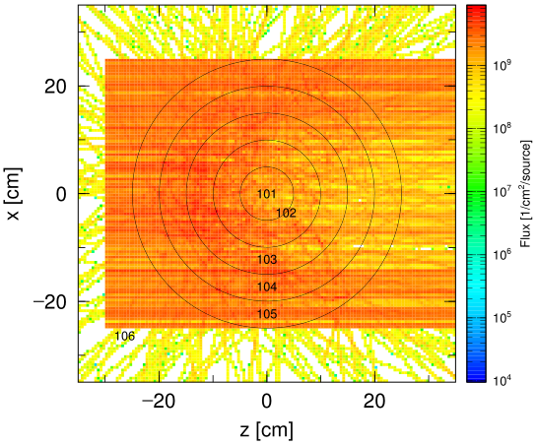
Answer 8
lec03.inp
Activate electron and positron transport using EGS5
[ P a r a m e t e r s ]
icntl = 0
maxcas = 1000
maxbch = 1
file(1) = c:/phits
file(6) = phits.out
$ istdev = -1
negs = 1
[ S o u r c e ]
・ ・ ・ ・ ・ ・
proj = photon
e0 = 10.0
Electron Flux
Photon Flux
track_xz.eps (2nd page)
track_xz.eps (4th page)
[ T - T r a c k ]
mesh = xyz
・ ・ ・ ・ ・ ・
part = proton electron positron photon
・ ・ ・ ・ ・ ・
file = track_xz.out
Electrons and positrons generated by photo-atomic interactions are transported using EGS5

Slide 48
Exercise 9
Let’s feel the extension of computational time by setting a lower cut-off energy (1 keV) for electrons and positrons
lec03.inp
Add emin(12) = 0.001 and emin(13) = 0.001 in [parameters] section
[ P a r a m e t e r s ]
icntl = 0
maxcas = 1000
maxbch = 1
file(1) = c:/phits
file(6) = phits.out
$ istdev = -1
negs = 1
emin(12) =
emin(13) =
Note: default value of emin(12) & emin(13) is 100 keV

Slide 49
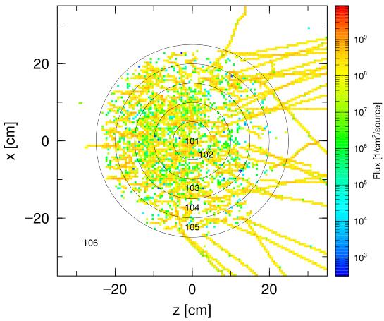
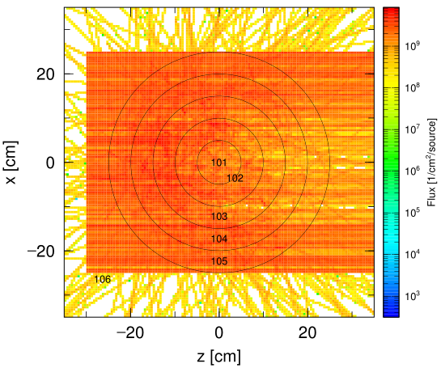
Answer 9
Let’s feel the extension of computational time by setting a lower cut-off energy (1 keV) for electrons and positrons
lec03.inp
[ P a r a m e t e r s ]
icntl = 0
maxcas = 1000
maxbch = 1
file(1) = c:/phits
file(6) = phits.out
$ istdev = -1
negs = 1
emin(12) = 0.001
emin(13) = 0.001
Electron Flux
Photon Flux
track_xz.eps (2nd page)
track_xz.eps (4th page)
Results are almost independent of the cut-off energy in this spatial resolution (5 mm), instead of the longer computational time
Note: range of 100 keV electron in water is approximately 0.14 mm

Slide 50
Contents of Lecture III
Selection of Calculation Mode
Convenient functions for input
Setting for statistics
Monte Carlo integration
History Number and statistical error
Scaling of tally results
Setting for physics
Nuclear Data Library
Physics Models
Summary

Slide 51
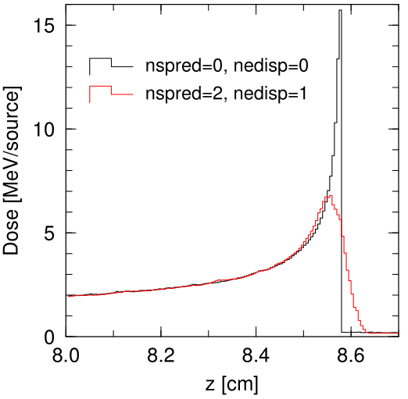
Option for beam transport analysis
nspred and nedisp: Consider angular and energy straggling of charged particle, respectively (Important for beam transport analysis). Entries of [Parameters] section.
Recommended settings are nspred = 2 & nedisp = 1.
(Default settings are nspred=0 & nedisp=0)
Depth-dose distribution of 200MeV/u ¹²C beams into water.
(close-up view around Bragg peak)

Slide 52
Switching Energy
Several nuclear reaction models are implemented in PHITS
You can switch the models in the [parameters] section
inclg | (D=1) | Control parameter for use of INCL
ejamnu | (D=20.) | Switching energy of nucleon-nucleus reaction calculation from Bertini to JAM model (MeV)
ejampi | (D=20.) | Switching energy of pion-nucleus reaction calculation from Bertini to JAM model (MeV)
eqmdnu | (D=20.) | Switching energy of nucleon-nucleus reaction calculation from Bertini to JQMD model (MeV)
eqmdmin | (D=10.) | Minimum energy of JQMD calculation (MeV/u)
ejamqmd | (D=3000.) | Switching energy of nucleus-nucleus reaction from JQMD to JAMQMD (MeV/u)
incelf | (D=0) | Control parameter for use of INC-ELF
dmax(i) | (D=emin(i)) | Maximum energy of library use for i-th particle
* note: easy to check what models are used from “phits.out”

Slide 53
Map of Nuclear Reaction Models
(1MeV)
emin(i)
(=emin)
dmax(i)
(3.0GeV)
einclmax
Nucleon Library INCL (inclg=1) JAM
(1MeV)
emin(i)
(3.0GeV)
einclmax
Pion INCL (inclg=1) JAM
(10MeV/u)
eqmdmin
(3.0GeV/u)
ejamqmd
Nucleus JQMD JAMQMD
(d, t, ³He, α) INCL (inclg=1)
Kaon, Hyperon JAM

Slide 54
Event Generator Mode
A nuclear reaction model for low-energy neutron interaction using nuclear data library combined with a mathematical model*
Determine all ejectiles emitted from low-energy neutron interaction, considering the energy and momentum conservation
Event generator mode is recommended to use in the cases:
to know spectra of proton or alpha particles from reactions of low-energy neutrons.
to obtain information on residual nuclei (e.g. recoil energies).
to perform event-by-event analysis (e.g. response function calculation).
Event generator mode is NOT recommended to use in the cases:
to know information only on neutrons and photons (e.g. shielding).
to calculate transmittance of neutrons.
to know accurate behaviors of thermal-neutrons.
to calculate absorbed doses from neutrons using the kerma approximation
* T. Ogawa et al., Nucl. Instru. Method. A 763 (2014) 575; T. Ogawa et al., Proc. ANS MC2015.

Slide 55
How to Use EG Mode
Set “e-mode = 2” in the [Parameters] section
e-mode | (D=0) = 0 = 1 = 2 | Option for event generator mode Normal mode Event generator mode version 1 Event generator mode version 2
55

Slide 56
Exercise 10
First, perform the transport calculation with 10-MeV neutron sources without using an event generator mode.
lec03.inp
Remove (or comment out) emin(12) & emin(13) to reduce the computational time
Set source particles to 10-MeV neutrons (change “proj” in [source] section)
Change “part = all” to “part = neutron proton”
[ P a r a m e t e r s ]
・ ・ ・ ・ ・ ・
emin(12) = 0.001
emin(13) = 0.001
[ S o u r c e ]
・ ・ ・ ・ ・ ・
proj = photon
e0 = 10.0
[ T - Deposit ]
・ ・ ・ ・ ・ ・
file = deposit.out
part = all
Execute PHITS and check neutron and proton doses (see deposit.out)
56

Slide 57
Answer 10
First, perform the transport calculation with 10-MeV neutron sources without using an event generator mode.
lec03.inp
[ P a r a m e t e r s ]
・ ・ ・ ・ ・ ・
$ emin(12) = 0.001
$ emin(13) = 0.001
[ S o u r c e ]
・ ・ ・ ・ ・ ・
proj = neutron
e0 = 10.0
[ T - Deposit ]
・ ・ ・ ・ ・ ・
file = deposit.out
part = neutron proton
deposit.out
(around line 29)
# num reg volume neutron r.err proton r.err
1 101 5.2876E+02 6.2543E-05 0.3825 0.0000E+00 0.0000
2 102 3.6874E+03 5.0788E-02 0.1497 0.0000E+00 0.0000
3 103 9.9447E+03 1.4100E-03 0.0929 0.0000E+00 0.0000
4 104 1.9398E+04 9.4330E-02 0.0489 0.0000E+00 0.0000
5 105 3.1908E+04 1.5915E-01 0.0270 0.0000E+00 0.0000
No dose contribution from protons → Charged particles are not produced in neutron transport simulation below 20 MeV without using event generator mode
57

Slide 58
Exercise 11
Use an event generator mode.
lec03.inp
[ P a r a m e t e r s ]
・ ・ ・ ・ ・ ・
e-mode = 2
Set “e-mode = 2” in [parameters] section and execute PHITS
A warning is shown when “neutron” is specified in “part” of [t-deposit]
because Kerma approximation is recommended to use for calculating “neutron dose”
Check neutron and proton doses (see deposit.out)
58

Slide 59
Answer 11
deposit.out
（e-mode = 0）
(around line 29)
# num reg volume neutron r.err proton r.err
1 101 5.2876E+02 6.2543E-05 0.3825 0.0000E+00 0.0000
2 102 3.6874E+03 5.0788E-02 0.1497 0.0000E+00 0.0000
3 103 9.9447E+03 1.4100E-03 0.0929 0.0000E+00 0.0000
4 104 1.9398E+04 9.4330E-02 0.0489 0.0000E+00 0.0000
5 105 3.1908E+04 1.5915E-01 0.0270 0.0000E+00 0.0000
deposit.out
（e-mode = 2）
(around line 29)
# num reg volume neutron r.err proton r.err
1 101 5.2876E+02 0.0000E+00 0.0000 0.0000E+00 0.0000
2 102 3.6874E+03 0.0000E+00 0.0000 4.5873E-02 0.2191
3 103 9.9447E+03 0.0000E+00 0.0000 5.7835E-04 0.3359
4 104 1.9398E+04 0.0000E+00 0.0000 7.9953E-02 0.0749
5 105 3.1908E+04 0.0000E+00 0.0000 1.4075E-01 0.0420
Neutron and proton doses are almost exchanged
Statistical uncertainties are larger for e-mode = 2 because neutron can deposit energies only when it causes nuclear reaction
59

Slide 60
Contents of Lecture III
Selection of Calculation Mode
Convenient functions for input
Setting for statistics
Monte Carlo integration
History Number and statistical error
Scaling of tally results
Setting for physics
Nuclear Data Library
Physics Models
Summary
Contents

Slide 61
Summary
[Parameters] section is used for controlling PHITS simulation procedure.
You can select the calculation modes such as particle transport simulation, geometry and source check using “icntl” parameter.
Statistical uncertainties of PHITS simulation depend on the history number (“maxcas” & “maxbch”)
Low-energy neutrons, as well as photons, electrons and positron must be transported using nuclear, atomic data libraries, and EGS5.
You have to carefully select the physics models used in your simulation, as well as the event generator mode
If you feel difficulties for selecting these parameters, see “recommendation” folder and find appropriate settings for your simulation
Summary

Slide 62
Homework #3
Continued with the HW #2
Transport electrons and positrons using EGS5
Activate an event generator mode
Obtain depth-dose distribution with the relative standard deviations less than 0.5% around the Bragg peak region, by changing maxcas, istdev, batch.out etc.
Normalize the dose distribution in (Gy/s) for the case of 1-nA irradiation
Homework
Notes:
宿題（3次元体系）

Slide 63
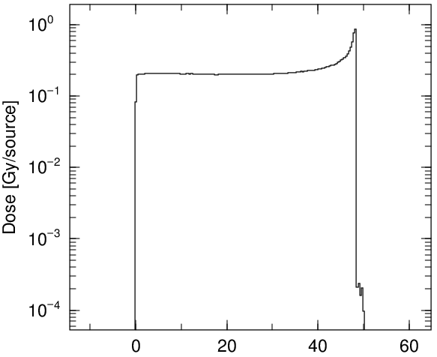
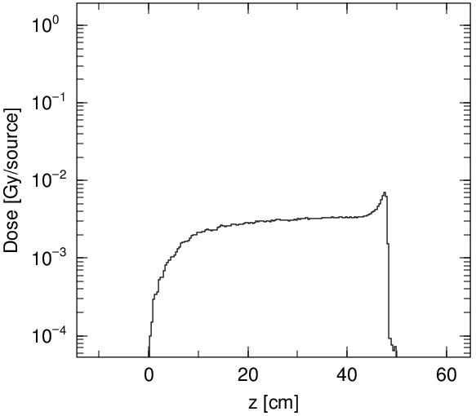
Example Answer
Proton (up) and neutron (down) fluences
Depth-dose distribution inside (up) and outside (down) beam radius
Homework

