Slide 1


Basic Lecture I:
Geometry and Source Definition
May 2021 revised
title
Notes:
PHITS講習会 入門実習

Slide 2
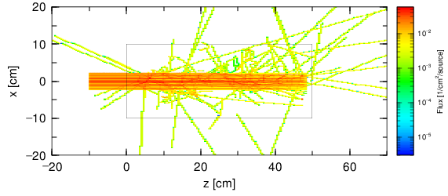
Purpose of This Lecture
Learn input format of PHITS, and how to define a simple geometry and a source term
You can obtain such results at the end of this lecture
(Particle fluence around a cylindrical water tank irradiated by a 290-MeV proton beam)
Purpose

Slide 3
Table of Contents
General Description
Geometry
Source
Summary and Homework
General definition
How to define cells
Definitions of boxes and cylinders
How to add materials
Geometry drawing software
Contents
Notes:
「実習」 前の基本的な話から

Slide 4
Format of PHITS input
Calculation conditions are specified by a text file
An input file consists of several sections
[ Section Name ] ←start of the section
Basic format
keyword（parameter） = value or character
(“space” means nothing)
or
parameter1 parameter2 parameter3 …
Parameters are separated by “space”
Up to 200 characters in one line
Lines starting with more than 6 spaces are successive lines
Parameters can be given in mathematic equations: e.g. 1.0+exp(-2.0)
General description
Notes:
所謂「PHITS言語」
角括弧（：大カッコ←最近では望ましくない呼び名らしい。）

Slide 5
Input support command
*Sections can be placed in an arbitrary order
[ ]off
skip this section
qp:
skip from this line to the next section
q:
equivalent to [end] section
Comment marks
C in the first 5 column of a line (except [material] section)
$ and # in the middle of a line
(but avoid using # in the [cell] and [surface] sections)
→$ is recommended
Characters are case insensitive
General description

Slide 6
Main components of input
In PHITS simulations, geometry in 3-dimensional virtual space and information on source particles are both essential to tally various quantities of the particles.
⇒ ① Geometry
② Source
③ Tally
Three fundamental components
See input example “lec01.inp”
General description
Notes:
この三大要素をテキストで表現しないといけない。

Slide 7
Sample input
[Title]
title comments
[Parameters]
define parameters
[Source]
define source
[Material]
define materials
[Surface]
define surfaces
[Cell]
define cells
[T-Track]
track length tally
[T-3dshow]
3d show tally
[End]
This file consists of 9 sections.
② Source
Production of particles
① Geometry
lec01.inp
Definition of 3D virtual space
③ Tally
Observation of quantities
General description

Slide 8
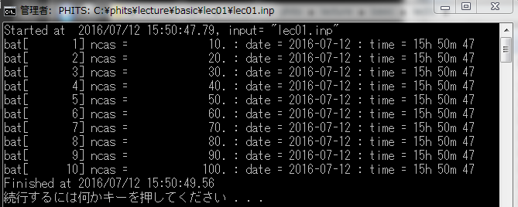
Output Files
batch.out: batch information → Basic lecture III
phits.out: Calculation summary
track_xz.eps: Picture of particle trajectories
track_xz.out: Numerical data of particle trajectories
track_xz_err.eps: Picture of statistical uncertainties
track_xz_err.out: Numerical data of statistical uncertainties
Basic
Lecture
II
Input file name
Calculation progress and time
Terminal output
(Error information is shown up in this screen)
General description

Slide 9
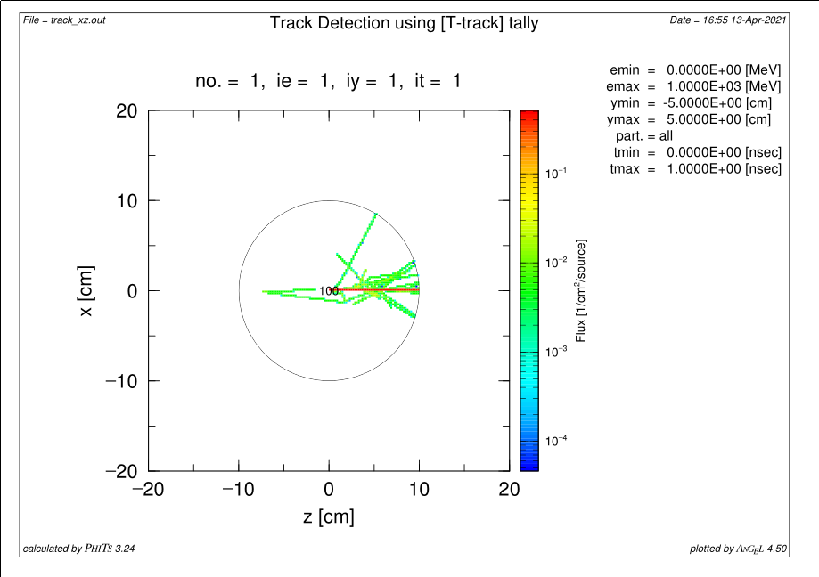
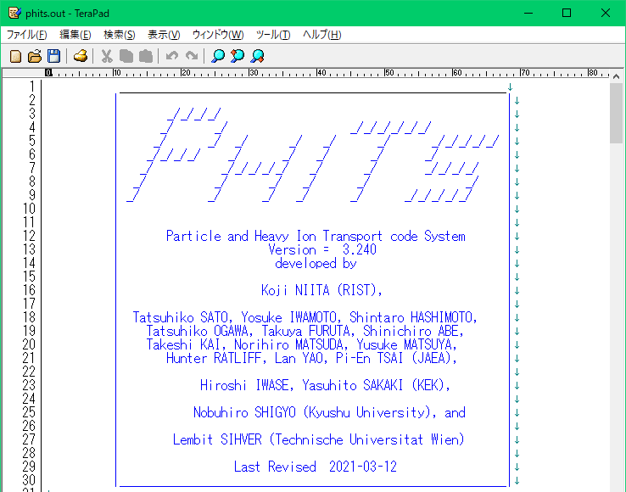
Result of the sample input
track_xz.eps
phits.out
Version Number
Visualization of the result
Summary of the calculation
General description

Slide 10
Output File
phits.out
PHITS Logo + Version information
Input Echo
  Echo of the parameters specified in the input file
  Description of the parameters and their default values
Memory status
  You can check how many memories are used in the calculation
Batch information (You will learn about “Batch” in Lecture 3)
Summary of PHITS simulation
  Numbers of events such as source generation and nuclear reaction occurred
  Information on transported particles
  Numbers of secondary particles
  CPU time
  Numbers of library data access and use of reaction models
Error information is mostly given in the console Window,
but occasionally in the output file!
General description

Slide 11
List of “section”
Section name
[title]
[parameters]
[source]
[material]
[surface]
[cell]
[transform]
[temperature]
[mat time change]
[magnetic field]
[electro magnetic field]
[delta ray]
[track structure]
Section name
[super mirror]
[elastic option]
[frag data]
[importance]
[weight window]
[forced collisions]
[volume]
[multiplier]
[mat name color]
[reg name]
[counter]
[timer]
[end]
※See PHITS manual Sec. 5
General description
Notes:
実際の実験条件を忠実に再現できるように様々なセクションが用意されている。

Slide 12
List of tally
Section name
[t-track]
[t-cross]
[t-point]
[t-deposit]
[t-deposit2]
[t-yield]
[t-product]
[t-dpa]
[t-let]
[t-sed]
Section name
[t-time]
[t-interact]
[t-dchain]
[t-wwg]
[t-wwbg]
[t-userdefined]
[t-gshow]
[t-rshow]
[t-3dshow]
Several tallies can be defined in one calculation to obtain various information on the particle transport.
*See manual sec. 6 for each tally section.
General description
Notes:
興味のある物理量を得ることに適したTally（検出器）が用意されている。

Slide 13
Table of Contents
General Description
Geometry
Source
Summary and Homework
General definition
How to define cells
Definitions of boxes and cylinders
How to add materials
Supporting software
Contents
Notes:
「実習」 前の基本的な話から

Slide 14
General definition
To make a 3-dimensional geometry, follow these three steps:
1) Define materials in [Material]
2) Define surfaces of cells in [Surface]
Water(H₂O)
Aluminum (Al)
sphere surface
cuboid surface
cylinder surface
Combine
3) Define cells with materials in [Cell]
water sphere
aluminum cuboid
water cylinder
Geometry (General definition)

Slide 15

3D virtual space
3D virtual space in PHITS consists of cells defined in XYZ coordinate system.
Z
void
or air
Y
X
outer void
You can use an infinite space.
But, void or air regions have to be defined explicitly. Furthermore, the outer boundary of the virtual space “outer void” has to be defined.
Geometry (General definition)
15
Notes:
XYZ座標系（無限に広がる空間）

Slide 16
Define materials
Written in the order of material number, (atom & composition)…
lec01.inp
[ M a t e r i a l ]
mat[1] H 2 O 1
[ S u r f a c e ]
10 so 10.
[ C e l l ]
100 1 -1.0 -10
101 -1 10
H : O = 2 : 1
⇒ H₂O（water）
Several ways to mix elements
H 2 O 1 (Positive number: Atomic ratio)
H -2/18 O -16/18 (Negative number: mass ratio)
*When elements are specified without mass number, natural isotopic composition is assumed. Following formats are available to specify the mass number.
Element symbol with mass number (e.g., 1H, 16O)
Formula Z*1000+A (e.g., 1001, 8016)
Geometry (General definition)
Notes:
物質を満たす1

Slide 17
Define surfaces
In the order of surface number, shape, parameters
Parameters are in units of “cm”
lec01.inp
[ M a t e r i a l ]
mat[1] H 2 O 1
[ S u r f a c e ]
10 so 10.
[ C e l l ]
100 1 -1. -10
101 -1 10
surface of sphere (so)
centered at the origin of the XYZ coordinate system with a radius of 10 cm
Various types of surfaces are available in PHITS
so, sx, sy, sz, s (Sphere)
px, py, pz (Plane)
cx, cy, cz (Cylinder)
rpp (Rectangular Parallelepiped)
etc. (see Manual 5.5)
Geometry (General definition)
Notes:
球の骨組み

Slide 18
Define cells
In the order of cell number, material number, density, surface numbers
100: Cell number
1 : Material number
-1. : Material density
= 1.0 g/cm³
>0 ⇒ atom density in units 10²⁴ atoms/cm³
<0 ⇒ mass density in units of g/cm³
-10 : Inside surface 10
lec01.inp
[ M a t e r i a l ]
mat[1] H 2 O 1
[ S u r f a c e ]
10 so 10.
[ C e l l ]
100 1 -1.0 -10
101 -1 10
101: Cell number
-1 : Outer void
(density is not necessary)
10 : Outside surface 10
Geometry (General definition)
Notes:
球の骨組み

Slide 19
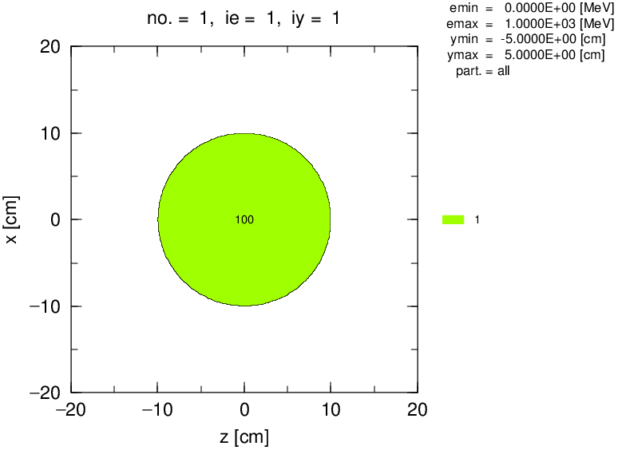
Confirmation of your geometry
lec01.inp
[ P a r a m e t e r s ]
icntl = 8
file(1) = c:/phits
file(6) = phits.out
Set 8
when you confirm
the geometry
Procedure to confirm your geometry
Change “icntl” parameter in the [Parameters] section.
Execute PHITS
See an eps file“track_xz.eps”
Confirm the geometry of lec01.inp.
track_xz.eps
Geometry (General definition)
Notes:
ここまで。
領域の二重定義でエラーが出るはずです。

Slide 20
Exercise 1
Change the radius of the sphere to 20 cm.
lec01.inp
[ M a t e r i a l ]
mat[1] H 2 O 1
[ S u r f a c e ]
10 so 10.
[ C e l l ]
100 1 -1.0 -10
101 -1 10
Geometry (General definition)
Notes:
課題[Surface]セクション
半径5cmの球を作ってみよう。

Slide 21
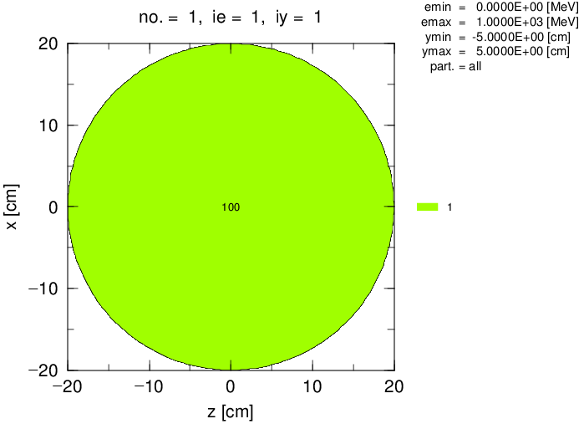
Answers 1
Change the radius of the sphere to 20 cm.
lec01.inp
[ M a t e r i a l ]
mat[1] H 2 O 1
[ S u r f a c e ]
10 so 20.
[ C e l l ]
100 1 -1.0 -10
101 -1 10
track_xz.eps
Is the radius of the sphere 20 cm?
Geometry (General definition)
Notes:
課題[Surface]セクション
半径5cmの球を作ってみよう。

Slide 22
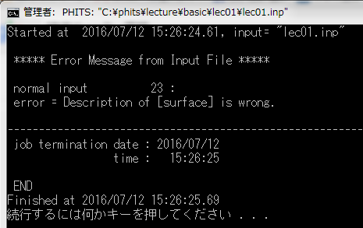
Error message from input file
lec01.inp
[ M a t e r i a l ]
mat[1] H 2 O 1
[ S u r f a c e ]
10 so 20.
[ C e l l ]
100 1 -1.0 -10
101 -1 10
The line number where the mistake was made and its contents are displayed. It may be output to phits.out.
Check contents of the corresponding line number and correct the input file.
Geometry (General definition)
22

Slide 23
About Input File
Every lecture of PHITS tutorial has a lot of exercises, but only one (or a few) input files are included in each folder.
If you would like to skip some exercises, you can use the input files in “input/” folder, such as lec01-2.inp. For example, if you would like to try the exercise 3, use “lec01-3.inp” in the “input/” folder. “lec01-3.inp” includes all the revisions that have been done in the exercises 1 and 2.
Geometry (General definition)

Slide 24
Definition of a new surface
Define a spherical surface whose radius is 5 cm and center is at the origin of the XYZ coordinate system.
“10” in the 1st line of [Surface] section is “surface number”. Use “11” for a new surface.
lec01.inp
[ M a t e r i a l ]
mat[1] H 2 O 1
[ S u r f a c e ]
10 so 20.
11 so 5.
[ C e l l ]
100 1 -1.0 -10
101 -1 10
Geometry (General definition)
Notes:
課題[Cell]セクション
半径5cmの球を作ってみよう。

Slide 25
Exercise 2
Add a spherical water cell with 5 cm radius to the system.
“100” in the 1st line of [Cell] section is “cell number”. Use “102” for a new cell.
lec01.inp
[ M a t e r i a l ]
mat[1] H 2 O 1
[ S u r f a c e ]
10 so 20.
11 so 5.
[ C e l l ]
100 1 -1.0 -10
101 -1 10
102 *** *** ***
Geometry (General definition)
Notes:
課題[Cell]セクション
半径5cmの球を作ってみよう。

Slide 26
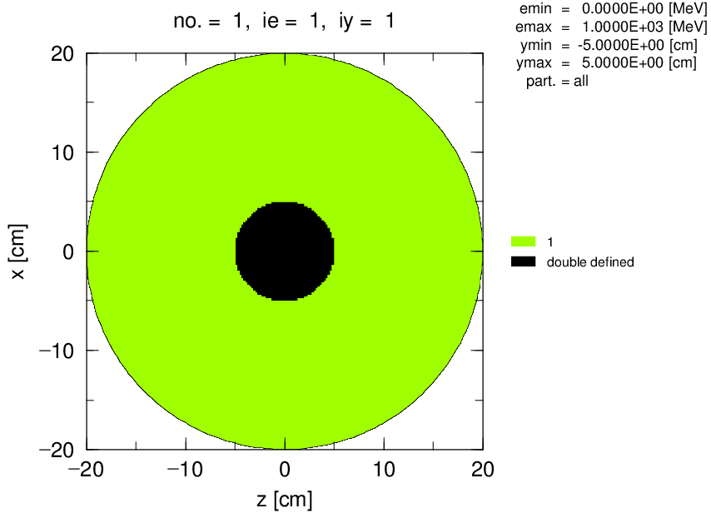
Answer 2
Add a spherical water cell with 5 cm radius to the system.
lec01.inp
[ M a t e r i a l ]
mat[1] H 2 O 1
[ S u r f a c e ]
10 so 20.
11 so 5.
[ C e l l ]
100 1 -1.0 -10
101 -1 10
102 1 -1.0 -11
Part of cell 100 overlaps cell 102.
⇒ Overlapped region!!
track_xz.eps
PHITS always identifies the region in which the particle is crossing, so PHITS gets confused when one location is doubly defined.
(geometry error file: track_xz_geo.out)
Overlapped region is painted in black.
Geometry (General definition)
Notes:
課題[Cell]セクション
半径5cmの球を作ってみよう。

Slide 27
Geometry error file
When a geometry error occurs, PHITS outputs an error file (*_geo.out) to provide detailed information on the error.
track_xz_geo.out
x, y, z coordinates of where the geometry error occurs.
Errors of cell definition in EPS Page No. = 1
Overlapped Cell IDs x, y, z coodinates
(Cells 0 0 indicate undefined region)
100 102 -4.847761E+00 1.234568E-11 -1.211940E+00
100 102 -4.847761E+00 1.234568E-11 -1.009950E+00
100 102 -4.847761E+00 1.234568E-11 -8.079602E-01
・・・ ・・・ ・・・ ・・・
Cell numbers. Error is observed there.
Even if only one error occurs, many lines may show up.
Geometry (General definition)
Notes:
未定義⇔二重定義 おおよそ対をなす言葉。

Slide 28
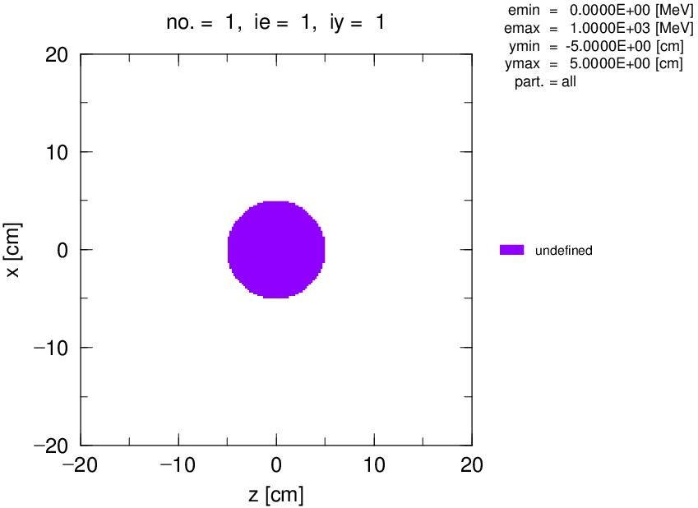
Geometry error (undefined region)
Geometry is defined in an infinite space, but every single point must be filled with certain material (or defined as void).
Undefined region is painted in purple.
(If undefined region is present, the other region does not appear sometimes.)
Geometry (General definition)
Notes:
未定義⇔二重定義 おおよそ対をなす言葉。

Slide 29
Table of Contents
General Description
Geometry
Source
Summary and Homework
General definition
How to define cells
Definitions of boxes and cylinders
How to add materials
Geometry drawing software
Contents
Notes:
「実習」 前の基本的な話から

Slide 30
How to define cells
Cells are defined by surfaces using “plus and minus signs” and “Boolean operators”.
Outside and inside of the surface are defined by putting plus and minus signs, respectively, before the surface number.
+11
(outside the surface 11)
-11
(inside the surface 11)
the surface number 11
Boolean operators
AND
blank intersection operator
OR
: union operator
NOT
# complement operator
Geometry

Slide 31
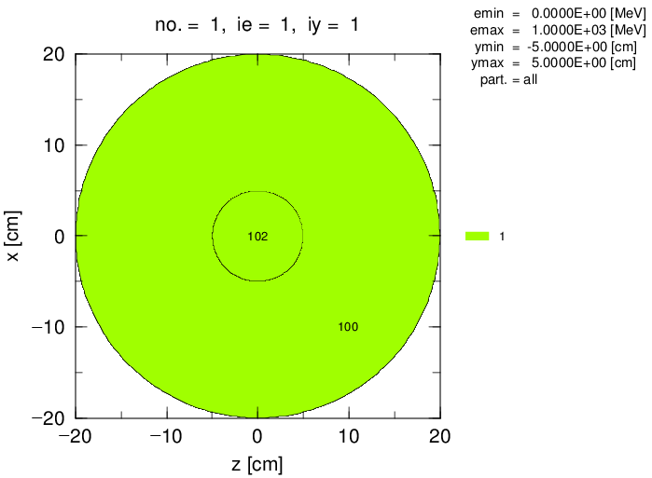
Boolean operator （AND）
To define a cell inside or outside of two surfaces, connect the two numbers with a “blank” (AND).
Add ‘+11’ to the definition of the cell 100.
(+ is omissible.)
lec01.inp
[ M a t e r i a l ]
mat[1] H 2 O 1
[ S u r f a c e ]
10 so 20.
11 so 5.
[ C e l l ]
100 1 -1.0 -10 11
101 -1 10
102 1 -1.0 -11
track_xz.eps
True answer of the 2nd exercise.
Inside of “10”and outside of “11”
Geometry
Notes:
ブール代数（積）の表現

Slide 32
Boolean operator （NOT）
Use NOT (“#”) to exclude a region.
lec01.inp
[ C e l l ]
100 1 -1.0 -10 11
101 -1 10
102 1 -1.0 -11
equivalent
Define with #.
[ C e l l ]
100 1 -1.0 -10 #102
101 -1 10
102 1 -1.0 -11
Exclude the cell number 102 from the inside of the surface 10.
＊Cells are usually defined by using surface numbers, but # must be followed by a cell number.
** Use surface numbers inside “()”. This will be explained later.
Geometry
Notes:
ブール代数（否定）の表現

Slide 33
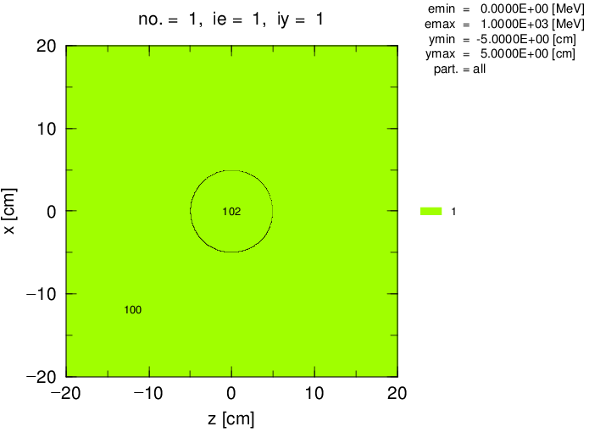
Extension of virtual space
3D virtual space should be large enough to contain all the geometrical components.
Change 20 cm to 500 cm.
lec01.inp
[ M a t e r i a l ]
mat[1] H 2 O 1
[ S u r f a c e ]
10 so 500.
11 so 5.
[ C e l l ]
100 1 -1.0 -10 #102
101 -1 10
102 1 -1.0 -11
track_xz.eps
Geometry

Slide 34
Exercise 3
Where is cell “103?”
lec01.inp
[ M a t e r i a l ]
mat[1] H 2 O 1
[ S u r f a c e ]
10 so 500.
11 so 5.
12 sz 11. 5.
[ C e l l ]
100 1 -1.0 -10 #102 #103
101 -1 10
102 1 -1.0 -11
103 1 -1.0 -12
sphere centered at
(0, 0, 11) in the XYZ coordinates with a radius of 5 cm
track_xz.eps
Geometry
Notes:
課題[Surface]セクション
半径5cmの球をもう1つ追加してみよう。

Slide 35
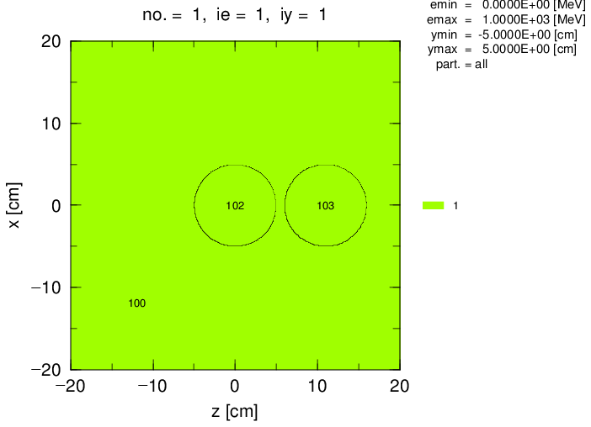
Answer 3
Where is cell “103?”
lec01.inp
[ M a t e r i a l ]
mat[1] H 2 O 1
[ S u r f a c e ]
10 so 500.
11 so 5.
12 sz 11. 5.
[ C e l l ]
100 1 -1.0 -10 #102 #103
101 -1 10
102 1 -1.0 -11
103 1 -1.0 -12
track_xz.eps
Spheres are defined with sx, sy, sz.
Universal expression s is used with the XYZ coordinates of its center and its radius.
Geometry
Notes:
この他に、sx, (sy,) sz が使用できます。
（汎用表現はsでXYZ座標と半径の数値入力が必要となります。）
数値を変えることで中心座標と半径を変えることができます。

Slide 36
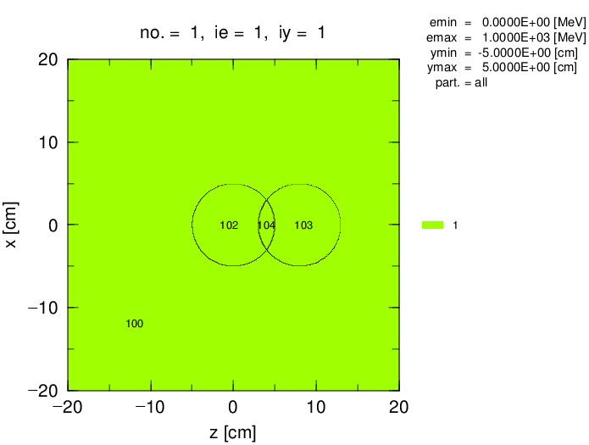
Exercise 4
Correct a geometry error.
lec01.inp
[ S u r f a c e ]
10 so 500.
11 so 5.
12 sz 8. 5.
[ C e l l ]
100 1 -1.0 -10 #102 #103
101 -1 10
102 1 -1.0 -11
103 1 -1.0 -12
Change the center of this sphere
An overlap of the two spheres causes the geometry error (overlapped region).
← Let’s exclude this overlap region from cells 102 and 103, and create a new cell 104
Expected result
track_xz.eps
Geometry
Notes:
球が重なる場合

Slide 37
Answer 4
Correct a geometry error.
lec01.inp
[ S u r f a c e ]
10 so 500.
11 so 5.
12 sz 8. 5.
[ C e l l ]
100 1 -1.0 -10 #102 #103 #104
101 -1 10
102 1 -1.0 -11 12
103 1 -1.0 -12 11
104 1 -1.0 -11 -12
An example of the answers
track_xz.eps
Geometry
Notes:
球が重なる場合

Slide 38
Boolean operator （OR）
To define a sum of two regions as a cell, connect the two numbers with “:” (OR) sign.
lec01.inp
[ C e l l ]
100 1 -1.0 -10 #102 #103 #104
101 -1 10
102 1 -1.0 -11 12
103 1 -1.0 -12 11
104 1 -1.0 -11 -12
equivalent
[ C e l l ]
100 1 -1.0 -10 #(-11 : -12)
101 -1 10
102 1 -1.0 -11 12
103 1 -1.0 -12 11
104 1 -1.0 -11 -12
Boolean operator “OR” is expressed by “:”.
*You have to use surface numbers inside “#()”.
Geometry (Boolean Operator)
Notes:
ブール代数（和）の表現

Slide 39
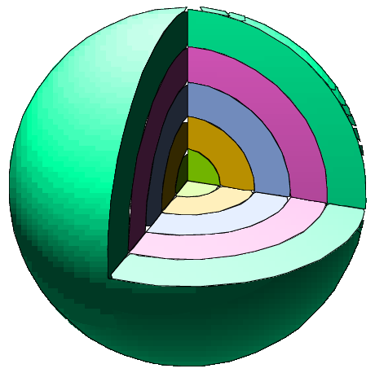
A bad example of using unnecessary #’s
input/onion.inp
Onion geometry
[ M a t e r i a l ]
mat[1] H 2 O 1
[ S u r f a c e ]
11 so 5.
12 so 10.
13 so 15.
14 so 20.
15 so 25.
[ C e l l ]
101 1 -1. -11
102 1 -1. -12 #101
103 1 -1. -13 #101 #102
104 1 -1. -14 #101 #102 #103
105 1 -1. -15 #101 #102 #103 #104
106 -1 15
[ M a t e r i a l ]
mat[1] H 2 O 1
[ S u r f a c e ]
11 so 5.
12 so 10.
13 so 15.
14 so 20.
15 so 25.
[ C e l l ]
101 1 -1. -11
102 1 -1. 11 -12
103 1 -1. 12 -13
104 1 -1. 13 -14
105 1 -1. 14 -15
106 -1 15
NOT(#) is convenient, but too many #’s can cause slow tracking.
Think twice if the geometry can be defined by simpler expressions using “AND” and “OR”.
Geometry (Boolean Operator)
Notes:
ミルフィーユ（たまねぎ）体系
コード内では、セル番号の否定はすべて展開されています。
空間認識に係る負荷は、計算速度に関係してきますので注意が必要です。

Slide 40
Table of Contents
General Description
Geometry
Source
Summary and Homework
General definition
How to define cells
Definitions of boxes and cylinders
How to add materials
Geometry drawing software
Contents
Notes:
「実習」 前の基本的な話から

Slide 41
How to make a box
Boxes can be defined using rpp (rectangular parallelepiped)
[ S u r f a c e ]
・
・
・
13 rpp x_{min} x_{max} y_{min} y_{max} z_{min} z_{max}
Z
z_{max}
Y
x_{min}
X
z_{min}
x_{max}
y_{min}
y_{max}
Set the lower and upper boundaries of x, y, z coordinates to define boxes.
*rpp is defined in the [surface] section, because rpp corresponds to 6 surfaces of the box.
Geometry
Notes:
《休憩はさむ》
直方体を作る。
XYZ座標系はある意味固定されているものなので、
空間をぶった切る“平面”の組み合わせで直方体を作ります。

Slide 42
Exercise 5
Let’s define a 10-cm cube centered at (0, 0, -11) using rpp.
Set x_{min} = y_{min} = -5.0 cm, and x_{max} = y_{max} = 5.0 cm
Set z_{min} = -16.0 cm, and z_{max} = -6.0 cm
Define the inside of the surface specified by rpp as a cell using a symbol -(minus).
lec01.inp
[ C e l l ]
100 1 -1.0 -10 #102 #103 #104 ***
101 -1 10
102 1 -1.0 -11 12
103 1 -1.0 -12 11
104 1 -1.0 -11 -12
105 1 -1.0 ***
[ S u r f a c e ]
10 so 500.
11 so 5.
12 sz 8. 5.
13 rpp *** *** *** *** *** ***
Let’s execute PHITS and see the result to confirm whether a cube is correctly defined or not.
Geometry

Slide 43

Answer 5
Let’s define a 10cm cube centered at (0, 0, -11) using rpp.
lec01.inp
[ S u r f a c e ]
10 so 500.
11 so 5.
12 sz 8. 5.
13 rpp -5. 5. -5. 5. -16. -6.
[ C e l l ]
100 1 -1.0 -10 #102 #103 #104 #105
101 -1 10
102 1 -1.0 -11 12
103 1 -1.0 -12 11
104 1 -1.0 -11 -12
105 1 -1.0 -13
track_xz.eps
Geometry

Slide 44
Cells divided by a plane
y
lec01.inp
[ S u r f a c e ]
10 so 500.
11 so 5.
12 sz 8. 5.
13 rpp -5. 5. -5. 5. -16. -6.
14 px 3.0
3
x
ｐｘ：plane perpendicular to X-axis
z
ｐｘ 3.0
[ C e l l ]
100 1 -1.0 -10 #102 #103 #104 #105
101 -1 10
102 1 -1.0 -11 12 -14
103 1 -1.0 -12 11
104 1 -1.0 -11 -12
105 1 -1.0 -13
－side
＋side
X=x₀
X axis
To distinguish the two regions divided by a plane, use symbols “+” or “-”.
Let’s add red texts and then execute PHITS.
Geometry

Slide 45
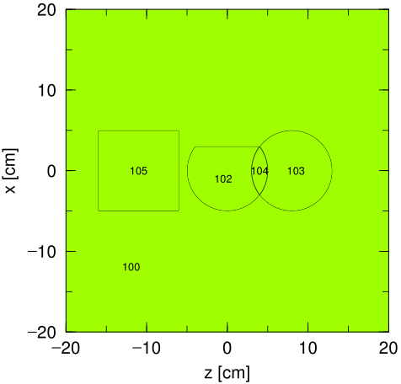
Cells divided by a plane
lec01.inp
[ S u r f a c e ]
10 so 500.
11 so 5.
12 sz 8. 5.
13 rpp -5. 5. -5. 5. -16. -6.
14 px 3.0
ｐｘ：Plane perpendicular to X-axis
[ C e l l ]
100 1 -1.0 -10 #102 #103 #104 #105
101 -1 10
102 1 -1.0 -11 12 -14
103 1 -1.0 -12 11
104 1 -1.0 -11 -12
105 1 -1.0 -13
track_xz.eps
Cell 102: inside of the surface 11 “AND” outside of the surface 12 “AND” negative region of the surface 14.
(The positive region of the surface 14
in the sphere with the 5-cm radius is cut.)
py and pz are also available.
*Be careful of the meaning of plus and minus when you use planes.
Geometry

Slide 46
How to make a cylinder
A cylinder is defined using an infinite cylindrical tube and two planes
Geometry
Notes:
円柱を作る。
XYZ座標系はある意味固定されているものなので、
円柱と、空間をぶった切る“平面”の組み合わせで円柱を作ります。

Slide 47
Exercise 6
Let’s define a cylinder.
Add red texts in the [surface] and [cell] sections.
The cell 106 overlaps the cells 100, 102, 103, 104 and 105.
lec01.inp
[ S u r f a c e ]
10 so 500.
11 so 5.
12 sz 8. 5.
13 rpp -5. 5. -5. 5. -16. -6.
14 px 3.0
15 cz 1.
16 pz -19.
17 pz 19.
[ C e l l ]
100 1 -1.0 -10 #102 #103 #104 #105 ***
101 -1 10
102 1 -1.0 -11 12 -14 ***
103 1 -1.0 -12 11 ***
104 1 -1.0 -11 -12 ***
105 1 -1.0 -13 ***
106 1 -1.0 *** *** ***
New cell should be excluded
The inside and outside correspond to “-” and “+” symbols, respectively.
Let’s execute PHITS and see the result to confirm whether a cylinder is correctly defined or not.
Geometry

Slide 48
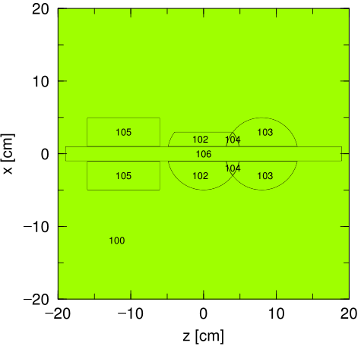
Answer 6
Let’s define a cylinder.
lec01.inp
[ S u r f a c e ]
10 so 500.
11 so 5.
12 sz 8. 5.
13 rpp -5. 5. -5. 5. -16. -6.
14 px 3.0
15 cz 1.
16 pz -19.
17 pz 19.
cell 107: a cylinder with a radius of 1.0 cm and a height of 38 cm.
[ C e l l ]
100 1 -1.0 -10 #102 #103 #104 #105 #106
101 -1 10
102 1 -1.0 -11 12 -14 #106
103 1 -1.0 -12 11 #106
104 1 -1.0 -11 -12 #106
105 1 -1.0 -13 #106
106 1 -1.0 -15 16 -17
track_xz.eps
Geometry

Slide 49
Rearrange Cell & Surface numbers
While you define geometries, it is useful to rearrange the cell and surface numbers according to your rules.
lec01.inp
[ S u r f a c e ]
999 so 500.
11 so 5.
12 sz 8. 5.
101 px 3.
111 pz -19.
112 pz 19.
201 cz 1.
301 rpp -5. 5. -5. 5. -16. -6.
[ C e l l ]
100 1 -1.0 -999 #102 #103 #104 #105 #106
101 -1 999
102 1 -1.0 -11 12 -101 #106
103 1 -1.0 -12 11 #106
104 1 -1.0 -11 -12 #106
105 1 -1.0 -301 #106
106 1 -1.0 111 -112 -201
For example,
rearrange the numbers in an ascending order in each px, py, pz.
Geometry

Slide 50
Table of Contents
General Description
Geometry
Source
Summary and Homework
General definition
How to define cells
Definitions of boxes and cylinders
How to add materials
Geometry drawing software
Contents
Notes:
「実習」 前の基本的な話から

Slide 51
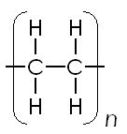
How to add materials
Add a new material number and define a composition ratio of the material in [material] section.
(Density is given in [cell] section.)
gold（density: 19.32 g/cm³）
Au 1
copper（density: 8.93 g/cm³）
Cu 1
air（density: 1.20x10⁻³ g/cm³）
N 8 O 2
polyethylene（density: 0.9 g/cm³）
C 2 H 4
Geometry (How to add material)
Notes:
体系の数が多くなったので・・・
金（同位体なし）
銅（天然存在比）
空気（我々の世界ではなくてはならないものだが、コンピューターの世界では1物質）⇔真空
ポリエチレン（化学形による比率）←真空0でも良い。

Slide 52
Exercise 7
Change the material of the cell “106”.
Element symbol of copper is Cu. Density of copper is 8.93 g/cm³
Define the material number 2 in [material] section and the material is used in [cell] section.
lec01.inp
[ M a t e r i a l ]
mat[1] H 2 O 1
mat[2] ******
・・・ ・・・ ・・・ ・・・
[ C e l l ]
100 1 -1.0 -10 #102 #103 #104 #105 #106
101 -1 10
102 1 -1.0 -11 12 -14 #106
103 1 -1.0 -12 11 #106
104 1 -1.0 -11 -12 #106
105 1 -1.0 -13 #106
106 1 -1.0 -15 16 -17
*Each material (number) has its own color.
Execute PHITS and see the result.
Geometry (How to add material)
Notes:
物質を入れ替える。
同番号は同色

Slide 53
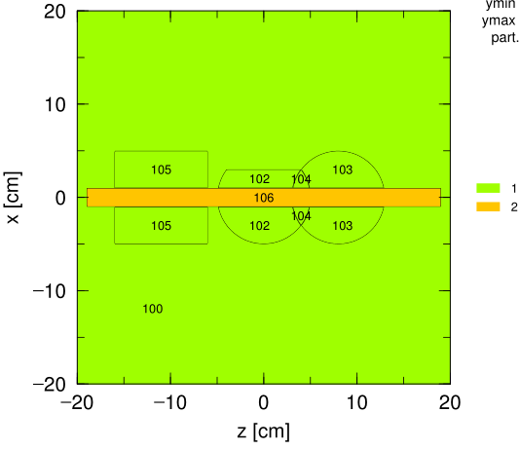
Answer 7
Change the material in the cell “106”.
lec01.inp
[ M a t e r i a l ]
mat[1] H 2 O 1
mat[2] Cu 1
・・・ ・・・ ・・・ ・・・
[ C e l l ]
100 1 -1.0 -10 #102 #103 #104 #105 #106
101 -1 10
102 1 -1.0 -11 12 -14 #106
103 1 -1.0 -12 11 #106
104 1 -1.0 -11 -12 #106
105 1 -1.0 -13 #106
106 2 -8.93 -15 16 -17
Natural isotopic composition is presumed.
track_xz.eps
Geometry (How to add material)
Notes:
物質を入れ替える。
同番号は同色

Slide 54
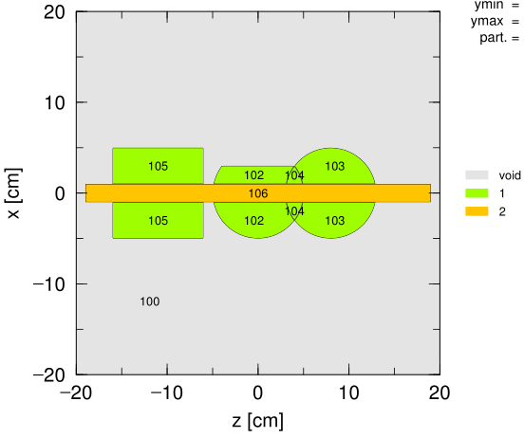
How to make void cells
Material number for void (inner void) = 0
(Material number for outer void = -1)
Skip density definition of void cells!
lec01.inp
[ C e l l ]
100 0 -10 #102 #103 #104 #105 #106
101 -1 10
102 1 -1.0 -11 12 -14 #106
103 1 -1.0 -12 11 #106
104 1 -1.0 -11 -12 #106
105 1 -1.0 -13 #106
106 2 -8.93 -15 16 -17
Define the cell 100 as void,
and then execute PHITS.
track_xz.eps
Geometry (How to add material)
Notes:
物質を入れ替える。
同番号は同色

Slide 55
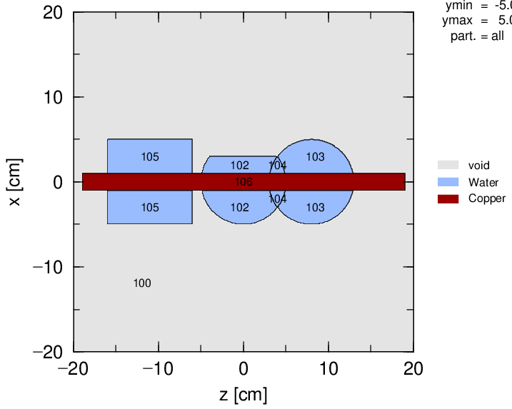
Change the colors
lec01.inp
[ M a t N a m e C o l o r ]
mat name color
1 Water pastelblue
2 Copper darkred
You can specify the name and color of each material (number).
Notice!
Characters are case sensitive only in this section.
You have to specify the color name in small character.
track_xz.eps
Geometry (Change material colors)
55
Notes:
物質の色を変える。

Slide 56
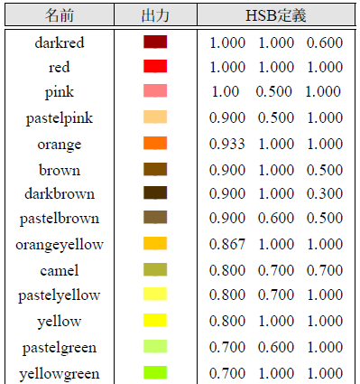
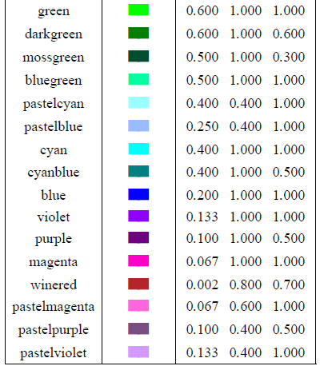
Color definition
Definition in Angel
Geometry (Change material colors)

Slide 57
Table of Contents
General Description
Geometry
Source
Summary and Homework
General definition
How to define cells
Definitions of boxes and cylinders
How to add materials
Geometry drawing software
Contents
Notes:
「実習」 前の基本的な話から

Slide 58
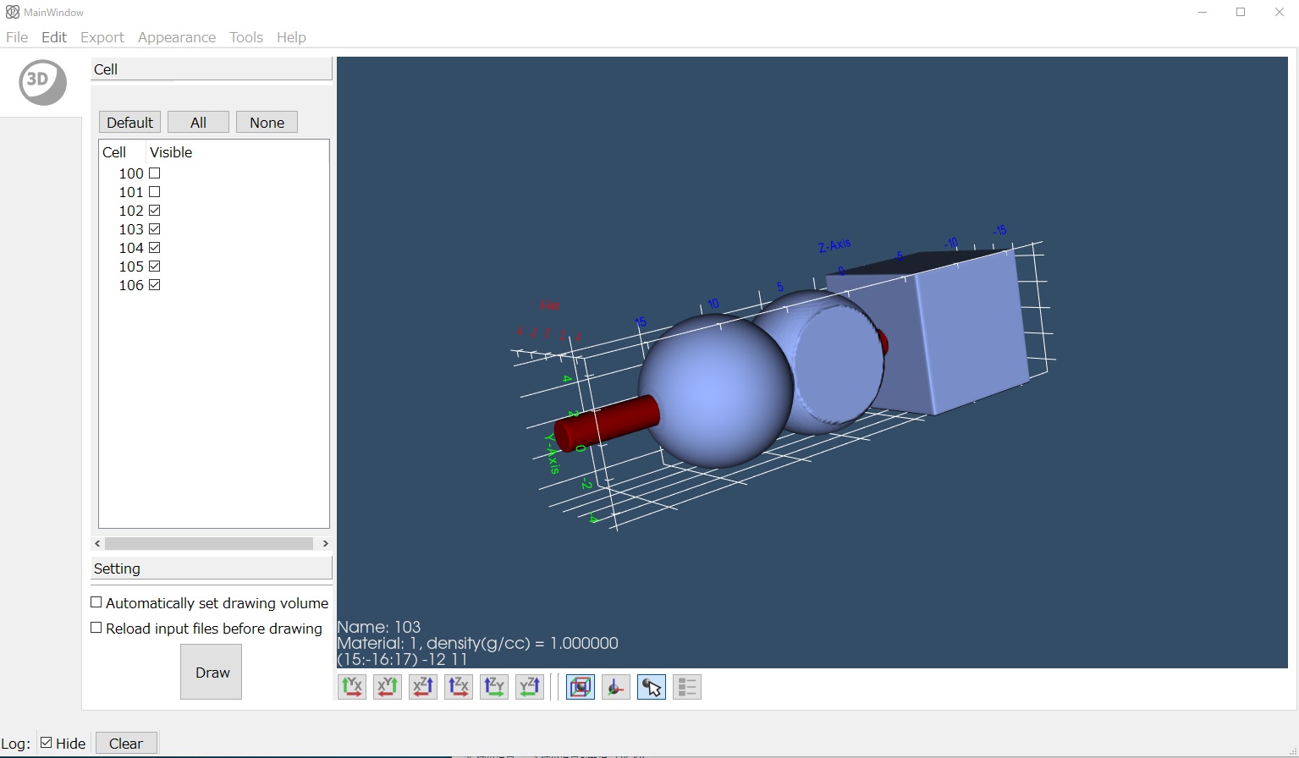
Confirmation of geometry with PHIG-3D
Let’s see the geometry in 3D view by using PHIG-3D.
PHITS Interactive Geometry Viewer in 3D (PHIG-3D) :
Input geometry visualization software for PHITS
S.Ohnish, SoftwareX, 14, 100681 (2021).
Details are in the PHIG-3D manual in the folder (phits/phig3d/manual).
An example of an output after mouse operation
Windows: Right-click the PHITS input file, and select “Send to” -> “PHIG-3D”.
MacOS: Drag and drop the PHITS input file to the PHIG-3D icon in the Dock*
Linux: In the terminal, move to the folder with the PHITS input file (e.g.: phits.inp), and type “phig3d.sh phits.inp”.
*If you get an unidentified developer error, you have to open the icon of PHIG-3D as well as “phits/phig3d/macos-x86_64/phig3d_mac” with pressing “ctrl” key
58

Slide 59
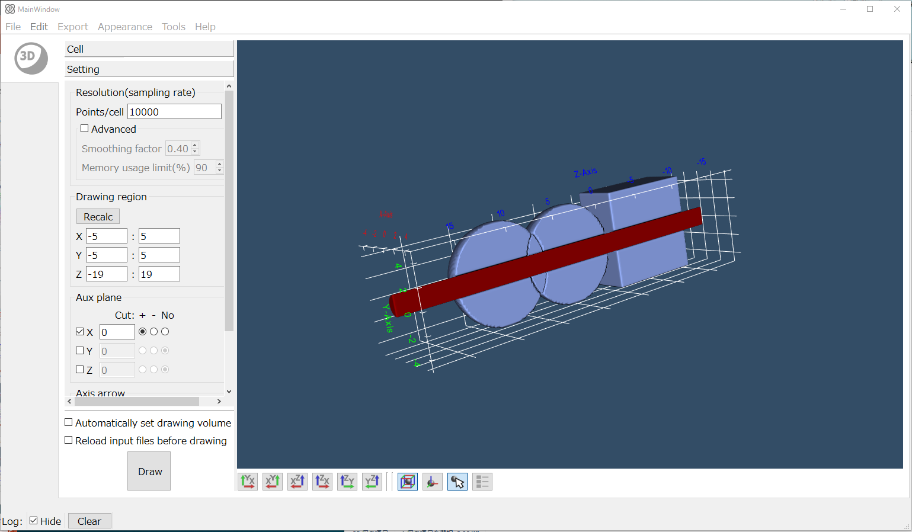
Cut of a cross section with an auxiliary plane
“Setting pane”
“Draw”
Result of a cutting plane at x=0 cm.
Select the setting pane -> Check the X box in the aux plane -> Select + with a radio button -> Click “Draw”
The cross section is displayed.
Geometry (3D plot with PHIG-3D)
59
Notes:
Cut a geometry with up to three planes. Here a plane is perpendicular to the x, y, and z axes, respectively. A plane is enabled/disabled with its check box. With a radio button, you can select to “cut a plane with a plus side/ cut a plane with a minus side/display a position of a plane without cutting”

Slide 60
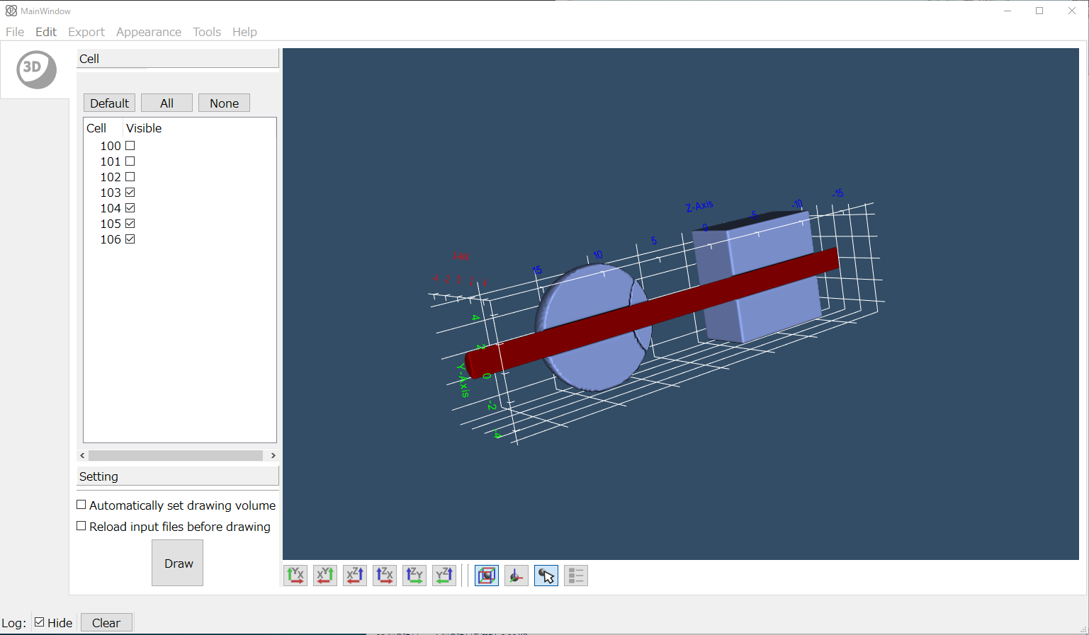
Select cells for visualization
“Cell pane”
“Draw”
Result of a cutting plane at x=0 cm.
Select the cell pane-> Uncheck the checkbox of cell 102 -> Click “Draw”
Cell 102 is not displayed.
Geometry (3D plot with PHIG-3D)
60
Notes:
After an input file is read, the list of cells is displayed in the cell pane. We can select cells for visualization in the cell plane.

Slide 61
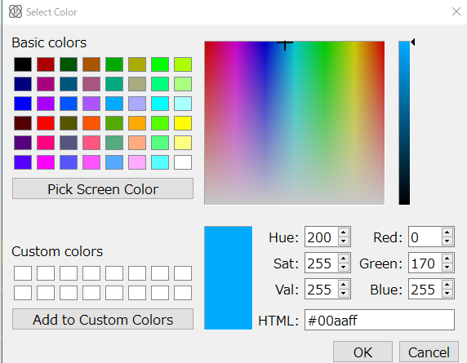
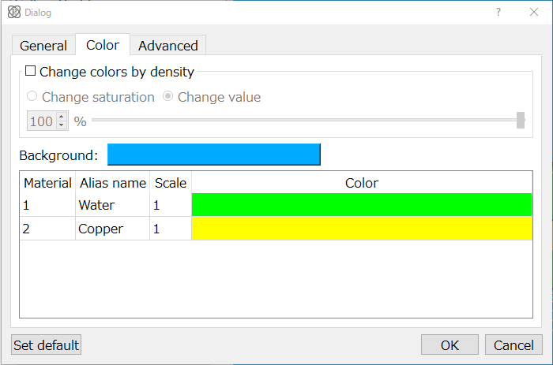
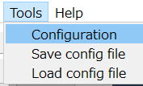
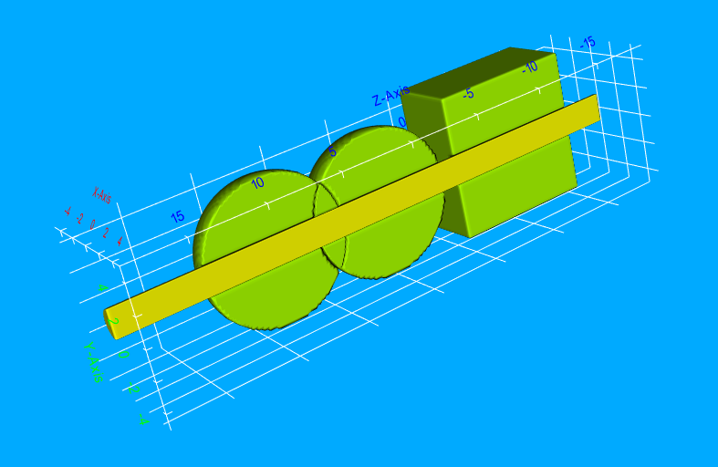
Change the colors
“Color tab”
Select “Tools-Configuration” in the menu bar -> Select colors of background / materials in the color tab -> Click “OK”.
Result after changing colors
*Changing the colors is available with the [ Mat Name Color ] section in PHITS.
Geometry (3D plot with PHIG-3D)
61
Notes:
The color table in the lower part of this dialog sets the name of materials and another name corresponding to them (name in legend), display scale of legend and their color. These setting parameters correspond to the [Mat Name Color] section in PHITS.

Slide 62
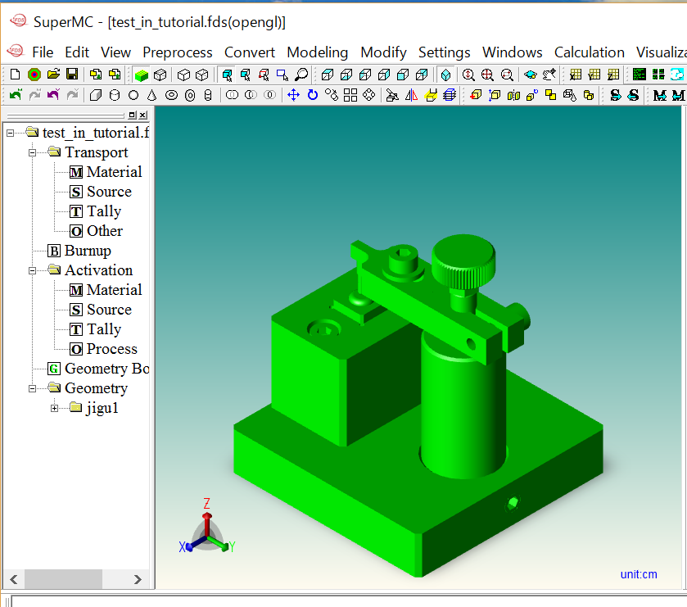
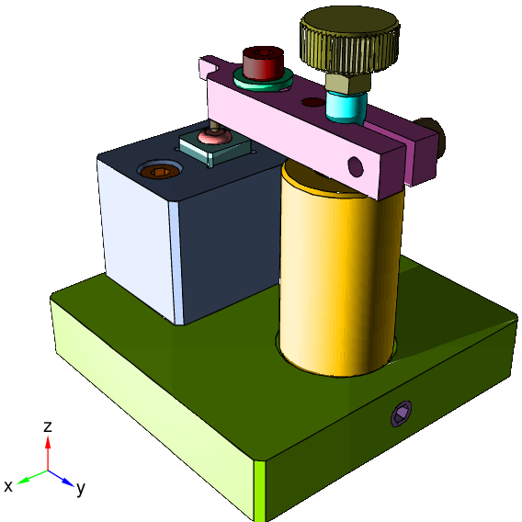
SuperMC
A free software developed by the FDS team at the Chinese academic of Science (registration required)
Software to convert CAD geometry into several MC code format (MCNP, FLUKA, GEANT4, TORIPOLI & PHITS)
Compatible CAD formats are *.sat, *.sab, *.stp &*.step
Instruction only available in Japanese at the moment
SuperMC + PHITS sample (utility\SuperMC)
https://www.oecd-nea.org/tools/abstract/detail/iaea1437/
To obtain license, utility\SuperMC\license\FirstEmail.txt

Slide 63
Table of Contents
General Description
Geometry
Source
Summary and Homework
General definition
How to define cells
Definitions of boxes and cylinders
How to add materials
Geometry drawing software
Contents
Notes:
「実習」 前の基本的な話から

Slide 64
Main components of an input
In the PHITS simulation, geometry in 3-dimensional virtual space and information on source particles are essential to tally various quantities of the particles.
⇒ ① Geometry
② Source
③ Tally
[Source]
define source
Source
Notes:
《休憩はさむ》
次は[Source]セクション（線源）の話です。

Slide 65
Types of sources
Radio-Isotope (RI) facilities
→ Point isotropic source
Accelerator facilities
→ Pencil or broad beam to certain direction
→ Cone beam source
Radioactive waste and internal exposure
→ Volume isotropic source
Cosmic-ray and external exposure
→ Isotropic irradiation within certain area
Source
Notes:
放射状かビーム状に大きく分類されます。
（放射線の名の由来通り）

Slide 66
Definition of sources
Shape of source distribution
← spatial distributions
(point, cylindrical, spherical etc.)
Energy of source particle
← mono-energy or having a spectrum
Source particle species
← neutron, photon, proton, heavy-ion etc.
Direction of source particle
← isotropic, directional, cone shape etc.
Source
Notes:
基本的な3要素になります。

Slide 67
Shape of source particles
lec01.inp
[ S o u r c e ]
s-type = 1
proj = proton
dir = 1.0
r0 = 0.0
z0 = 0.
z1 = 0.
e0 = 150
[ S o u r c e ] section
: definition of sources
s-type: Define source type
= 1 cylindrical shape
What information is required to define a cylinder?
Source

Slide 68
Definition of a cylinder source
Z0: minimum Z
Z1: maximum Z
r0: radius of cylinder
Z-axis
（r1: inner radius）
X,Y coordinates of center position: （x0, y0）
The default direction of PHITS is +z.
Source

Slide 69
Extension of cylinder source
Z-axis
Z-axis
Z-axis
z0 = z1
e.g.
z0 = 5.0
z1 = 5.0
z0 = z1
r0 = 0.0
Cylinder
Disk
Point
(Note) Source disk or points should not be set on boundaries of cells
Source

Slide 70
Exercise 8
Execute the transport calculation.
lec01.inp
[ P a r a m e t e r s ]
icntl = 0
file(1) = c:/phits
file(6) = phits.out
Transport
calculation
[ S o u r c e ]
s-type = 1
proj = proton
dir = 1.0
r0 = 0.
z0 = 0.
z1 = 0.
e0 = 150
Point source at the origin (0,0,0)
[ T - T r a c k ]
・・・ ・・・ ・・・ ・・・
t-type = 2
nt = 10
tmin = 0.
tmax = 1.
Output of transport from 0 to 1 nsec, in 0.1 nsec increments.
track_xz.eps has 10 pages
*In GSview, you can switch the pages of *.eps by space and backspace keys
Source
70
Notes:
サンプルインプットの結果

Slide 71
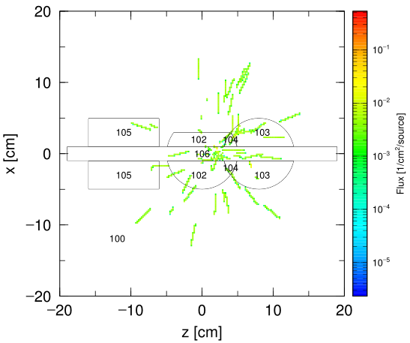
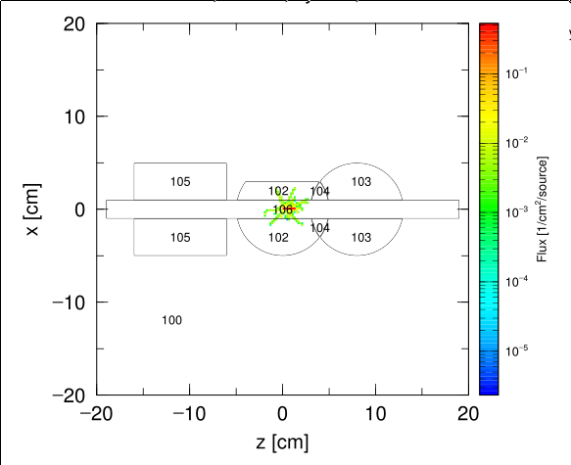
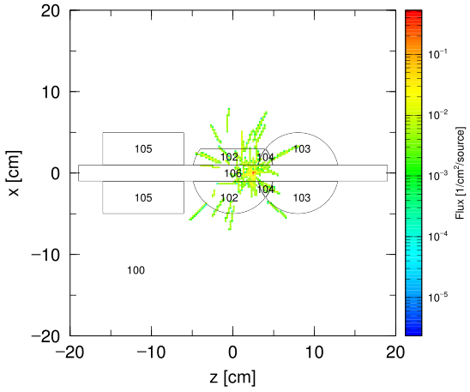
Answer 8
Execute the transport calculation.
lec01.inp
[ P a r a m e t e r s ]
icntl = 0
file(1) = c:/phits
file(6) = phits.out
Transport
calculation
[ S o u r c e ]
s-type = 1
proj = proton
dir = 1.0
r0 = 0.
z0 = 0.
z1 = 0.
e0 = 150
Point source at the origin (0,0,0)
[ T - T r a c k ]
・・・ ・・・ ・・・ ・・・
t-type = 2
nt = 10
tmin = 0.
tmax = 1.
Output of transport from 0 to 1 nsec, in 0.1 nsec increments.
track_xz.eps
(1 page[0nsec～0.1nsec])
track_xz.eps
(3 page[0.2nsec～0.3nsec])
track_xz.eps
(5 page[0.4nsec～0.5nsec])
Source
71
Notes:
サンプルインプットの結果

Slide 72
Exercise 9
Make a disk source with a radius of 1 cm.
lec01.inp
[ S o u r c e ]
s-type = 1
proj = proton
dir = 1.0
r0 = 0.
z0 = 0.
z1 = 0.
e0 = 150
Source
Notes:
課題[Source]セクション

Slide 73
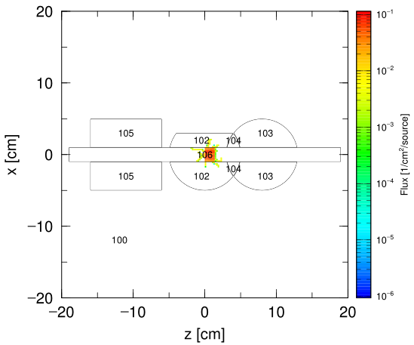
Answer 9
Make a disk source with a radius of 1 cm.
lec01.inp
[ S o u r c e ]
s-type = 1
proj = proton
dir = 1.0
r0 = 1.
z0 = 0.
z1 = 0.
e0 = 150
The radius of the beam is 1cm.
track_xz.eps
(1 page[0nsec～0.1nsec])
Source
Notes:
課題[Source]セクション

Slide 74
Energy distribution of source particles
Mono-energy:
the energy is defined by e0.
Energy spectrum:
the distribution is defined by e-type subsection.
(For details;
lecture\advanced\sourceA
or Manual 5.3.19)
lec01.inp
[ S o u r c e ]
s-type = 1
proj = proton
dir = 1
r0 = 1.0
z0 = 0.
z1 = 0.
e0 = 150
In units of “MeV/nucleon”
(MeV per nucleons)
Source

Slide 75
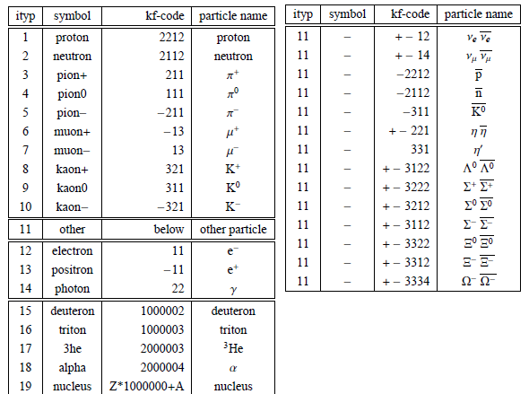
Source particle species
lec01.inp
[ S o u r c e ]
s-type = 1
proj = proton
dir = 1
r0 = 1.0
z0 = 0.
z1 = 0.
e0 = 150
proj: particle species
Both ‘symbol’ and ‘kf-code’ are available.
To use radioisotope sources, specify the particle species, such as ‘photon’.
nucleus is specified by
(mass number)+(element symbol)
e.g., 12C
Source

Slide 76
Exercise 10
Define a neutron source at 100 MeV.
lec01.inp
[ S o u r c e ]
s-type = 1
proj = proton
dir = 1.0
r0 = 1.
z0 = 0.
z1 = 0.
e0 = 150
Source
Notes:
課題[Source]セクション

Slide 77
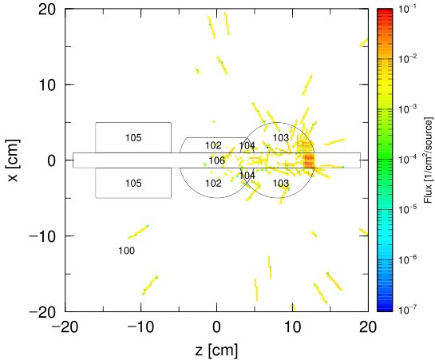
Answer 10
Define a neutron source at 100 MeV.
lec01.inp
[ S o u r c e ]
s-type = 1
proj = neutron
dir = 1.0
r0 = 1.
z0 = 0.
z1 = 0.
e0 = 100
Neutrons penetrate materials unlike protons.
track_xz.eps
(10 page[0.9nsec～1nsec])
Source
Notes:
課題[Source]セクション

Slide 78
Direction of source particles
The direction is defined in the spherical coordinate system.
Z-axis is the default direction in PHITS.
Defined by polar angle (dir), azimuthal angle (phi), and beam spread (dom).
dir = 1.0
dir: cosine of the angle between the pointing direction and the z-axis
e.g. θ =0 (deg): dir=1.0.
θ =90 (deg): dir=0.0
Special: dir=all; isotropic source
Z-axis
θ (deg)
dir = cosθ
Source

Slide 79
Direction of source particles
The direction is defined in the spherical coordinate system.
Z-axis is the default direction in PHITS.
Defined by polar angle (dir), azimuthal angle (phi), and beam spread (dom).
X-axis
φ (deg)
phi (φ in units of degrees): counterclockwise angle between the +x-axis and the projection onto the xy-plane
e.g. the direction tilted by 45 degrees from the +x-axis on the xy-plane:
dir=0.0, phi=45
Z-axis
Y-axis
Source

Slide 80
Direction of source particles
The direction is defined in the spherical coordinate system.
Z-axis is the default direction in PHITS.
Defined by polar angle (dir), azimuthal angle (phi), and beam spread (dom).
dom: solid angle Ω (degree)
e.g. a beam spread of 30 degrees: dom=30
Ω (deg)
Source

Slide 81
Source direction and parameters
Relation of dir, phi, and dom in the spherical coordinate system
X-axis
Ω =dom
φ =phi
cosθ =dir
θ
Z-axis
Y-axis
Source

Slide 82
Exercise 11
Define an isotropic point source at the XYZ coordinate （0, 0, 10）.
lec01.inp
[ S o u r c e ]
s-type = 1
proj = neutron
dir = 1.0
r0 = 1.
z0 = 0.
z1 = 0.
e0 = 100
When s-type=1, you can set an isotropic source by setting dir=all.
Source
Notes:
課題[Source]セクション

Slide 83
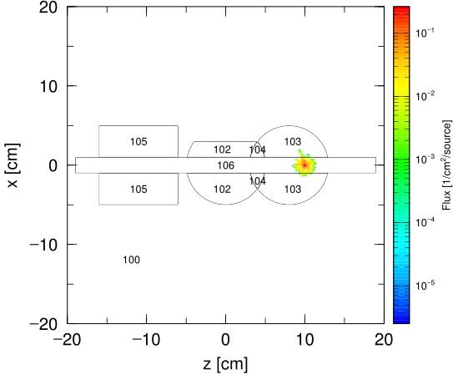
Answer 11
Let’s set a point isotropic source at the XYZ coordinate （0, 0, 10）.
lec01.inp
[ S o u r c e ]
s-type = 1
proj = neutron
dir = all
r0 = 0.
z0 = 10.
z1 = 10.
e0 = 100
When s-type=1, you can set a isotropic source by setting dir=all.
track_xz.eps
(1 page[0nsec～0.1nsec])
Source
Notes:
課題[Source]セクション

Slide 84
Table of Contents
General Description
Geometry
Source
Summary and Homework
General definition
How to define cells
Definitions of boxes and cylinders
How to add materials
Geometry drawing software
Contents
Notes:
「実習」 前の基本的な話から

Slide 85
Summary
The main components of a PHITS input file are “Geometry”, “Source” and “Tally”
“Geometry” is defined by [material], [surface] and [cell] sections, and you can define various 3D geometrical components based on the GG concept
“Source” is defined by shape, species, energy and direction of the particles
“Tally” is used to calculate the quantities in PHITS radiation transport calculation.
You will learn more about “Tally” in phits-lec02-en.ppt
Summary
Notes:
《休憩はさむ》
まとめ

Slide 86
Homework #1 (Geometry)
Delete cell 1 (Aluminum sphere)
Make a cylinder with a 10 cm radius and a 50 cm height (starting at z = 0 cm) filled with water. The outside of the cylinder is void (do not change cell 100 & 101)
Confirm the geometry (icntl = 8)
3D space
Y-axis
R-axis
cz
cz
X-axis
Z-axis
pz
pz
Start with “Phits\lecture\basic\homework\homework1.inp”
Homework
Notes:
宿題（3次元体系）

Slide 87
Homework (source)
Set a proton beam at 290 MeV/u with a 2.5 cm radius, incident from the bottom of the cylinder
Execute the transport calculation (icntl = 0)
3D space
Y-axis
R-axis
cz
source
cz
X-axis
Z-axis
pz
pz
Homework
Notes:
宿題（線源）

Slide 88
Example Answer
xz_track.eps
Sum of the proton and neutron trajectories
Homework

