Slide 1
PHITS
Multi-Purpose Particle and Heavy Ion Transport code System
variance reduction techniques to improve efficiency of calculation A
August 2018 revised

Slide 2
Contents of Lecture
１．Introduction
２．Neutron deep penetration calculation
[importance]
Geometry splitting and Russian Roulette
３．Calculation of particle production in thin target
[forced collision]

Slide 3
Neutron deep penetration calculation
Calculate neutron transport in thick shield
and dose rate distribution to depth
imp.inp
Execute “imp.inp” and measure computational time
Number of history: 1,500
you can find CPU time in phits.out “total CPU time”.
[ P a r a m e t e r s ]
icntl = 0
maxcas = 8000
maxbch = 1
...
[ T - T r a c k ] (3rd)
mesh = xyz
…
axis = xz
z-txt = Effective dose [pSv/source]
file = imp-dose-xz.out
part = neutron
epsout = 1
gshow = 1
multiplier = all
mat mset1
all ( 1.0 -202 )
Concrete
50cm radius x 180 cm thick cylinder
Air
14 MeV neutron
Effective dose is obtained by multiplying neutron fluence by dose conversion coefficient in PHITS.

Slide 4
Calculation of effective dose
Fluence calculated by [t-track] can be multiplied with several functions that are pre-defined or defined in [multiplier] section
Excerpt of data for dose conversion coefficient in /phits/data/multiplier
[ T - T r a c k ] (2nd and 3rd )
…
multiplier = all
mat mset1
all ( 1.0 -202 )
ID number | Dose conversion coefficient pSv cm²
-200 | H*(10)
-201 | Effective dose based on ICRP60 (AP irradiation)
-202 | Effective dose based on ICRP103 (AP irradiation)
-203 | Effective dose based on ICRP103 (ISO irradiation)
(C k):
C normalization factor
k ID number
Source intensity
Dose conversion coefficient
Dose with pSv unit is calculated when fluence is normalized by source intensity
In this time, source intensity is not used in the normalized factor C.
Fluence (1/cm²/source) x Dose conversion coefficient (pSv・cm²) = Dose (pSv/source)
Please see manual for the [multiplier] section
4

Slide 5
Neutron deep penetration calculation
Normal calculation using a single CPU (Intel Core i5-4590 CPU @ 3.30GHｚ)
Number of history= 8,000
total cpu time = 6.39 sec
imp-dose-xz.eps
Number of history= 500,000
total cpu time = 215.36 sec
imp-dose-xz.eps
Need to improve the efficiency of Monte Carlo simulation!
Use variance reduction techniques

Slide 6
Concept of weight in Monte Carlo calculation
Example：track length tally
L_{i}: track length of i-th particle
W_{i}: weight of i-th particle
n₀: total history number
Weight： Importance of the particles in Monte Carlo simulation
is always 1 in normal calculation*
Artificially increase the probability of rare event occurrences.
Frequency distribution per a history cannot be calculated,
e.g. [t-deposit] with output = deposit, NO MORE event generator!
*Not the case for low-energy neutron transport simulation

Slide 7
Contents of Lecture
１．Introduction
２．Neutron deep penetration calculation
[importance]
Geometry splitting and Russian Roulette
３．Calculation of particle production in thin target
[forced collision]

Slide 8
Cell Importance Method
Set important I to each cell. When a particle passes through the boarder of cell 1 and cell 2, set I₂/I₁
I₂/I₁>1: Particle split
e.g. I₂/I₁ is integer.
I₂/I₁ = 3: Always split into 3
I₂/I₁ is not an integer
I₂/I₁ = 2.75:
Split into 3 by 75%
Split into 2 by 25%
I₁=1
I₂=3
W=1/3
W=1/3
W=1/3
W=1
I₂/I₁<1: Russian Roulette
killed or alive
I₁=1
I₂=1/3
W=3
1/3 probability
W=1
killed
2/3 probability

Slide 9
Check the Trajectory of Single Particle
imp-hist.inp
[importance]
part = neutron
reg imp
10 1
1 1
2 1
Execute “imp-hist.inp”, and check the neutron trajectory
Air
Concrete
（R= 20cm，
Depth = 8cm×2）
5MeV
Neutron
I₁₀=1.0
I₁=1.0
I₂=1.0
Importance for all cells is set to 1.0 in the default setting
imp-trajectory.eps

Slide 10
Let’s Increase Importance
imp-hist.inp
[importance]
part = neutron
reg imp
10 1
1 2
2 4
Reaction occurs here
I₁₀=1
I₁=2
I₂=4
divided into 2 neutrons here
imp-trajectory.eps

Slide 11
Let’s Decrease Importance
imp-hist.inp
[importance]
part = neutron
reg imp
10 1
1 1/2
2 1/4
1/2 neutron survives
1/2 neutron is killed
I₁₀=1
I₁=1/2
I₂=1/4
imp-trajectory.eps

Slide 12
Let’s Increase Importance EXTREMELY!
imp-hist.inp
[importance]
part = neutron
reg imp
10 1
1 2
2 100
Particles are divided too much
You waste your machine time without improving statistics!
I₁₀=1
I₁=2
I₂=100
imp-trajectory.eps
It is better to set 2~3 for max importance ratio between neighboring cells.
“A Sample Problem for Variance Reduction in MCNP” LA-10363-MS DE86 004380

Slide 13
Example of calculation using [importance]
Activate the [importance] section in “imp.inp”, and execute PHITS
I_{i+1}/I_{i} = 2.5
[importance]
part = neutron
reg imp
1 2.5**0
2 2.5**1
3 2.5**2
4 2.5**3
5 2.5**4
6 2.5**5
7 2.5**6
8 2.5**7
9 2.5**8
10 2.5**9
11 2.5**10
12 2.5**11
Concrete:
50cm radius x 180 cm thick cylinder, 15cm thick cell x 12
14MeV neutrons with 1cm radius incidence along with z axis
total history = 1,500
14 MeV neutron
Thickness of 1 cell is 15 cm

Slide 14
Example of calculation using [importance]
3.30GHz, single
total history = 8,000
[importance] off
total cpu time = 6.39 sec
Dose
Relative error
imp-dose-xz.eps
imp-dose-xz_err.eps
[importance]
total cpu time = 48.39 sec
1
・Check statistical uncertainty
Red:1.0, Yellow: ~0.1, Green: ~0.01
More neutrons penetrate to deeper locations

Slide 15
Example of calculation using [importance]
15
With importance
Without importance
Original data：imp-dose-reg.out
Dose rate in each cell (15 cm thickness)

Slide 16
Important Notice of Setting [importance]
Large ratio among cells cause many particle splits.
source
Good example
1
2
4
8
16
32
Bad example
1
1
8
8
8
32
It is better to set 2~3 for max importance ratio between neighboring cells.
Reference:
“A Sample Problem for Variance Reduction in MCNP” LA-10363-MS DE86 004380

Slide 17
Bad Example for using [importance]
Let’s try a bad example!
Bad example:
Very large importance gap between cell 5 & 6
[importance]
part = neutron
reg imp
1 2.5**0
2 2.5**0
3 2.5**0
4 2.5**0
5 2.5**0
6 2.5**5
7 2.5**6
8 2.5**7
9 2.5**8
10 2.5**9
11 2.5**10
12 2.5**11
imp-dose-xz.eps
imp-dose-xz_err.eps
Relative errors are too large in comparison to previous setting!

Slide 18
Contents of Lecture
１．Introduction
２．Neutron deep penetration calculation
[importance]
Geometry splitting and Russian Roulette
３．Calculation of particle production in thin target
[forced collision]

Slide 19
What is forced collision?
Radiation is forced to collide with a very thin target (film).
10μm thick Si
10μm thick Si
100MeV proton
with forced collision：
Proton always collide with Si.
without forced collision：
No collision occurred in such thin target.
Example of application： Simulation of particle production measurements with a film

Slide 20
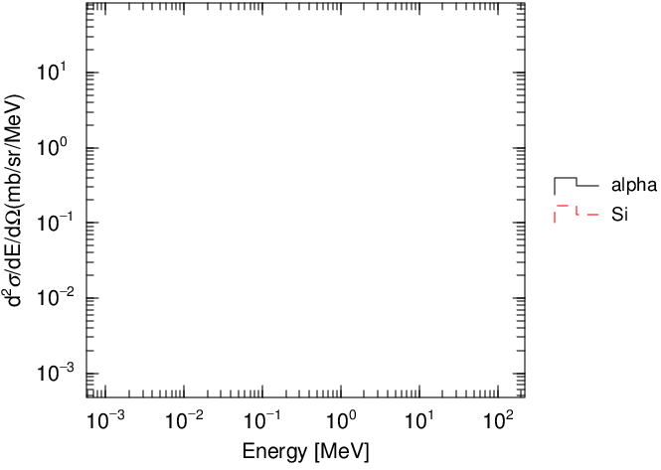
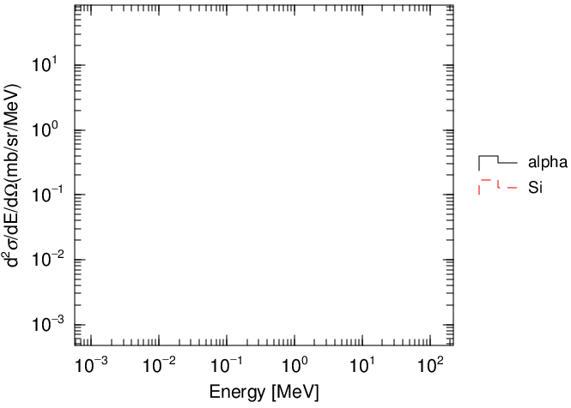
Simulation of particle production measurements with a film.
[t-product]: energy distribution of alpha and Si produced in a target → true cross section
[t-cross]：energy distribution of alpha and Si in a detector → measured cross section
Without forced collision: protons do not collide with a film.
force.inp
Let’s execute force.inp
maxcas = 5000
maxbch = 5
Radius 0.5cm, 10μm thick Si
product.eps
100MeV proton
void
detector
cross.eps

Slide 21
Forced collision
The forced collision is useful for analyzing secondary particles generated from a thin target
Split into two particles
d: distance across cell
Weight of uncollided particle：W_{i}×exp(-Σd)
Incoming weight W_{i}
Uncollided particle
Collided particle
Weight of collided particle：
W_{i}×{1-exp(-Σd)}
Forced collision cell
Σ: macroscopic cross section
Collide position is decided by cross section at random.
Method of forced collision decreases history variance, but calculation time per history increases.
fcl: Forced collision factor (normally, fcl = -1)
fcl = -1: applies only to particles entering the cell (weight cut-off is not applied)
fcl = 1: applies to all particles surviving weight cutoff (weight cut-off is applied)

Slide 22
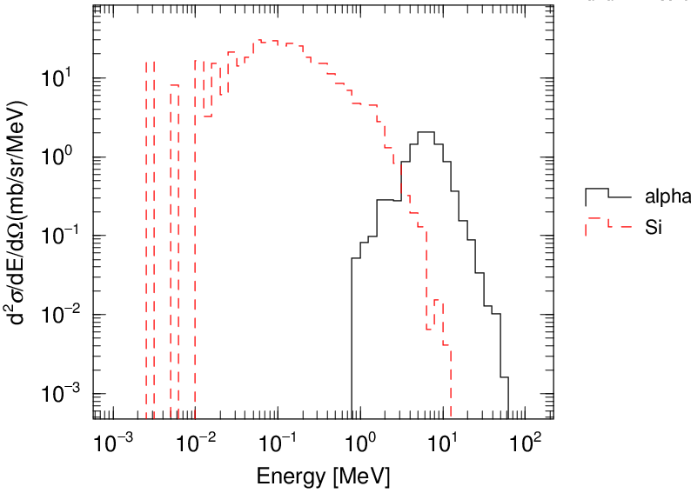
Let’s force particles to collide with a film
force.inp
Tally information in a film at particle production
forced collision
[Forced Collisions] off
part = proton
reg fcl
1 -1.0
Delete off and execute it
product.eps
Weight of particles produced by forced collision are below weight cutoff, wc2.
⇒ It is hard to transport secondary particles due to Russian Roulette.
track-xz.eps
α
cross.eps

Slide 23
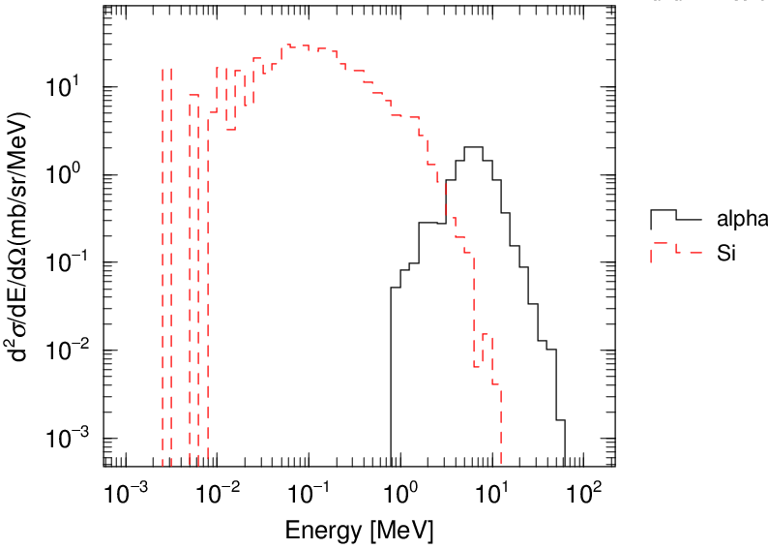
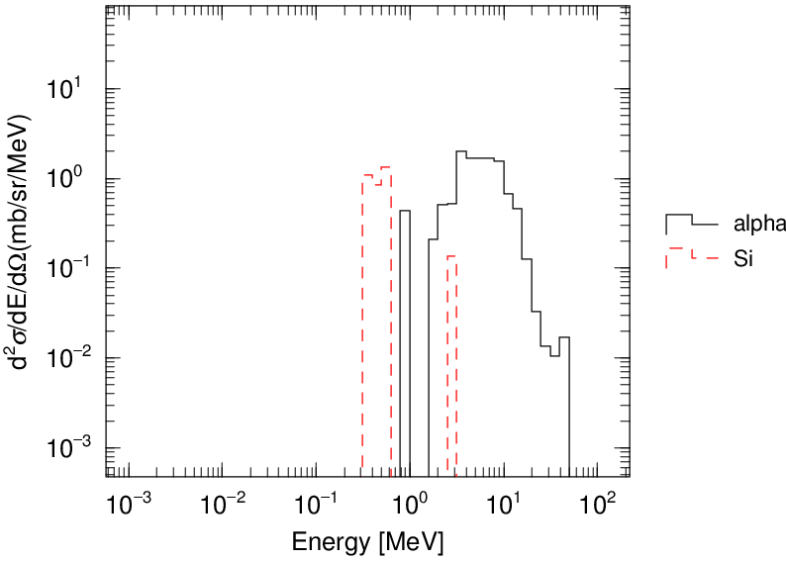
How to transport secondaries produced by forced collision?
To transport secondaries produced by forced collision,
Let’s set a small number on weight cutoff, wc2.
force.inp
[parameters]
……….
wc2(1) = 1.0E-12 # weight cutoff of proton
wc2(18) = 1.0E-12 # weight cutoff of Alpha
wc2(19) = 1.0E-12 # weight cutoff of Nucleus
product.eps
α
Si
cross.eps
track-xz.eps
This experiment can not measure Si production cross sections correctly
because many Si are stopped within a target.

Slide 24
Summary
Cell importance method is effective in deep penetration calculations.
Ratios of importance between neighboring cells are better to be less than 3
→ Appropriate setting of [importance] is very important.
It is better to use Weight Window Generator
for complicated geometry (weight B).
Forced collision method is effective to calculate particle production in a thin target.

