Slide 1
PHITS
Multi-Purpose Particle and Heavy Ion Transport code System
Guidance for hands-on exercise
Environmental radioactivity
Aug. 2018 revised
title
Notes:
PHITS講習会 入門実習

Slide 2
Step 1
Define contamination source of Am-241
Use RI source function
Depth 3cm, Radius: 1m in soil
Calculate effective dose rate (Sv/h)
Use [T-Track] with “multiplier”
Sample of [T-Track] with “multiplier” is available in \phits\recommendation\H10multiplier
To calculate effective dose, set multiplier ID=-203 (ISO irradiation) or -202 (AP irradiation).

Slide 3
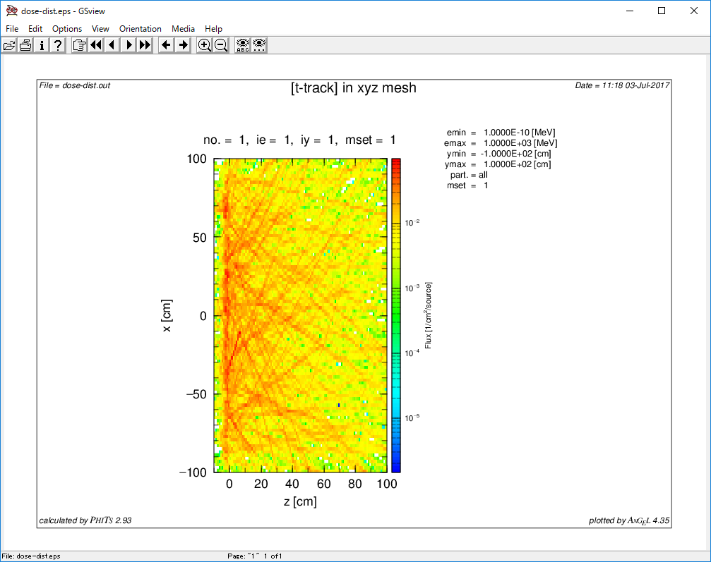
Results of Dose equivalent
Ground

Slide 4
Step 2
Add Cs-137 contamination
Check the plot. How does it change?
Calculate effective dose rate at 1 m above the ground
Dose in a box... x:-10~10, y:-10~10, z: 90~100
Hint: make another t-track with nx, ny, nz = 1
Be careful of statistical error
Increase ncasc if necessary
Challenging task ! (Please try if possible)

Slide 5
Effective dose normalization hints
Necessary for challenging task !
According to the manual [T-Track] section
Output of [T-track] is (particle/cm^2/source)
When RI source is used it is (particle/cm^2/sec)
Coefficient of Multiplier is (pSv*cm^2)
Convert the unit of the result to (μSv/h)

Slide 6
1m of the height
1.1x10^-02 (uSv/h)

Slide 7
Step 3
Change the source radius : 1 m -> 3 m -> 9 m
Keep the contamination density (Bq/cm^3) constant
Check if dose rate reaches constant
Compare dose distribution in 3 cases
Change other source definitions (depth, isotope, activity ratio…)

Slide 8
Result
3 m
9 m
1m of the height
2.0x10^-02 (uSv/h)
1m of the height
1.2x10^-01 (uSv/h)
Large source area is necessary to reach equilibrium

Slide 9
Step 4
Source radius : 3m
Calculate dose when ground is covered with
1cm Soil
1 cm Fe
1 cm Pb

