Slide 1
PHITS
Multi-Purpose Particle and Heavy Ion Transport code System
Guidance for hands-on exercise
Medical linac
Aug. 2018 revised
title
Notes:
PHITS講習会 入門実習

Slide 2
Step 1
Install X-ray generator made of Tungsten
Install X-ray collimator made of Lead
Check the geometry by T-track with axis = xz

Slide 3
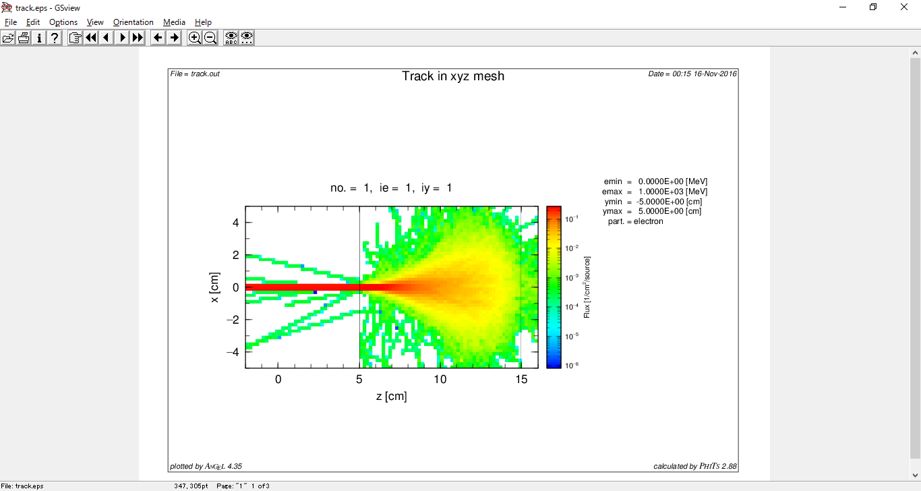
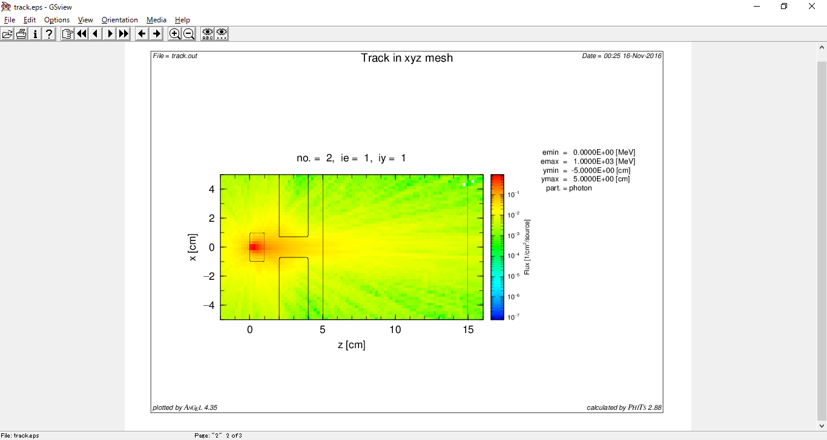
Without (target + collimator)
With (target + collimator)

Slide 4
Step 2
Score 2D distribution of dose
Activate [T-deposit] by deleting “off ”
fill in mesh, x-type …..unit
XYZ covers, target, collimator and phantom
What does it look like?
Think why vacuum is white
i.e, why colors appear only in materials

Slide 5
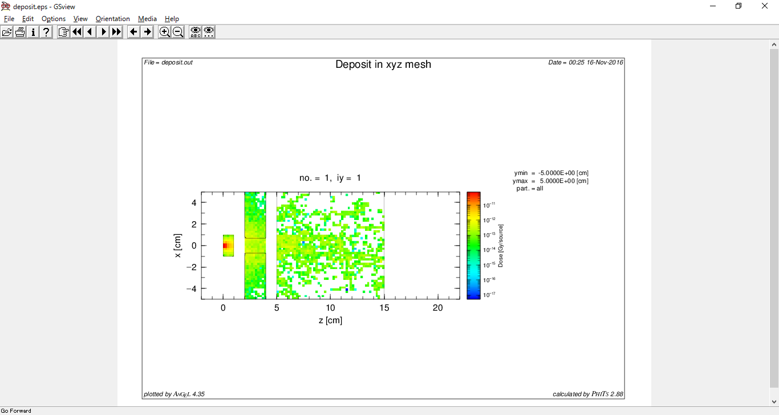
Dose distribution example

Slide 6
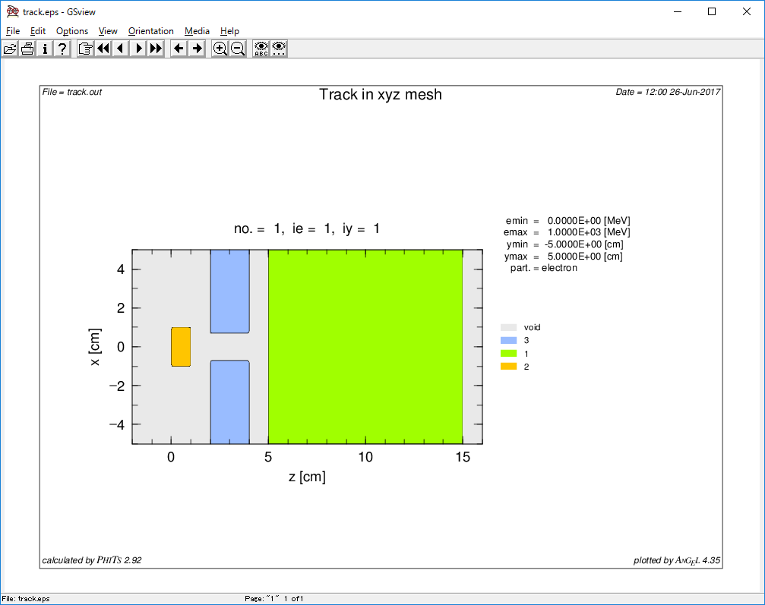
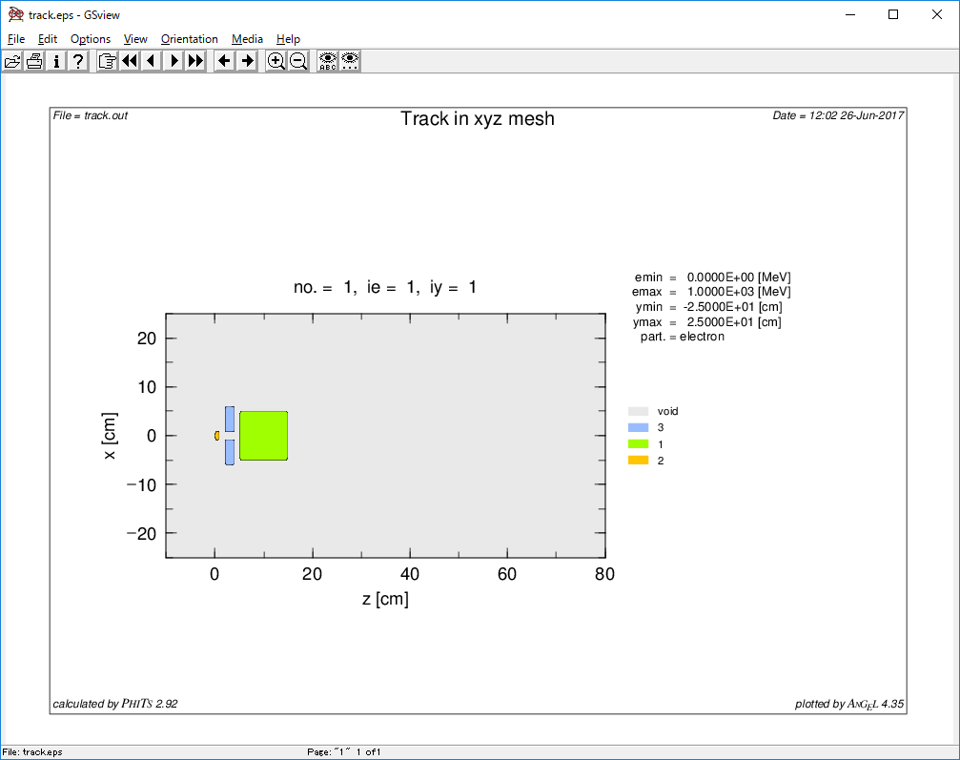
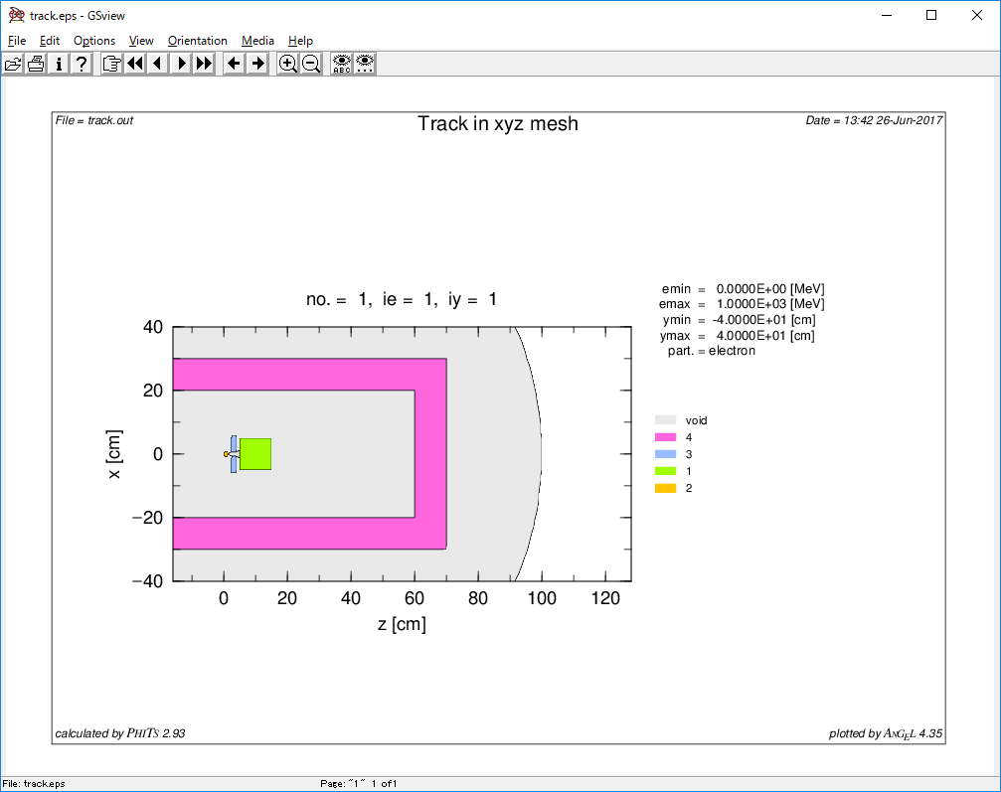
Step 3
Change to g-show mode
Change icntl = 8
See track.eps
Extend the g-show range
Extend 8 times
Install shielding
Thickness 10cm
Concrete (take composition from C:\phits\data\ material.inp)
Inner dimension
X: -20 ~ +20, Y: -20 ~ +20, Z: -20 ~ +60

Slide 7
Step 4
Measure dose
maxcas = 300 (save CPU time)
Measure dose in the concrete shielding
[T-Track] + Effective dose
Define [T-track] in the backward concrete shielding
Define effective dose multiplier (set multiplier ID=-202 [AP irradiation])
Hint is in C:\phits\recommendation\H10multiplier\H10multiplier.inp
Dose distribution in whole geometry and depth profile

Slide 8
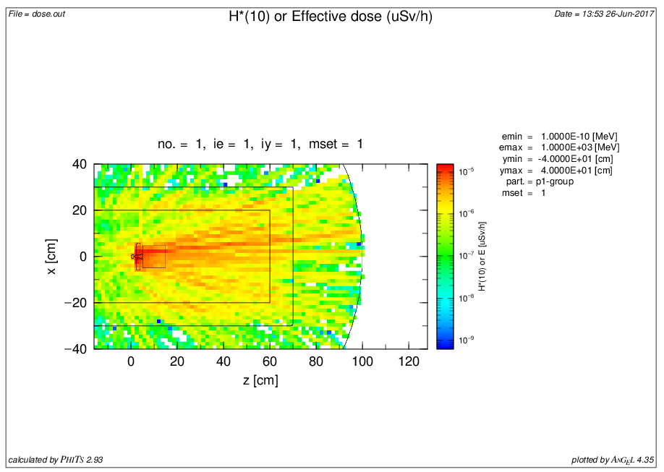
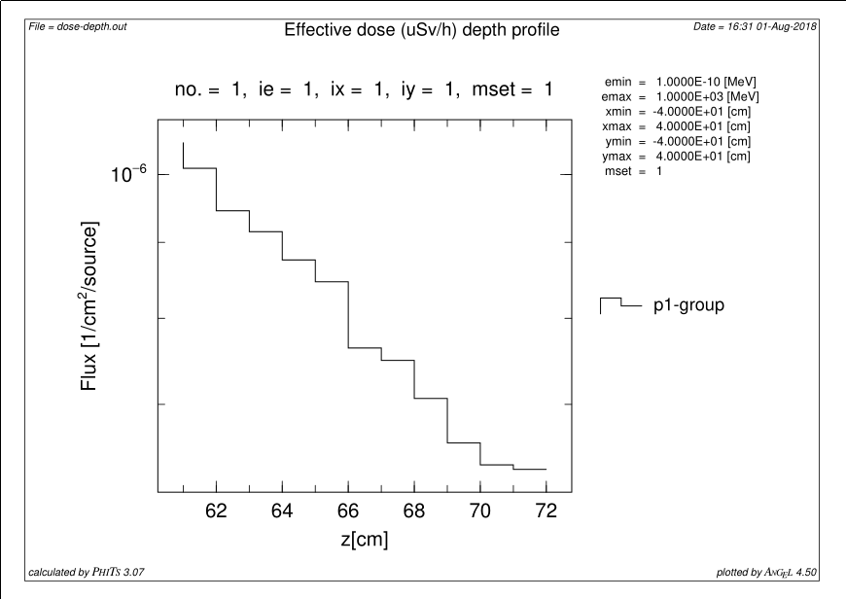

Slide 9
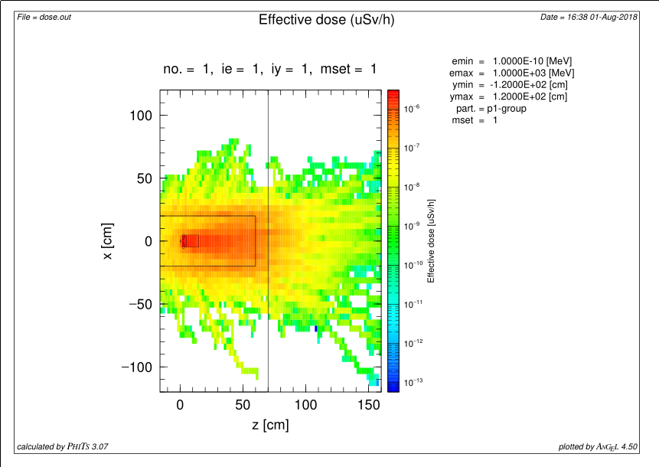
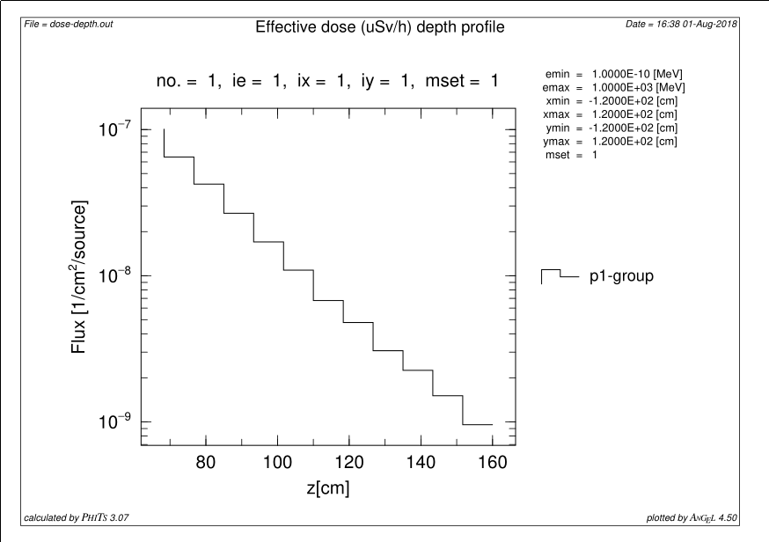
Step 5
Measure dose beyond 100 cm concrete
Increase concrete thickness
Be careful of outer vacuum “999 so 100.0”
Introduce importance or weight-window

Slide 10
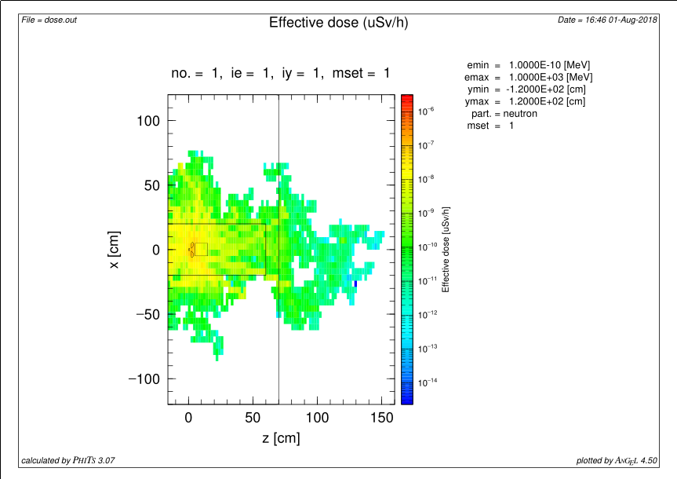
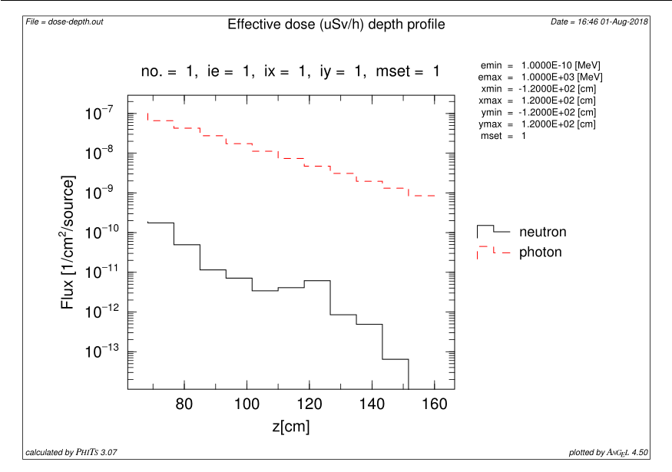
Step 6
Measure neutron dose
Turn on photo-nuclear reaction
Introduce photo-nuclear reaction bias
pnimul, importance, istdev = -2 or -1

