Slide 1

Basic Knowledge of Radiation
Physics Behind PHITS Simulation

Slide 2
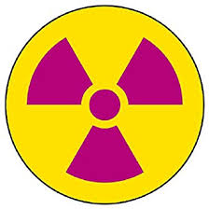
Radiation & Radioactivity
What’s Radiation?
A particle or electromagnetic wave that can cause atomic and/or nuclear interactions*
Example: neutron, proton, α-ray, β-ray, γ-ray
Fundamental Unit: Electron volt (eV) = 1.602 x 10⁻¹⁹ (J)
*to be explained later
What’s Radioactivity & Radioactive Material?
Ability to generate radiation due to decay of nucleus
Example: Spent nuclear fuel
Plume containing ¹³⁷Cs emitted by nuclear accident
Checking source of ⁶⁰Co
Fundamental Unit: Becquerel (Bq) = 1 (decay / second)

Slide 3

Radiation & Radioactivity
fire sparks and firework is a good analogy of radiation and radioactivity
time
Radioactivity (Bq) decreases as time goes by,
but energy of each radiation (eV) does not change

Slide 4
Interaction between Radiation & Matter
Atomic Interaction
Radiation knocks out an orbital electron from an atom (ionization)
Radiation excites an atom (excitation)
Atomic interaction is induced via electromagnetic force
Probability to cause interaction (cross section) is very high (~10⁸ / cm)*
Fundamental mechanism to cause influence on life form & material
Nuclear Interaction
Radiation breaks a nucleus and create new nucleus & radiation
Nuclear fission and fusion are a kind of nuclear interactions
Nuclear interaction is induced via strong force
Probability to cause nuclear interaction is very low (~0.1 / cm)*
Fundamental mechanism to generate energy by nuclear power plant
*macroscopic cross section of high-energy proton in water

Slide 5
Kind of Radiation
Characteristics of major radiations
Type | Charge (e) | Mass (MeV) | Atomic Interaction | Nuclear Interaction
Photon (γ-ray, X-ray) | 0 | 0 | Very low^{*1} | Low
Electron (β-ray) | -1 | 0.511 | Low | Very low^{*2}
Muon | ±1 | 105.7 | Low | Very low^{*2}
Proton | 1 | 938.3 | Middle | Middle
Neutron | 0 | 939.6 | No^{*3} | High^{*4}
He ion (α-ray) | 2 | 3733 | High | Middle
Heavy ion | > 2 | Heavy^{*5} | Very high | High
*1) Cause photo-electric, Compton scattering, and pair production
*2) Cause nuclear reaction via virtual photon production
*3) Secondary particles produced by nuclear reaction can cause atomic interaction
*4) Low energy neutron has higher cross section due to resonance with nuclear structure
*5) Roughly proportional to mass number

Slide 6
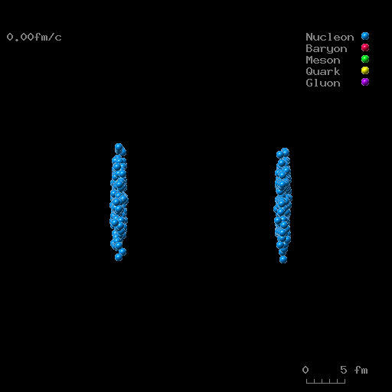
Energy Dependence
Characteristics of radiation (ability to cause atomic and nuclear interactions) depend on radiation energy. In general…
High energy particles have lower ability to cause atomic interactions
→ Shorter time for interactions
High energy particles can cause “significant” nuclear interactions
→ break nucleus into many fragments
Electronic stopping power
(keV/μm)
Energy (MeV)
Example of high-energy nuclear reaction （Au+Au 200GeV/n in CM)
Atomic energy loss of proton in water

Slide 7
Radiation Effect
Effect to life form (animal, plant, cell etc.)
Negative aspect: DNA damage, carcinogenesis, death
Positive aspect: Radiotherapy, sterilization, trigger of evolution
Effect to material (metal, semi-conductor, polymer etc.)
Negative aspect: deterioration, semi-conductor error
Positive aspect: Graft polymerization for creating new materials
Index for estimating the significance of radiation effect
Primary index: Absorbed dose = Deposition energy / mass
Fundamental unit: Gray (Gy) = (J/kg)
Used for both life-form and material effects
Additional index: Effective dose = Absorbed dose x weighting factor
Fundamental unit: Sievert (Sv)
Biological significance
depending on
Radiation type & energy
Used only for radiological protection purpose

Slide 8
Radiation Transport Simulation
Deterministic Method
Mathematically solve the Boltzmann equation for incoming, outgoing, produced and annihilated radiations for a discretized time & volume
Advantage: Short computational time
Disadvantage: Inaccurate in the case of complicated geometry
Monte Carlo Method
Reproduce the motion of each radiation in computer using random number, and iterate the simulation for many radiations to estimate their average behavior
Advantage: Accurate even in the case of complicated geometry
Disadvantage: Long computational time to obtain precise results
Recent progress of computer technology allows the accurate Monte Carlo simulation even using conventional PC
PHITS is one of the most widely-used Monte Carlo code!

Slide 9
Summary
Radiation interacts with matter by inducing atomic and nuclear interactions via electromagnetic and strong forces, respectively.
Characteristics (e.g. cross section) of radiation significantly depend on its type and energy
PHITS is a Monte Carlo code that can treat nearly all interactions induced by any types of radiation in any material
Don’t be afraid of Monte Carlo simulation too much. PHITS can guide you to the world of radiation physics

